Slide 1
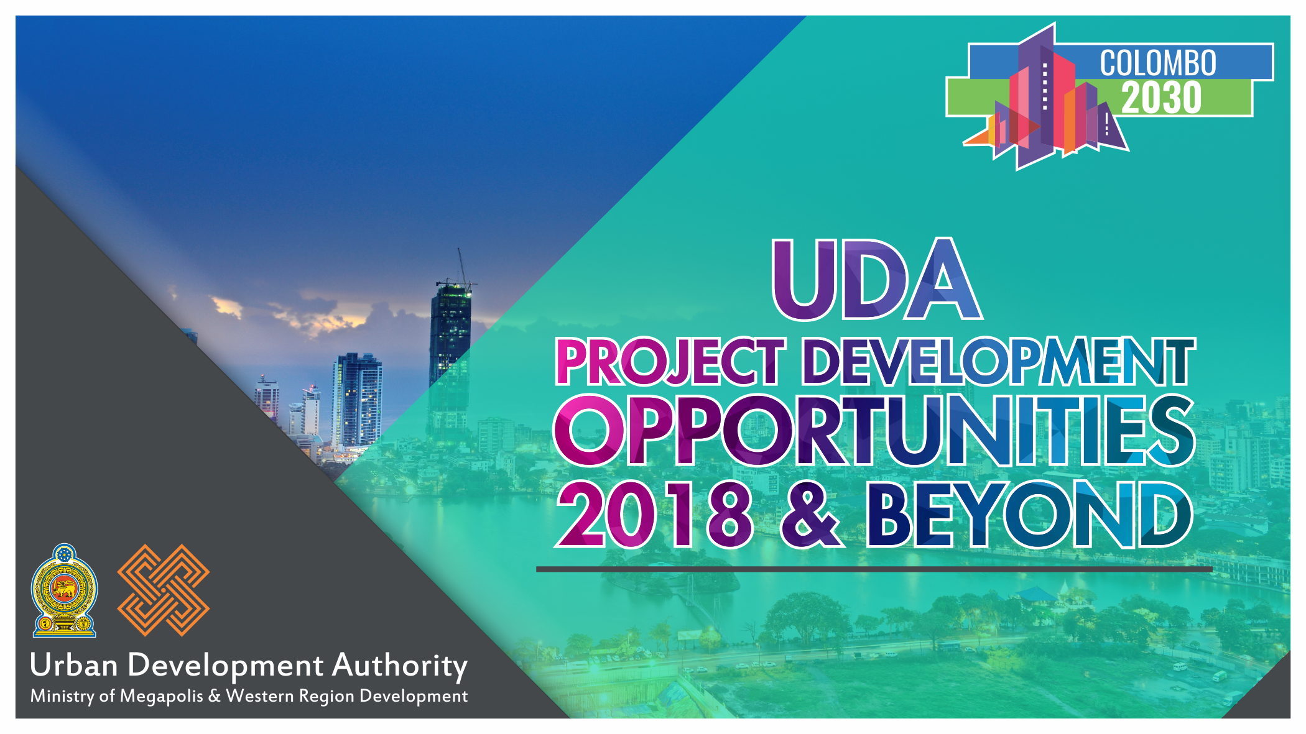

Slide 2
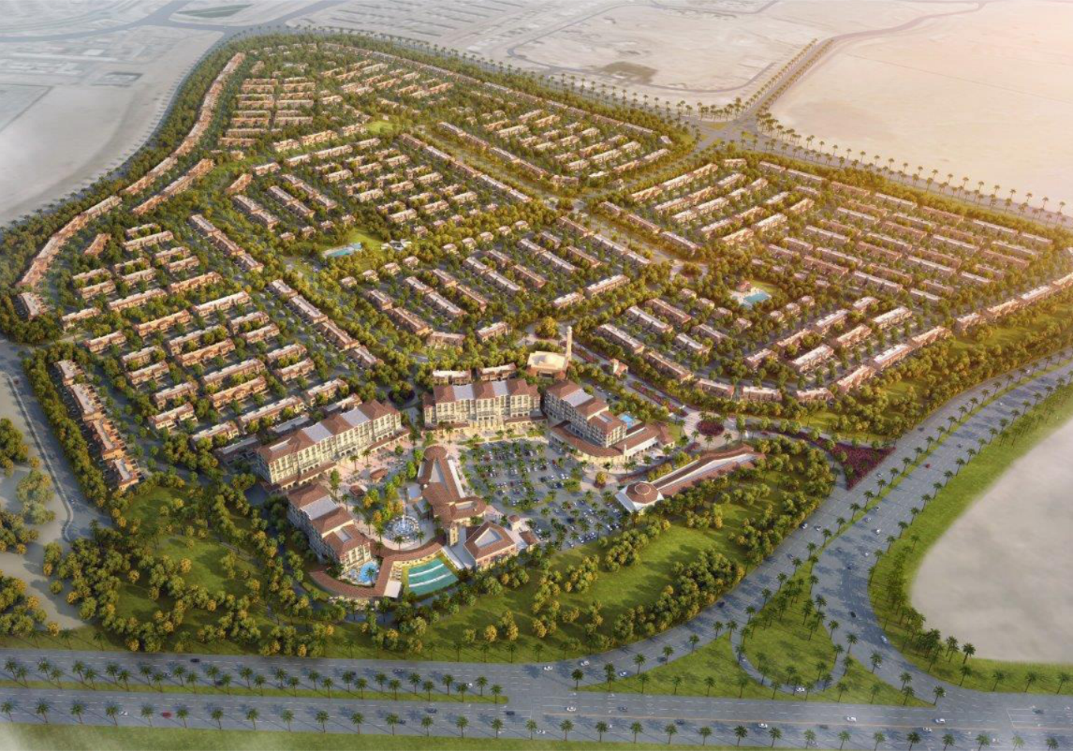
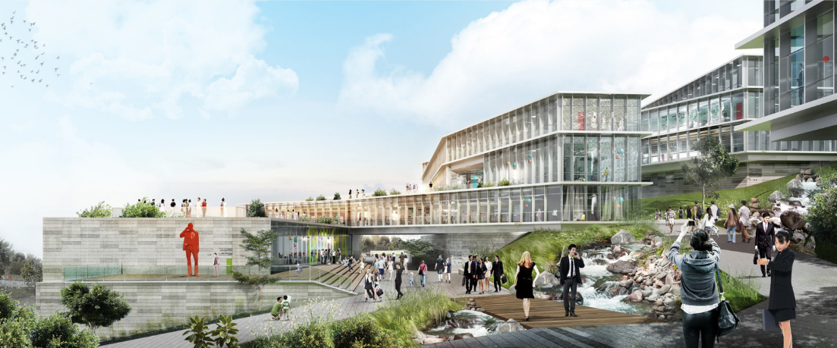
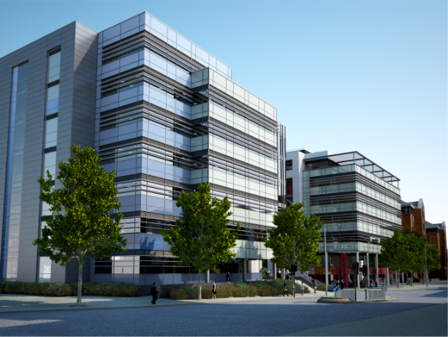
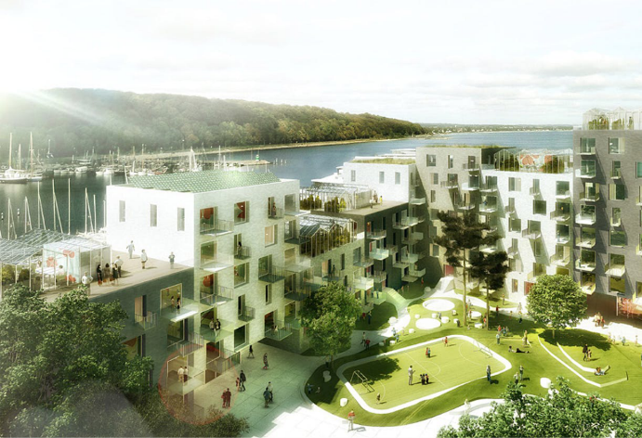
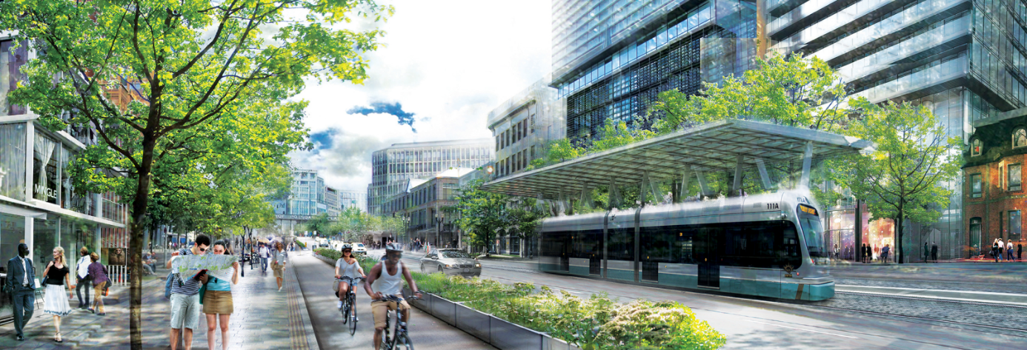
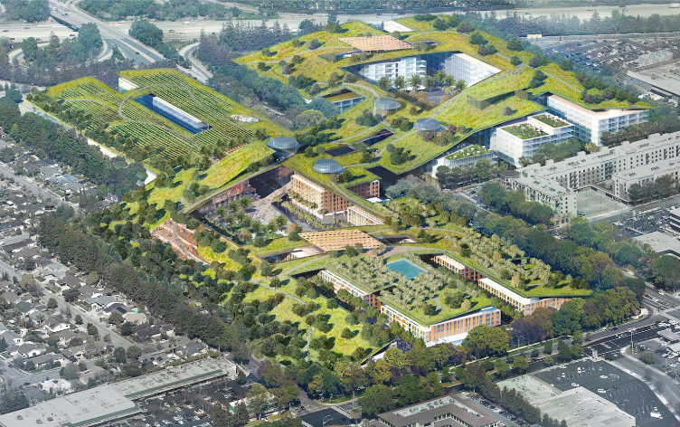
LANDS

Slide 3
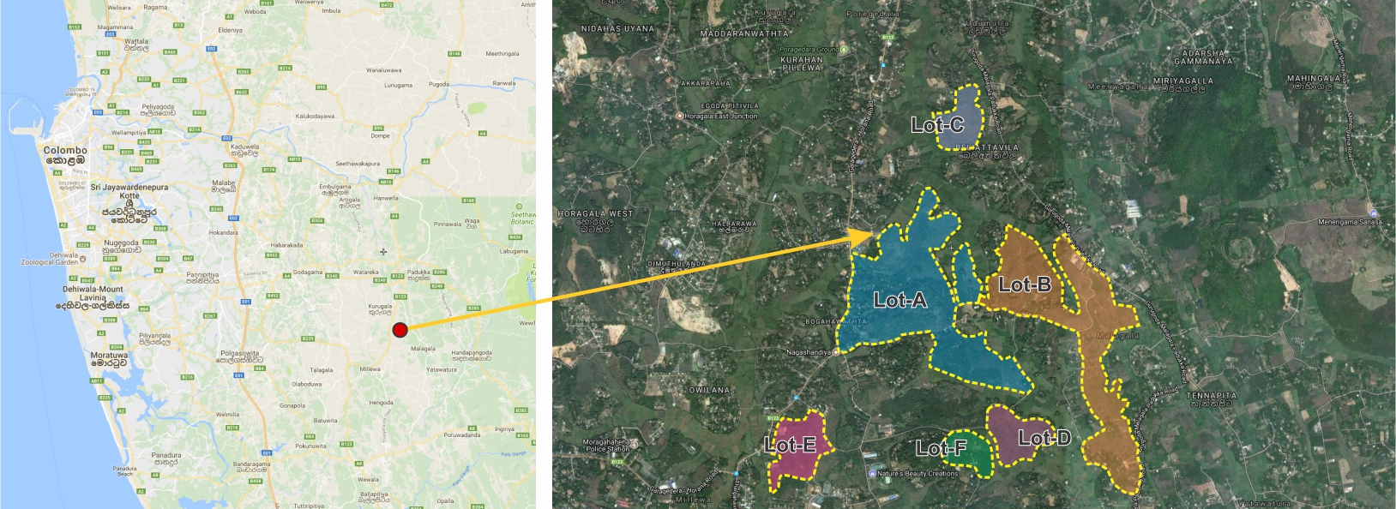

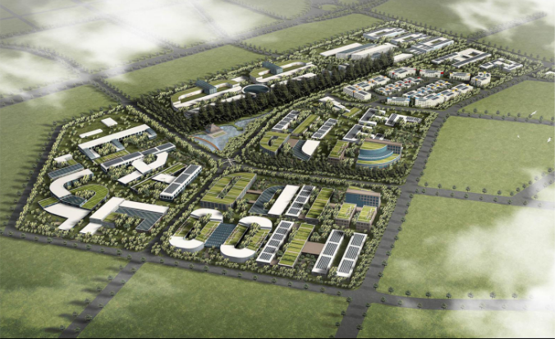
Millawa Industrial Cluster Development - Kaluthara
01
Location
6.8021602N 80.0934474E
Land Extent :- 735 Acres
Est. Value:- Rs. 11 Billion (69.5 USD Mn)
Project introduction
Located in Western Province in Sri Lanka - Kalutara & Colombo Districts
Consisting 2 DS Divisions - Horana & Padukka
with 6 GN Divisions - Beliaththavila, Gorokgoda, Kidelpitiya, Pahala Millewa north,Pahala Millewa South, Malagala
Location linkages
The land is located in Horana
42 km (26 mi) from Colombo
18 km (11 mi) from Panadura
Proposed Development
Industrial Township Development with integrated activities by harnessing the available potentials within the region and capitalizes on key economic drivers of the region for massive investment
The project aims to accommodate the large numbers of large scale industries which was scattered in the Western Region without proper planning
The site in Horana was selected due to land availability and its good connectivity via the north south highway and in line with other development cities according to megapolis master plan

Slide 4
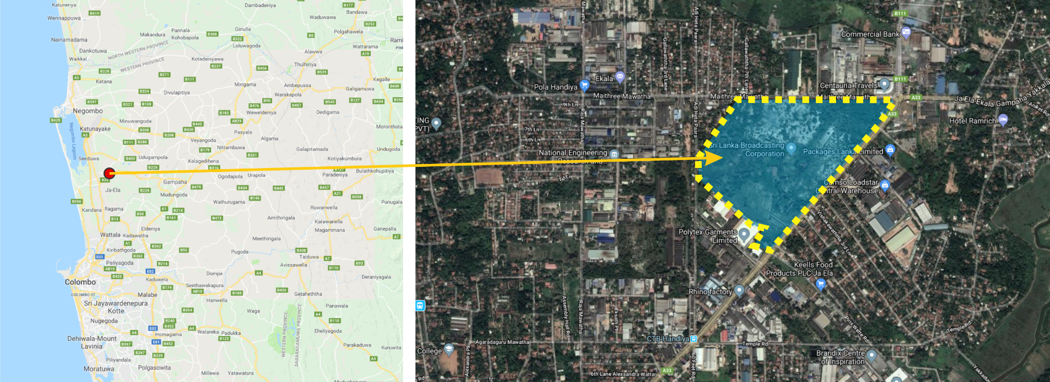

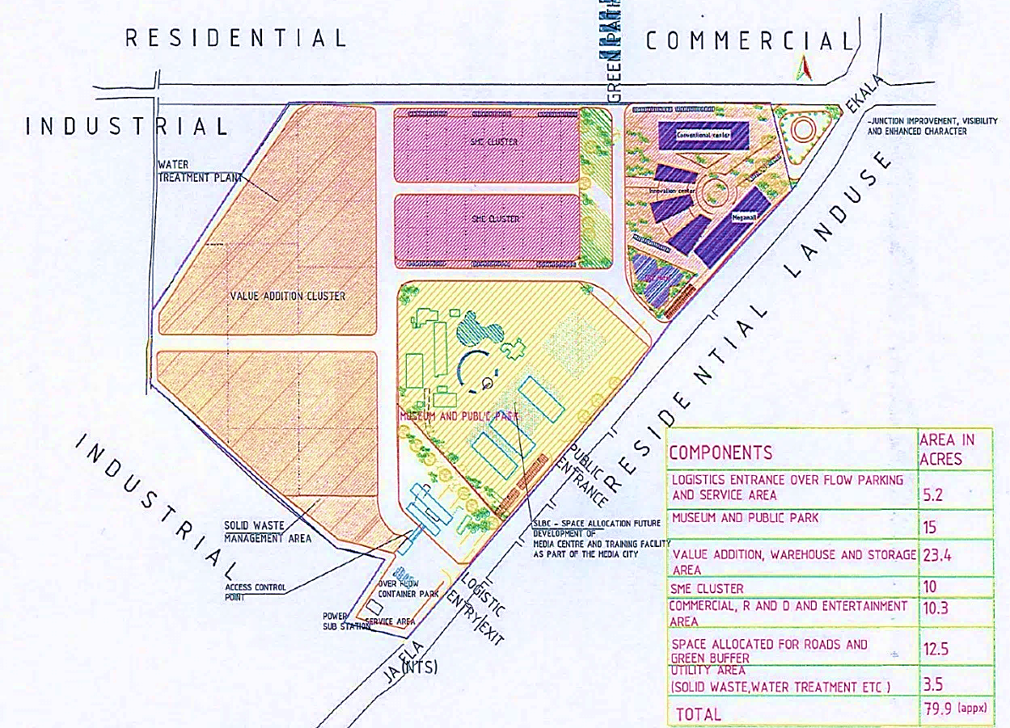
Ekala (SLBC) Land
02
Location
7.099472N
79.907222E
Land Extent :- 80 Acres
Est. Value:- Rs. 10 Billion (70 USD Mn)
Objectives
To develop and strengthen the specific cluster for air cargo supply, value addition industries, storage, warehouse facilities, collection & local level distribution of cargo.
To promote local entrepreneurs away from mere-trade and commerce towards production and industry based with special focus on high value addition, innovative and usage of modern appropriate technologies.
Encouraging creation and growth of new businesses by fostering collaboration and innovation, along with enhancing the development, transfer, and commercialization of technology.
To develop and demarcate areas for ancillary facilities, residential, commercial and recreational development
Proposed Development
Logistics & Business Park
Value addition Cluster
Small and Medium Entrepreneurs Cluster (SME)
Commercial & Entertainment Cluster
Radio Ceylon Museum Park & Infrastructure Development

Slide 5
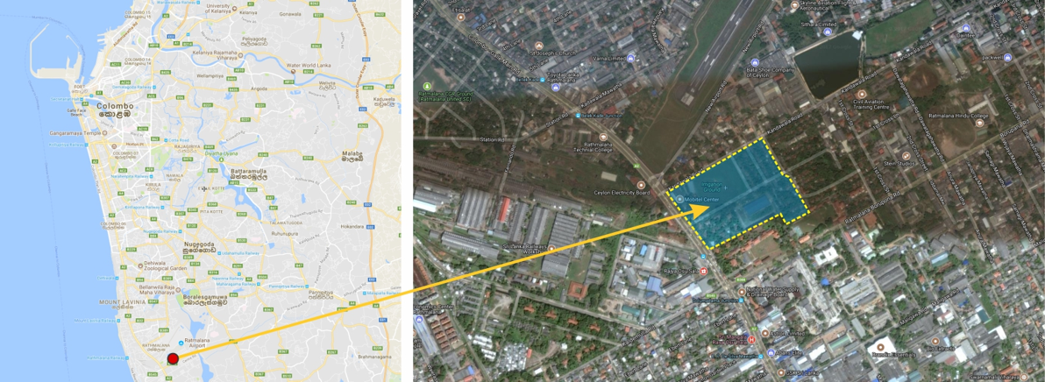


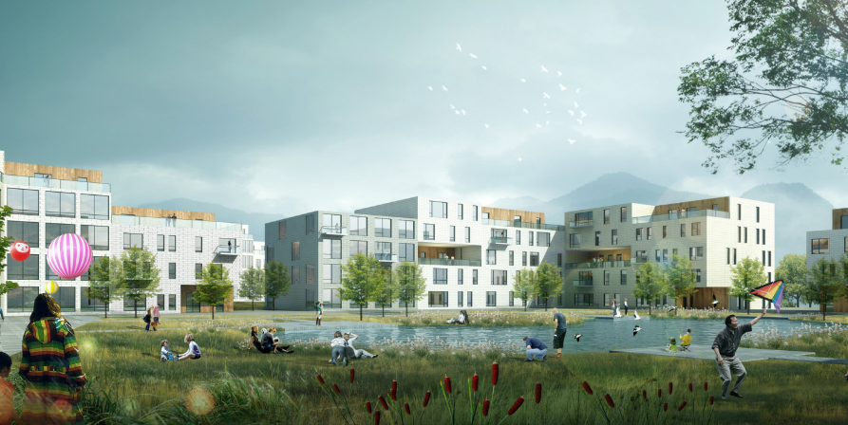
Irrigation Land, Rathmalana - Colombo
03
Location
6.8125535N
79.8833452E
Land Extent :- 28A. 2R. 4P.
Project introduction
Close proximity to Rathmalana Air Port
Main Access from Colombo - Galle Road (A2)
1.8km for Beach
Proposed Development
Suitable for Housing with Mixed Development

Slide 6
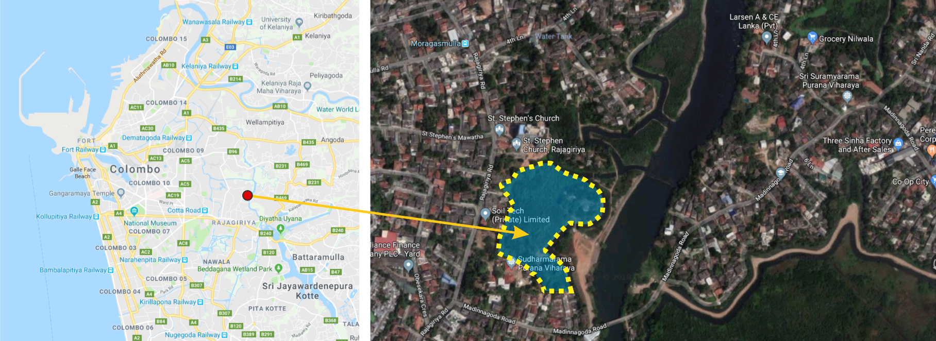

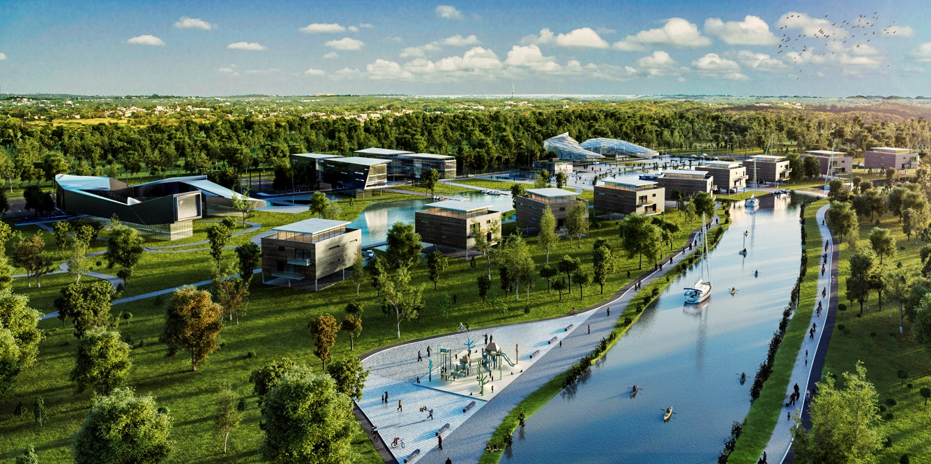
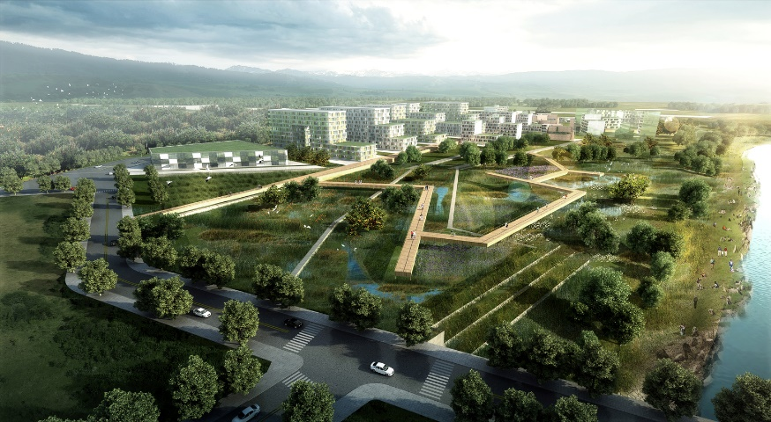
Madinnagoda Land (Araliya Land)
04
Location
6.918139N
79.898583E
Land Extent :- 10Acres
Est. Value:- Rs. 300 Million (1.90 USD Mn)
Project introduction
Close proximity to Rajagiriya area
Locate near to the Heen Canal
High demand for the Residential & Commercial activities
Proposed Development
Mixed Development Project

Slide 7
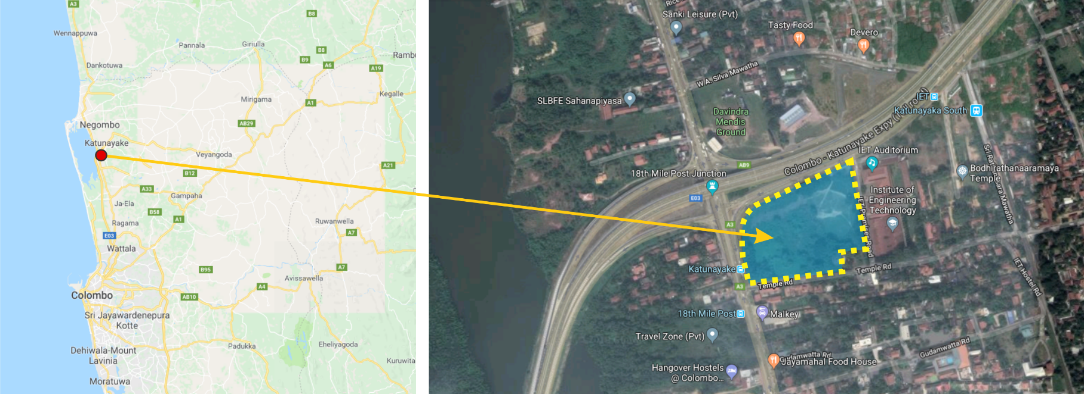

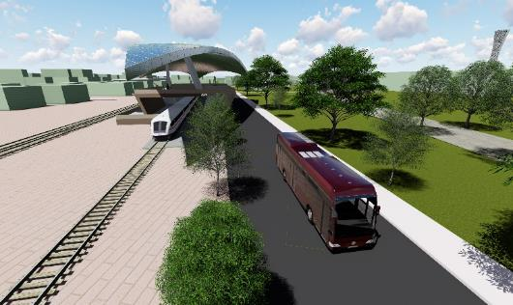
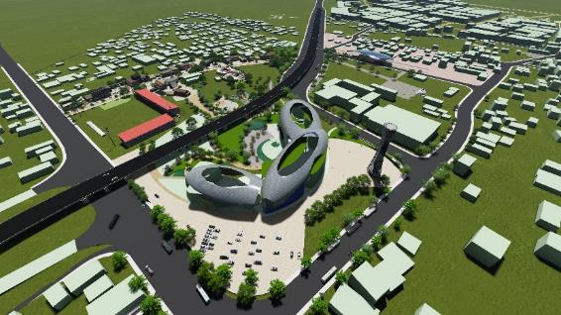
18th Mile Post
05
Location
7.156167N
79.872694E
Land Extent :- 05Acres
Est. Value:- Rs. 300 Million (1.90 USD Mn)
Strategic framework
Facilitate the activities of Bandaranaike International Airport (BIA)
Facilitate Inter and Intra Regional Movement
Improve the Socio Economic Condition of the Community in the area
Options analyzed by
Traffic & Transportation aspects
Environmental and Aesthetic aspects
Socio - Economic aspects
Technical aspects
Outcome
Multi modal Transport Terminal (Inter Provincial Bus, Taxi, Railway Station, Park & Ride)
Destination Mall (Shopping Plaza, Supermarket, Open Market, Banking Services)
Public Recreation Park (Waterfront Development, Pedestrian Underpass, Restaurants, Play Area)

Slide 8
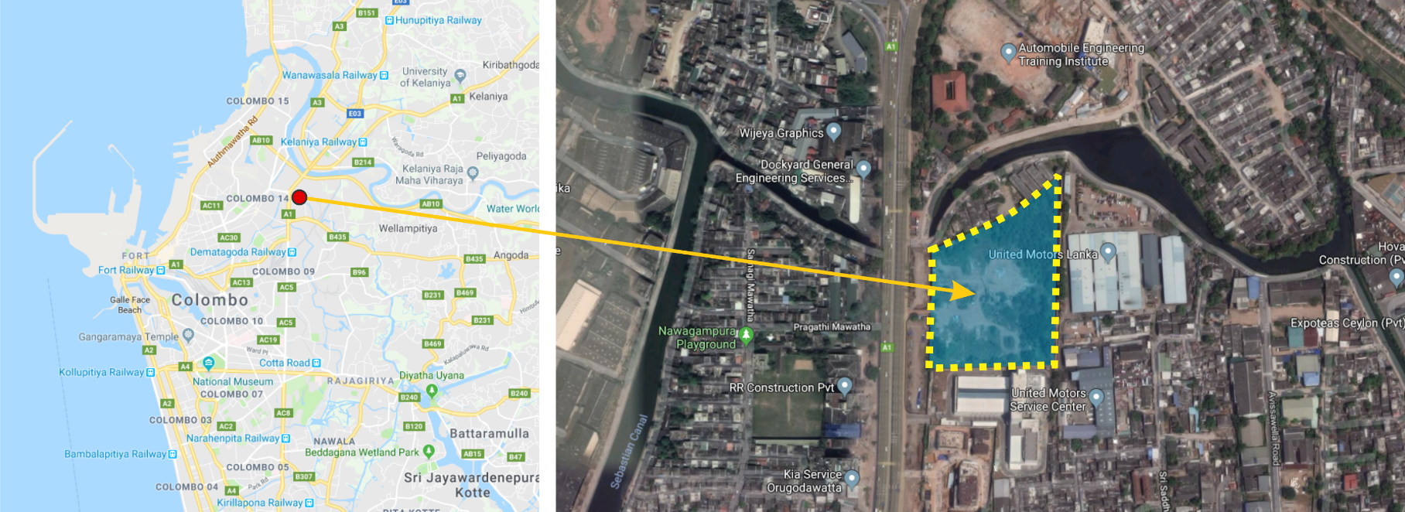

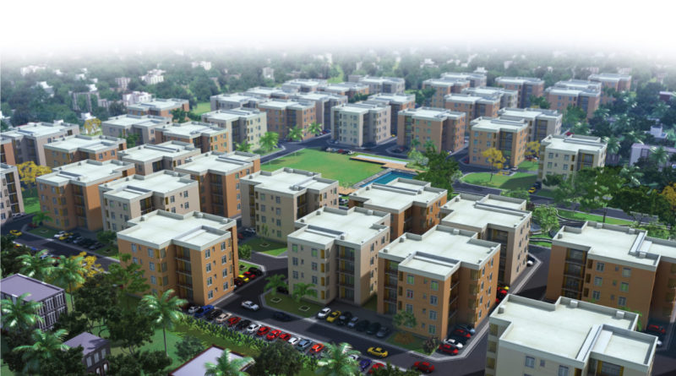
Timber Corporation Land
06
Location
6.947524N
79.879456E
Land Extent :- 05Acres
Location
Locate in the Northern part of the City of Colombo
Main Access from Colombo - Kandy Road (A1)
Close proximity to the Katunayake Expressway
Present Situation
Old Investor terminated cause of Inactivation
Piling for 2 tower buildings are done
Proposed Development
Middle Income & High-end Residential Project

Slide 9
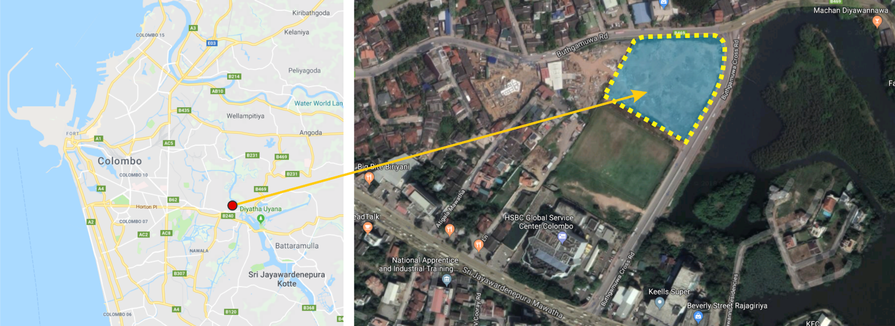

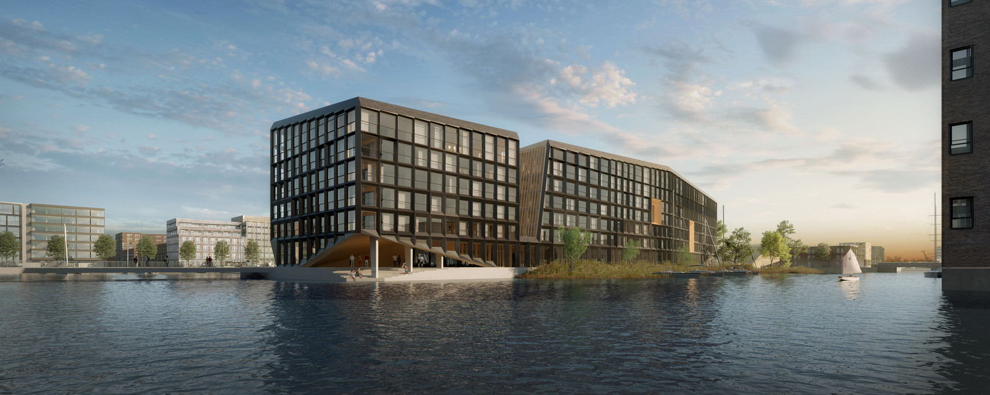
Land at Buthgamuwa Road
07
Location
6.909417N
79.902333E
Land Extent :- 2A. 3R. 0P.
Location
Site Locate in Rajagiriya Area
Close Proximity to Diyatha Uyana Public Park,
Proposed Development
Mixed Development

Slide 10
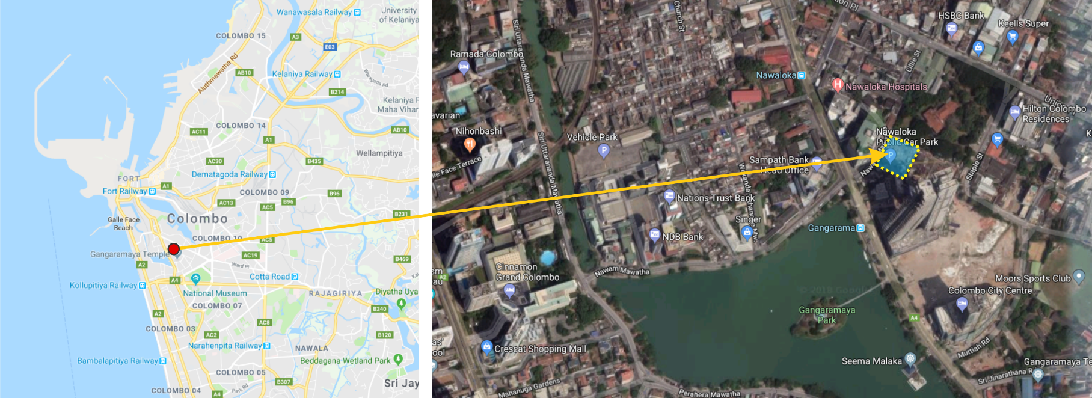

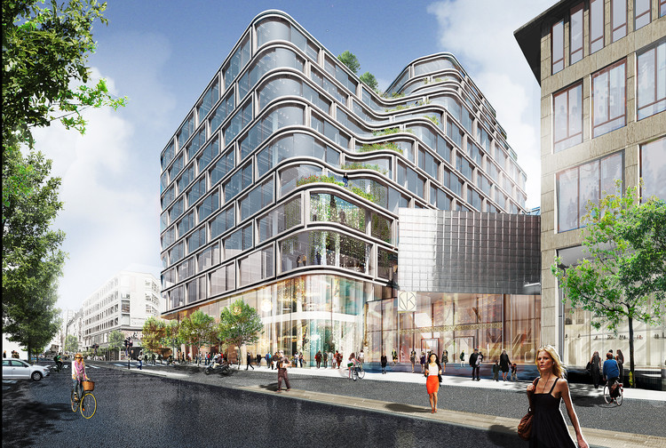
Superlative (CCC) Land
08
Location
6.920139N
79.854361E
Land Extent :- 0A. 3R. 1P.
Location
Site located in the Heart of the Colombo City
Highly demand area
Altair tower, Gangarama Temple, Nawaloka Hospital Near by
Proposed Development
Mixed Development

Slide 11
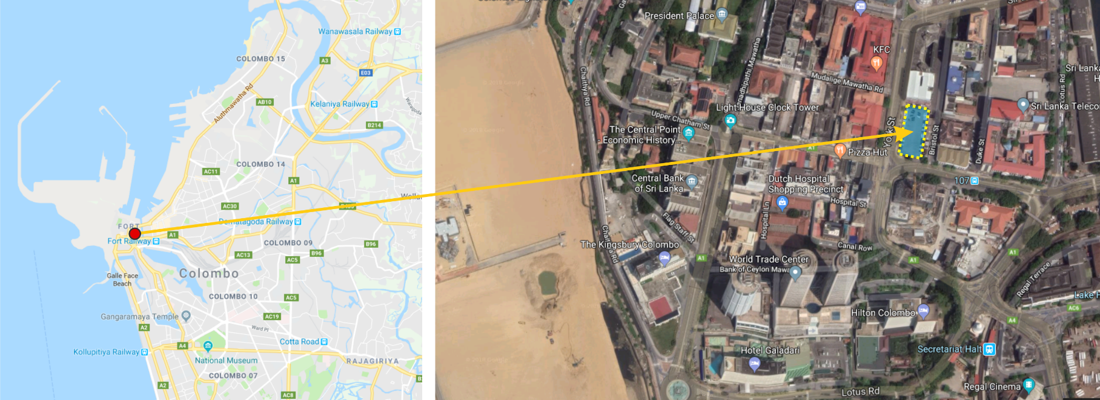

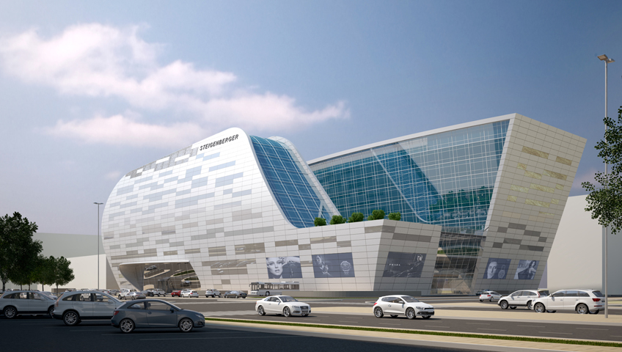
Chatham Street
09
Location
6.934639N
79.845139E
Land Extent :- 0A. 2R. 14.72P.
Location
Site Locate in the Middle of the Colombo Commercial area
Close Proximity to Colombo Fort, World Trade Center, Dutch Hospital Commercial Complex, Kirshh Squre
So close to Port City - Colombo
Proposed Development
Mixed Development

Slide 12
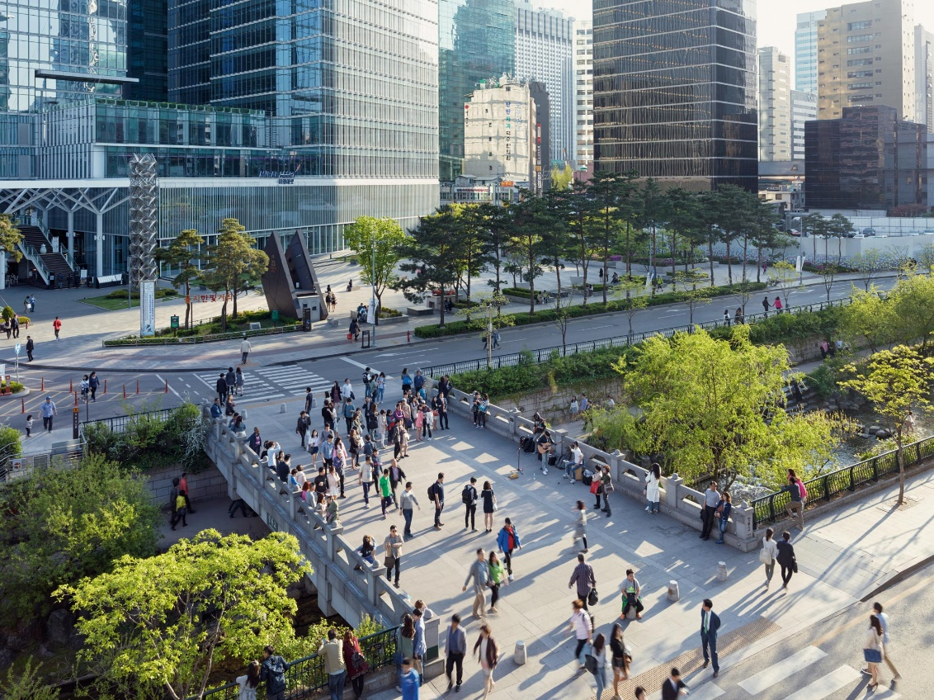
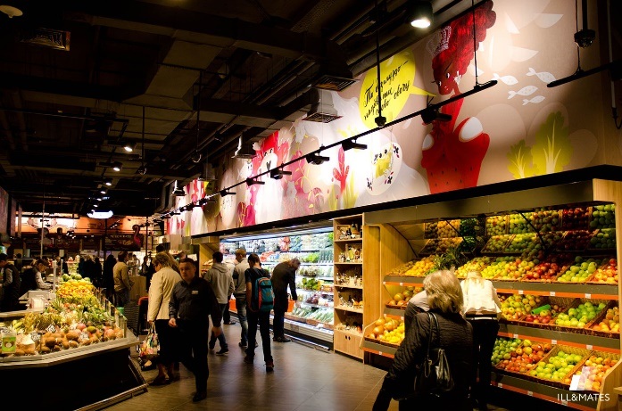
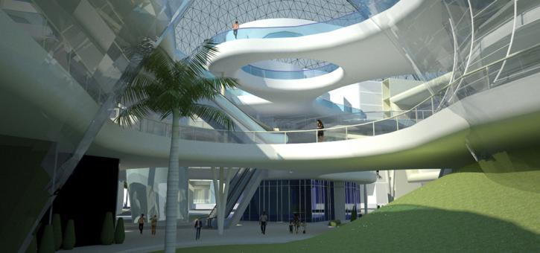
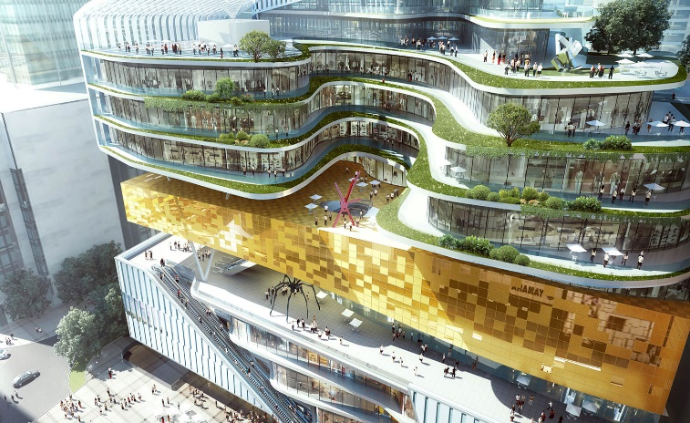
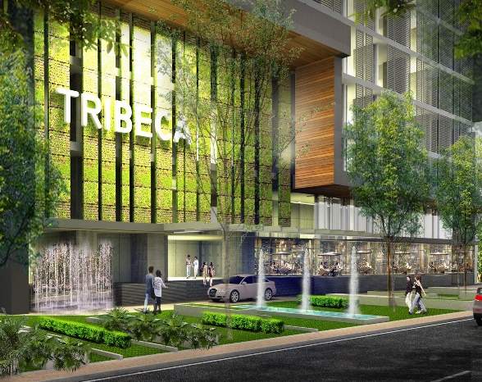
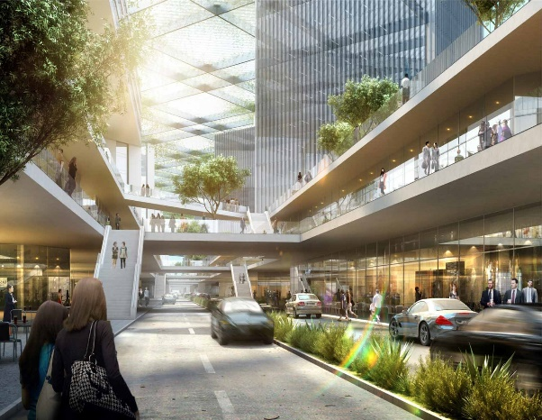
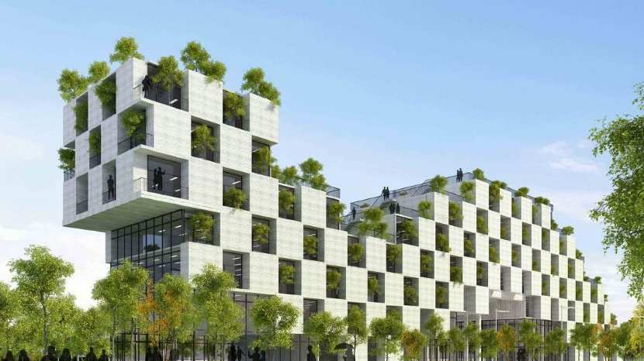
PROJECTS

Slide 13
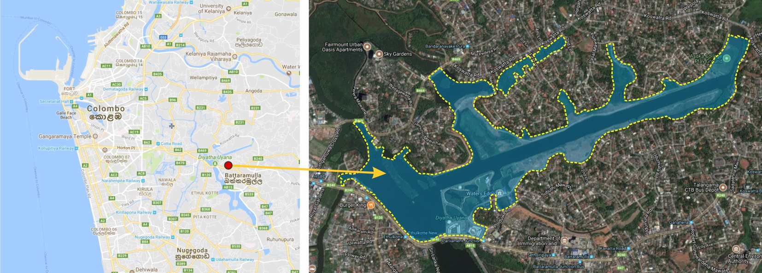

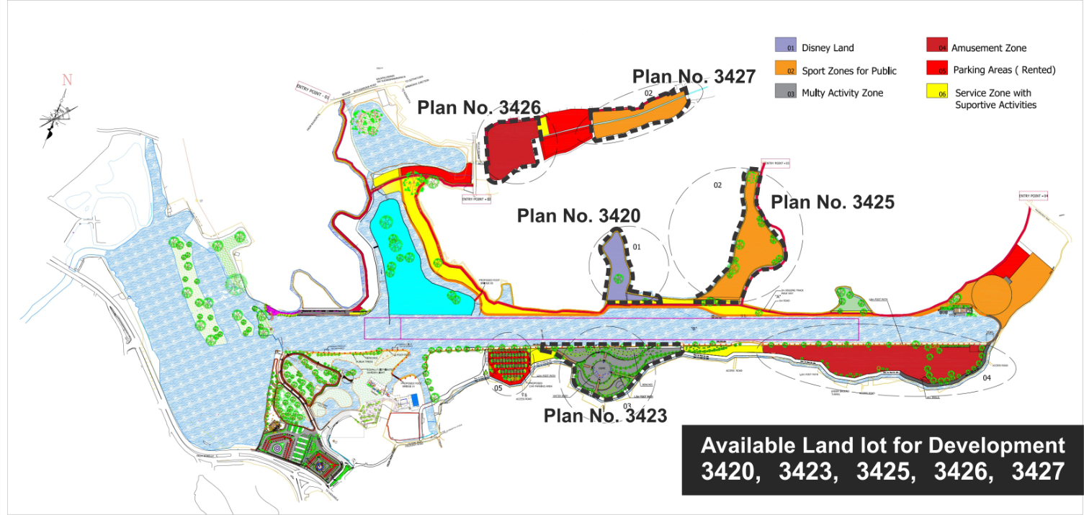
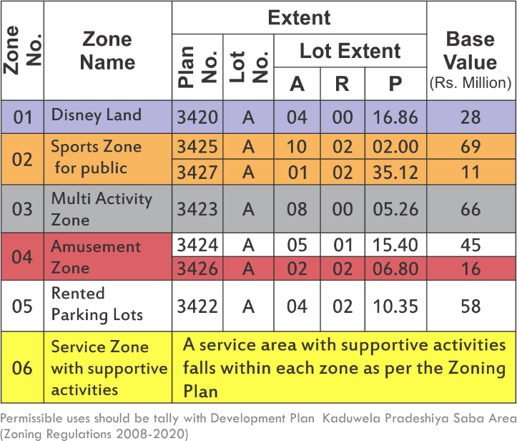
Waters’ Edge Greenway Trail, Diyatha Uyana- Colombo
10
Location
6.9093153N
79.9123393E
Land Extent :- 25 Acres
Location & Surrounding
Located in a prime location in Battaramulla area.
Next to the Diyatha Uyana Park & Waters’ Edge Hotel
Proposed Development
Proposed Development based on the Zoning Plan show in the Chart

Slide 14
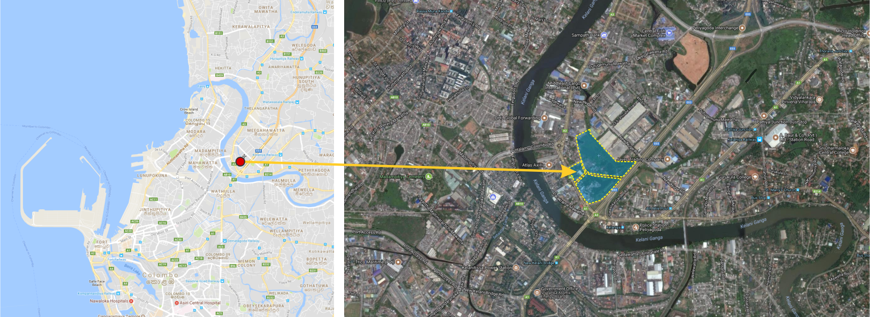

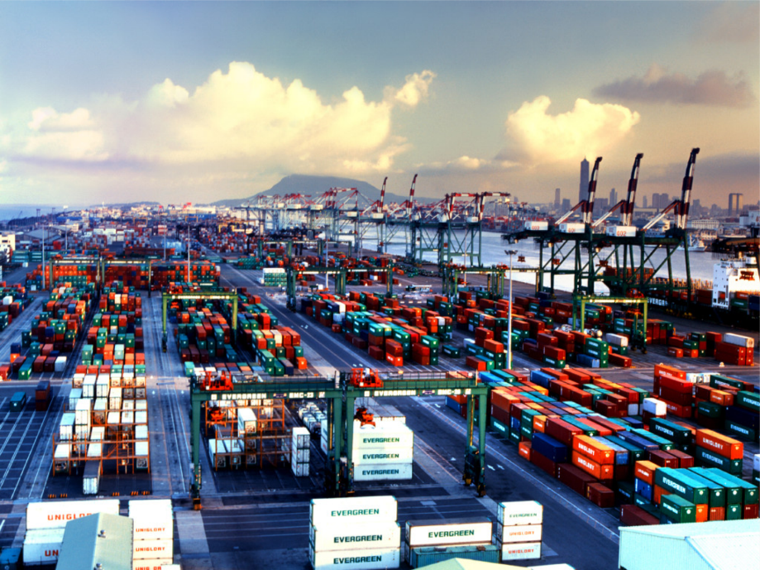
Paliyagoda Land - Colombo
11
Location
6.959586N
79.8835652E
Land Extent :- 21 Acres
Location & Surrounding
Situated in Northern part of the CMC area which is most developing in the city of Colombo.
Close to the Peliyagoda Interchange (Katunayake Expressway)
Proposed Development
Port, Logistic related Activities

Slide 15
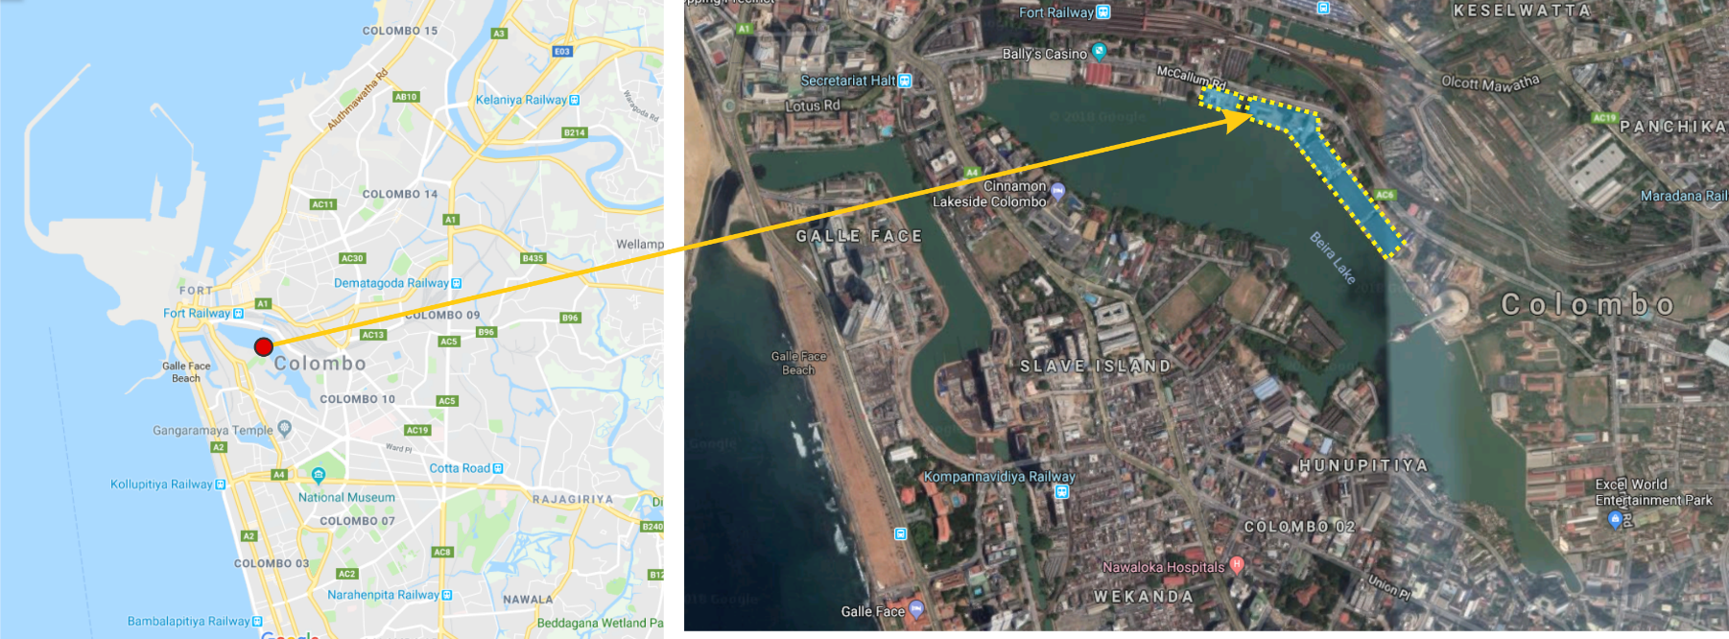

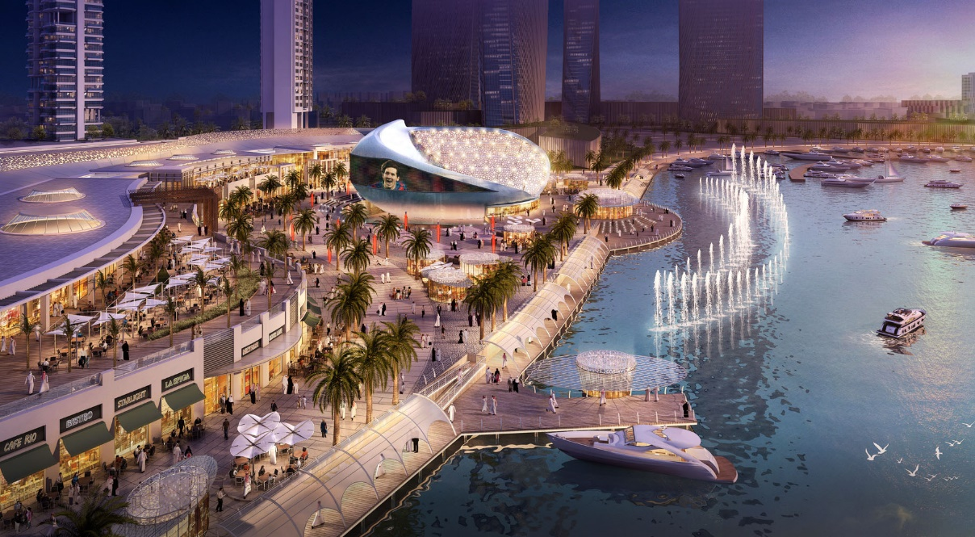
Beira Lake
12
Location
6.929575N
79.854094E
Land Extent :- 13 Acres
Location & Surrounding
Situated in Middle part of the CMC area which is most commercialized area an the City.
Close proximity to “Nelum Kuluna” Tower, Colombo Railway Station, Colombo Bus Stand & Gall-face Beach.
Proposed Development
Mixed & Commercial Development

Slide 16
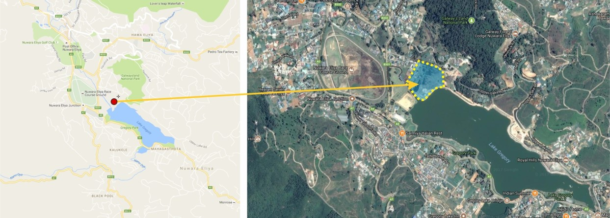

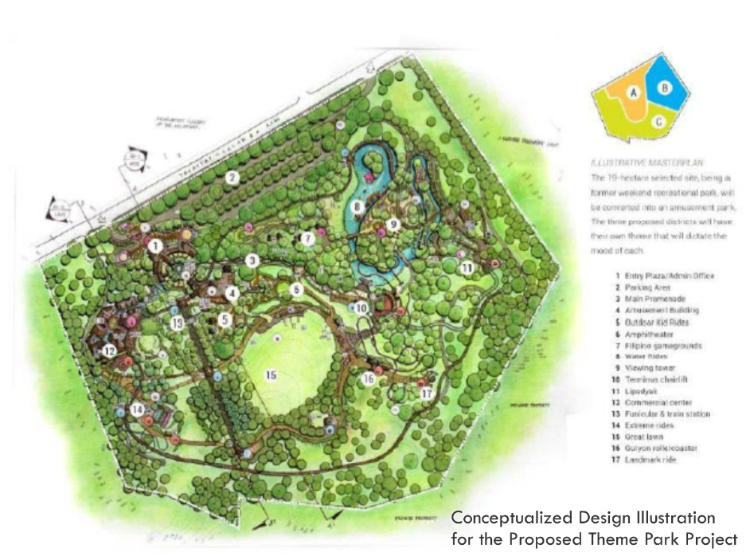
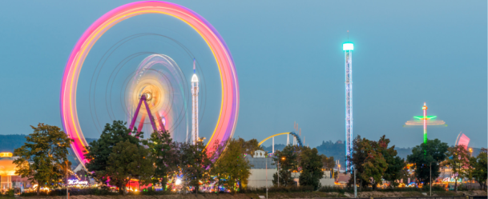
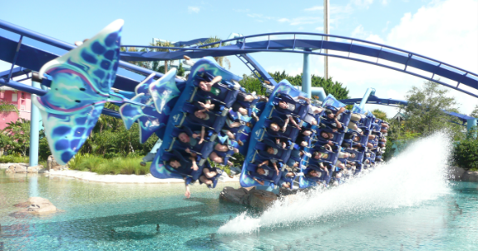
Theme Park - Nuwara Eliya
13
Location
6.9620594N
80.7746191E
Land Extent :- 12A. 2R. 0P.
Location & Surrounding
located facing the lake Gregory. flat land covered in grass. No build up surrounding area.
Land falls under the central environmental protection zone
Proposed Development
Accordingly, the above land proposed to develop as a theme park considering high influx of tourists visit to the Lake Gregory. Especially in seasonal period heavy crowd gathered Nuwara Eliya to celebrate function in the area. The seasonal function is based on outdoor recreational function as well as theme park functions. Within the period, there are many investors fixed their leisure activities around the lake but no any permanent place to operate their activities. The project envisages permanent location to functions the recreational activities.

Slide 17
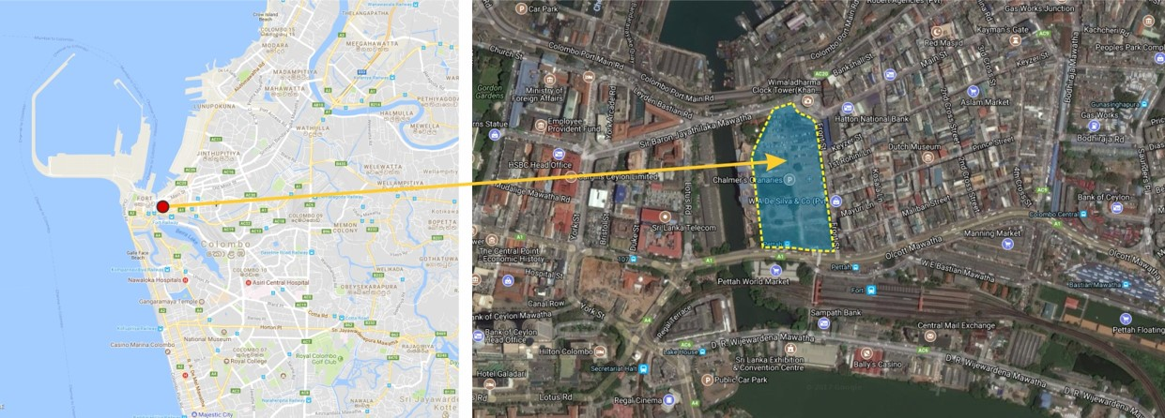

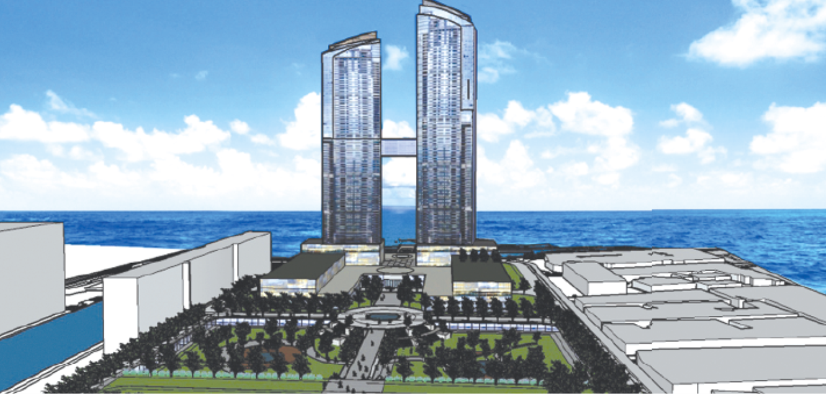
Chalmers Granary Land Development - Colombo
14
Location
6.9354823N
79.8489003E
Land Extent :- 09A. 02R. 31.75P.
Est. Value:- Rs. 19 Billion (120 USD Mn)
Location & Surrounding
Located in a prime location in the Heart of the Colombo
Close proximity to Colombo Fort & Colombo Railway Station
Access road to the site is from both Olcott Mawatha & Sir Baron Jayathilaka Mawatah
Proposed Port City project located in few hundred meters from this Site
Proposed Development
Mixed Development Project

Slide 18
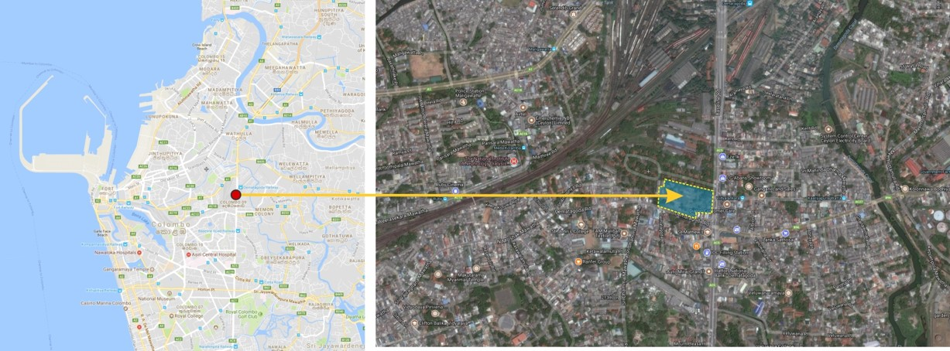

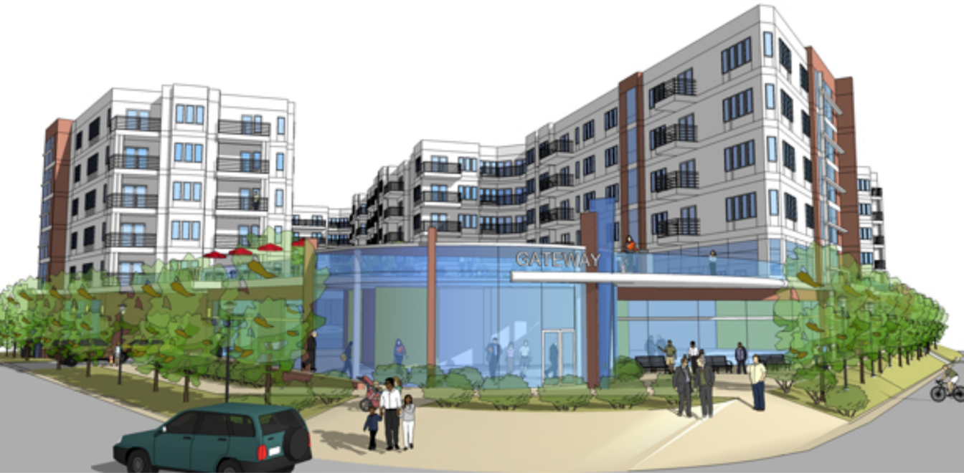
Dematagoda Junction Land- Colombo
15
Location
6.9312317N
79.8770361E
Land Extent :- 03A. 03R. 14.91P.
Location & Surrounding
Main access from Baseline Road
Close Proximity to Dematagoda Railway Station
Proposed Development
Suitable for Housing with Mixed Development

Slide 19
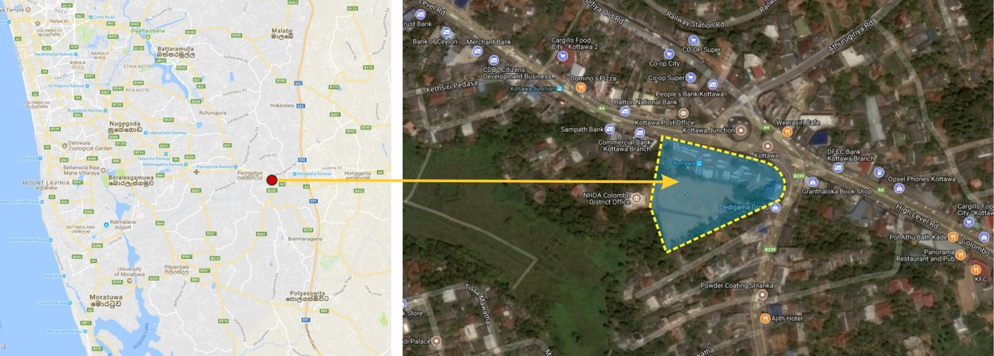



Kottawa Mixed Development Project - Colombo
16
Location
6.8409831N
79.9641495E
Land Extent :- 1A. 1R. 19P.
Location & Surrounding
The proposed site is situated in Kottawa Town Center (Existing Bus Stand land) facing High Level Road. The Main access road to the site is from High Level Road.
Proposed Development
Mixed Development Project

Slide 20



Navinna Land
17
Location
6.851739N
79.917183E
Land Extent :- 1A. 0R. 30.4P.
Location & Surrounding
The proposed site is situated in Nawinna area facing High Level Road.
The Main access road to the site is from High Level Road.
Close proximity to Nawinna Railway Station & Nawinna Ground
Proposed Development
Mixed Development Project

Slide 21

Thank You

