Slide 1
impact of timetable data on railway business In Europe
Shanghai, 18 November 2017
THNS 2017
Marc GUIGON – UIC – Director Passenger Department

Slide 2
Customer Experience Lifecycle
Consultation
Timetable Information
Consultation of Pricing and Tariffs
Ticketing
(Home Print, Mobile, ATB)
Post-Trip
(Compensation Refunds)
Booking and Availability
Trip
Information
Services
Control
Notes:
Customer consults the timetable for the Origin/destination
Customer wants to know how much it will cost?
Customer wants to know if there is space available and the price of the journey
Customer needs to receive the ticket
Customer will need to know if there are any delays, location of track, etc.
For the post-trip, the customer may need information about compensation for late trains, refunds, etc.

Slide 3
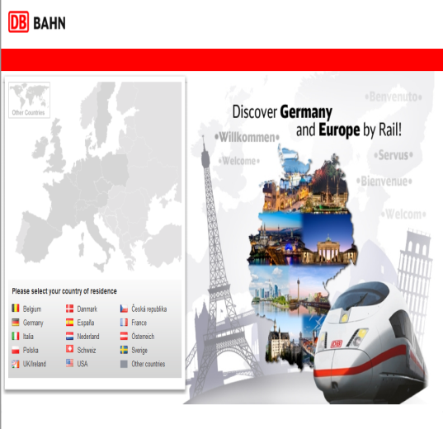

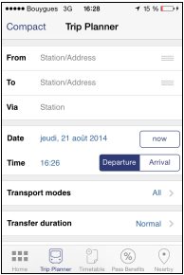
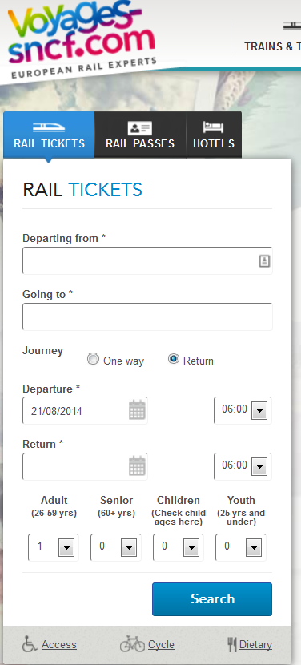

Consultation of Timetable Information
And RUs
Customer

Slide 4
Set up of TimeTable data step by step
In MERITS System
Elaboration of time table by each RU (production commercial data) in MERITS format
Validation and integration in MERITS tool
Data redistribution to the RUs, member of MERITS
Timetable Data operated in railways IT systems and web sites for reservation, information, journey planning, mobile apps …
Integration of the MERITS consolidated package with the set of members data deliveries
Preparation and optimization of the timetable data for IT operation (EVA, Hafas,…)
Each RU
Each RU

Slide 5
UIC tool for exchange of timetable data
MERITS
Timetable, Services and Location Data

Slide 6
MERITS
Multiple East-West Railway Integrated Timetable Storage
The database of UIC for:
  Timetable (600 000 train services)
  Stations (70 000 stations)
  38 workspaces for Railway Undertakings
The European system for collecting, verifying, integrating and exporting timetable data for domestic, cross-boarder and international trains from Western Europe to Russia

Slide 7
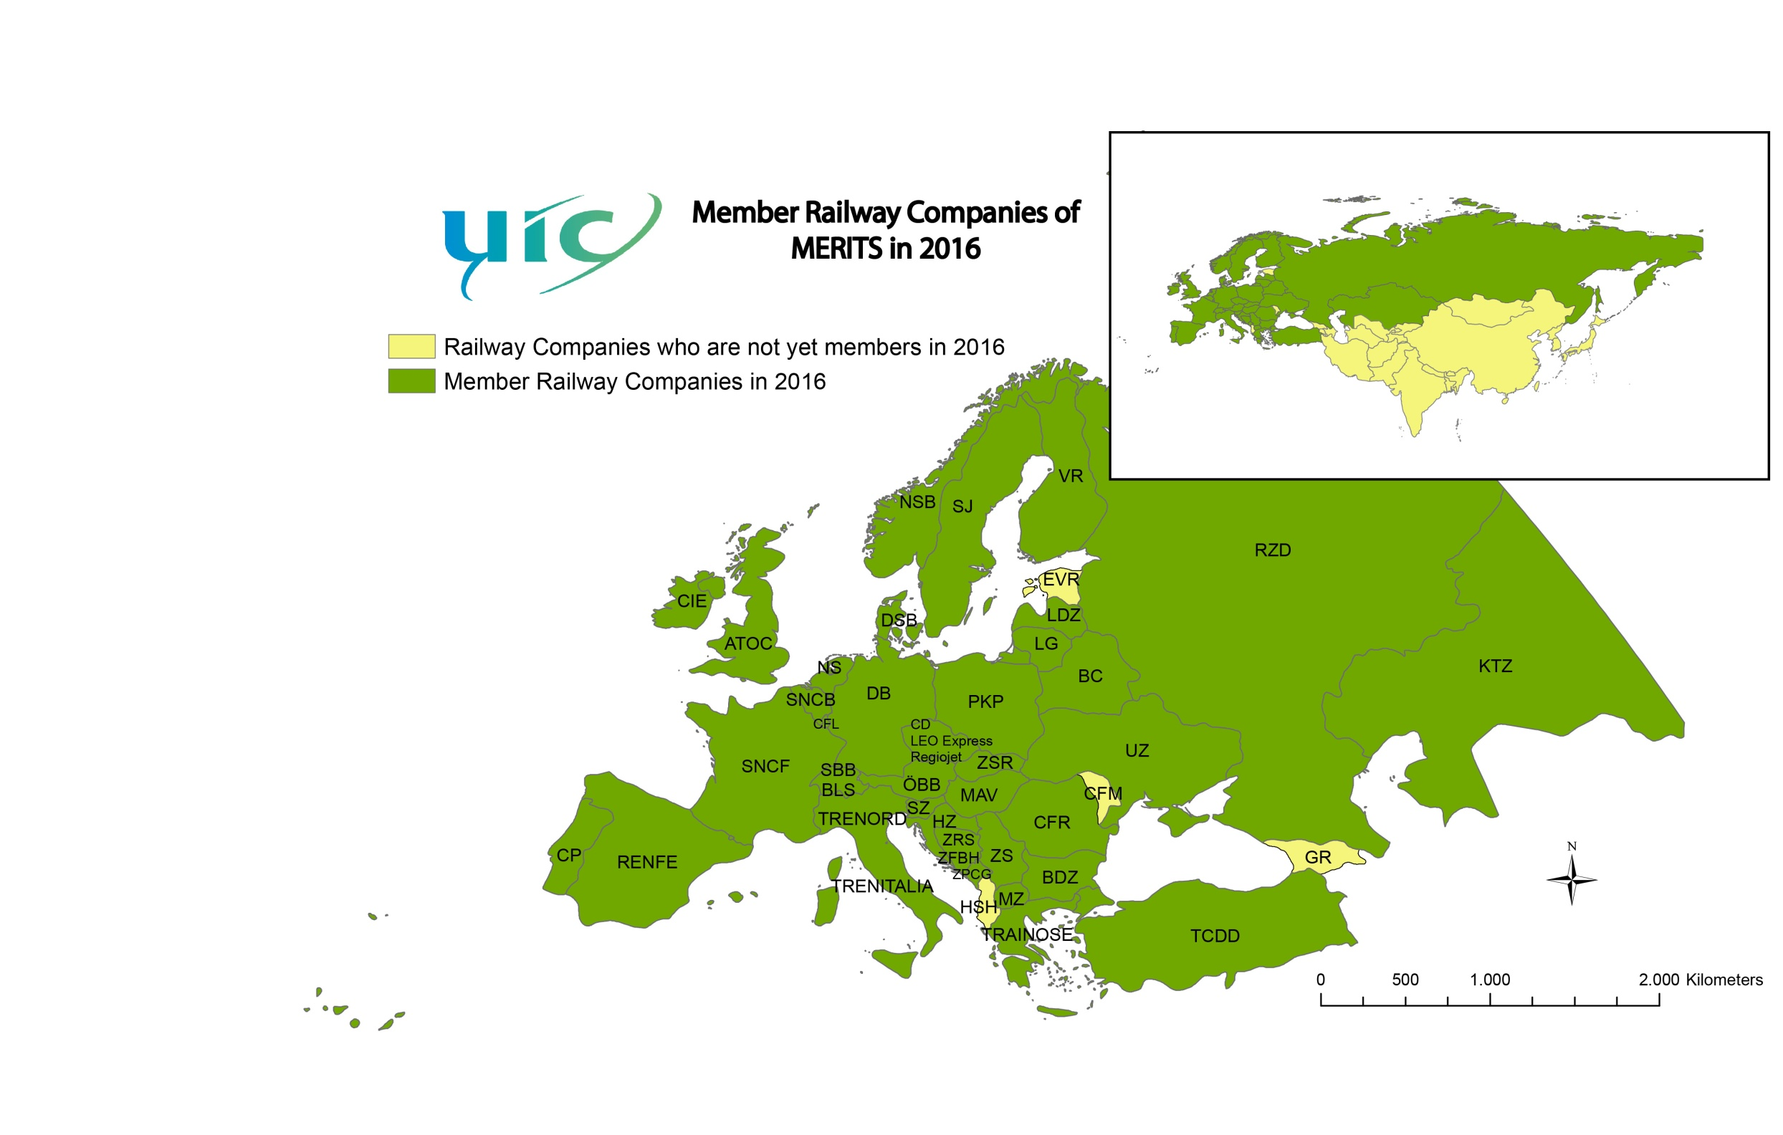
THNS Novembre 2017 - Shanghai

Slide 8
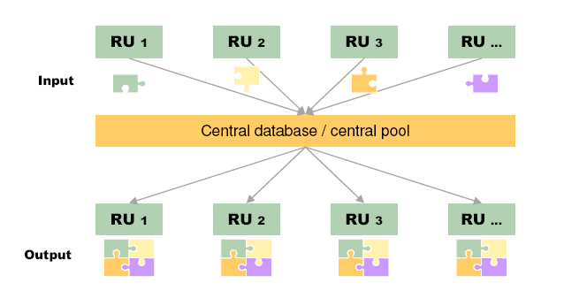
MERITS CONCEPT
Input
raw data
Output Integrated data

Slide 9
Which data are included in MERITS
Stations data, minimum connecting times, station coordinates…
Brand codes, types of train
Classes, coach groups, seats, couchette…
Timetables (departure and arrival at stations), running periods, time zones
Tariffs (eg: East-West tariff…), type of reservation (compulsory…)
Service data and facilities: restaurant, sleeping cars, bicycle, mini bar, wheelchair, power supply sockets…
  All what is needed in the journey planners

Slide 10
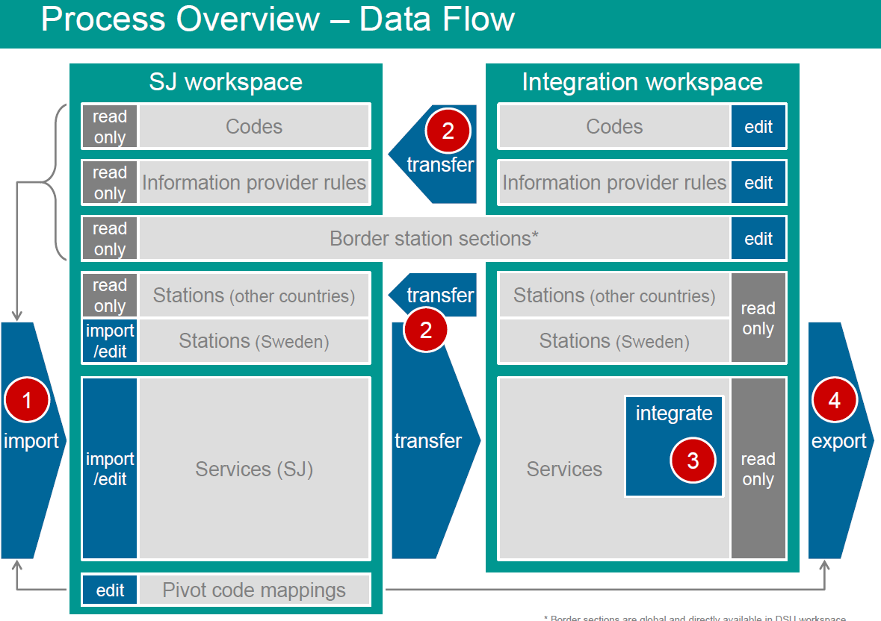

Slide 11

MERITS: different actors
participating members
DB Vertrieb
HaCon
data management
database operator
Data – Fee
Memorandum
of Understanding
13 Nov 2012
UIC
UIC leaflet
916-1 EDIFACT messages
UIC
MERITS/PRIFIS
code list

Slide 12
Stakes of MERITS for the member
To provide weekly* or more its own timetables to the community in order to be known and/or sold by other railway undertakings
To get bi-weekly integrated timetable data of all railway undertakings to develop the international rail business and sell tickets of other railway undertakings
To have timetables to be able to be positioned as supplier of IT software solution, journey planner, APPs (bahn.com, voyages-sncf.com, others...)
* Monthly or edited directly is also possible

Slide 13
Use of MERITS within the railway undertakings
MERITS data are mandatory to run the IT systems and apps of the European railway undertakings (bahn.com, voyages-sncf.com, Eurail app…) in order to have a large coverage of railway undertakings data (Domestic and international trains including regional trains, ferries, busses)
For customer information
For journey planning
For booking
For mobile apps

Slide 14
Give Third Parties Access to MERITS Integrated Data
Decision of UIC members on 4 April 2017 to give third parties access to MERITS Integrated Data
A task force has been set up for:
  Define a business model,
  Negociate terms and conditions in contracts
It is a revolution in Rail Business
  Today Third parties do not have access to Integrated Data
  They only have access to National Data
  It is difficult for them to inform / sell International Trains

Slide 15
Give Third Parties access to timetable integrated data
Who are the data users?
  UIC MERITS members (Railway Undertakings)
  Non-UIC MERITS members
      Ticket vendors: On-Line Travel Agencies (OTA: Trainline,…))
      Ticket Vendors: GDSs (Amadeus, Sabre, Travelport…)
      Public Authorities (Europe, State, Regional, Local authorities)
      RUs who are not UIC/MERITS members
      Other transport modes (air industry, ferries…)
      Apps developers (small and big companies)
      Information systems (Google…)
  The UIC decision is to sell data to data users

Slide 16
Example of distribution through third parties (OTA) using comprehensive integrated data

Slide 17
Carrier data provider agreement between UIC and providers
Proposal to include the following points:
  Worldwide license to UIC to host, copy, use, reproduce… data
  Not modify the content of the information
  License to use trademarks and logos
  Data format; leaflet 916-1
  Most up to date data
  Frequency, completeness…
  Accurate, consistent
  Exactly to the ones loaded on its own reservation system inventory
  UIC quality check, and Data Provider shall correct and adapt errors
  Term and termination
  Support from UIC
  Limitation of liability
  …

Slide 18
License contracts between UIC and users
One license per legal entity. Group license is possible
Proposal to include the following points:
  Non-exclusive, revocable, worldwide license with no right to sub-license, even to one of its associated undertakings which is not the same legal entity as it
  Possibility to adapt data to be compatible/compliant with the product (journey planner) under the condition that it does not change the content of the data
  Data User is permitted to develop an API based on MERITS
  …

Slide 19
License contracts between UIC and users
Proposal to include the following points:
  Data quality level
  Frequency of delivery
  Not entitled to grant sub-licenses for the rights that have been granted
  Not entitled to disclose its access codes, transfer data…
  May edit, make changes or derive elements…
  Permitted to develop an API based on MERITS data
  Disclaimer: UIC is not responsible for incorrect or missing data
  Intellectual property rights
  …

Slide 20
EXAMPLES

Slide 21
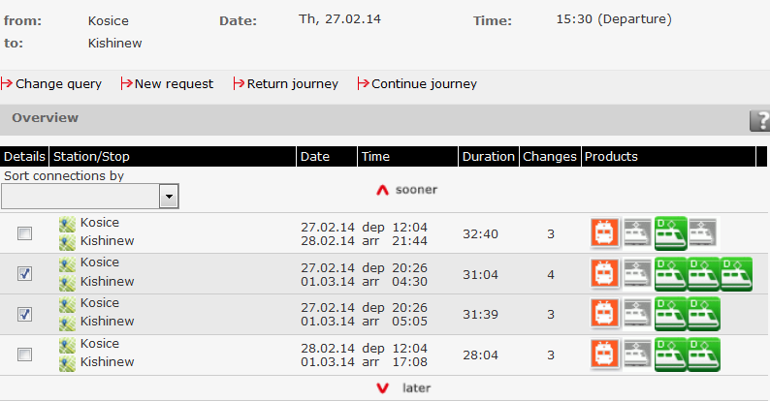
Exemples of MERITS data in RUs systems

Slide 22
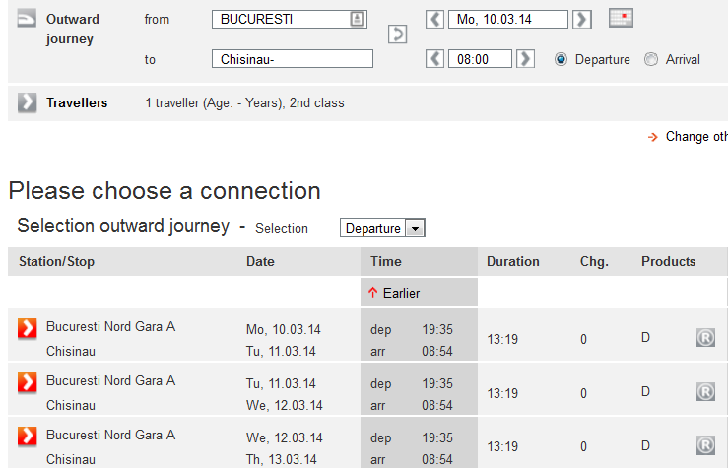
Bahn.de journey planner: Bucuresti Nord to Chisinau

Slide 23
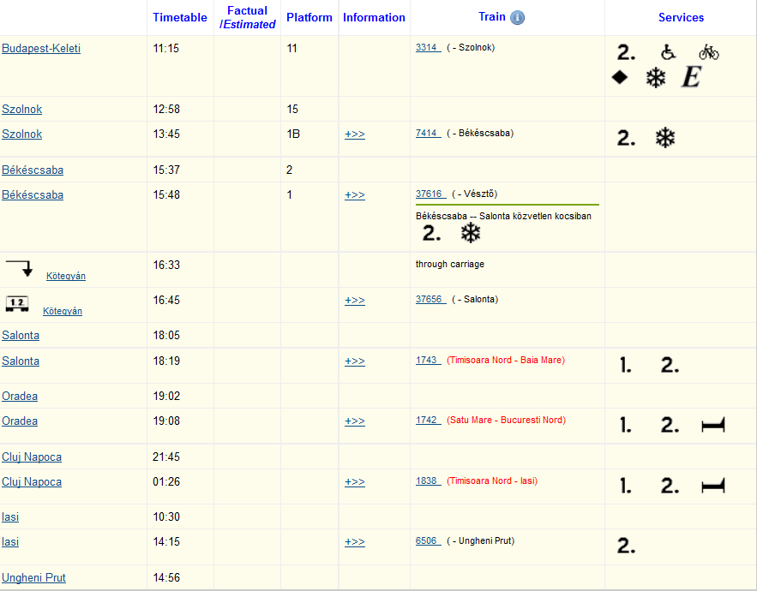
MAV-START journey planner: Budapest to Ungheni

Slide 24
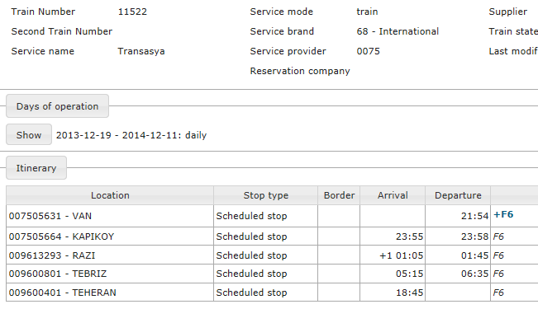
Iranian data in MERITS system delivered by TCDD

Slide 25
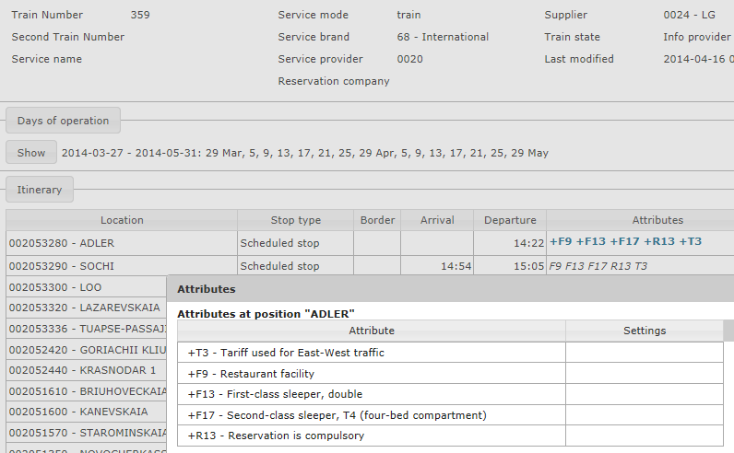
Service data in MERITS

Slide 26
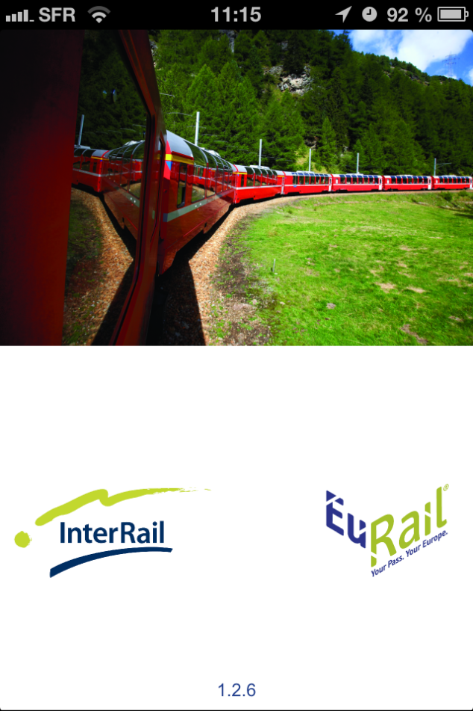
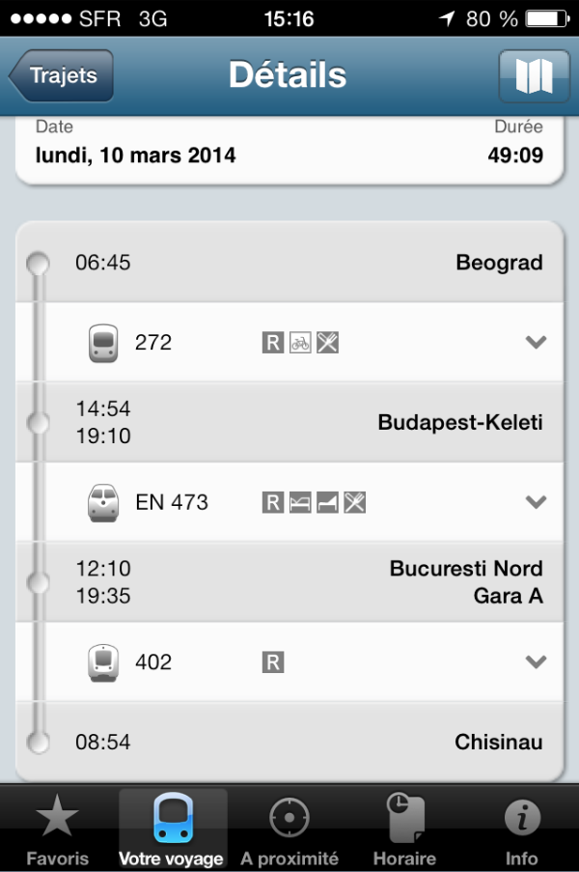
Exemples of MERITS data in mobile apps
InterRail & EuRail apps
Beograd to Chisinau

Slide 27
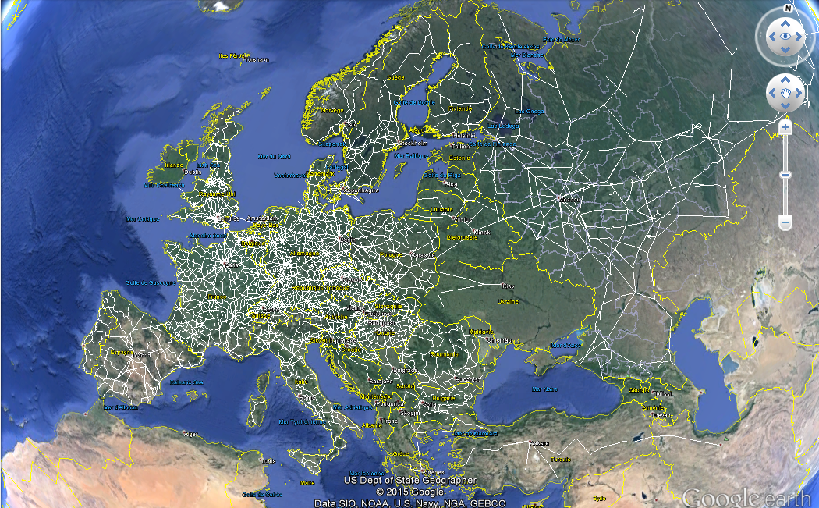

Slide 28
Thank you for your kind attention
谢谢各位
guigon@uic.org

