Slide 1
同济大学世界交通大会
（WCTR 2016）
World Transport Research Conference
10-15th July, 2016
Tongji University, Shanghai
Pan Haixiao
Prof. Tongji University
Chair, IVM China
LOC, WCTR2016

Slide 2
WCTRS—Established Since 1978, The WCTRS (World Conference on Transport Research Society) provides a forum for the interchange of ideas among transport researchers, managers, policy makers, and educators from a perspective, which is multi-modal, multi-disciplinary, and multi-sectoral.
a truly international network of transport academics and practitioners, which is the only such worldwide network: more than 1400 experts interested in transport research, representing about 75 countries.
a wide variety of Special Interest Groups (SIGs), each dedicated to a specific academic topic from mode specific policy and modelling to well-being seeking solutions on economic development, climate change and disaster resilience.
a free on-line subscription to the Society’s two Journals: Transport Policy and Case Studies on Transport Policy
a free digital copy of the proceedings of past conferences.
best conference papers published in partner journals, which each SIG is associated with.
SIGs’ outreaching to international society such as ITF, World Bank, UNFCCC conferences, etc.
WCTRS Young Initiatives including the WCTRS-Y conference, grants award to young researchers, and dedicated newsletters and job information.
-- Developing country: Bursary

Slide 6
Summary
Activity:
SB: Session block
PS: Poster Session
GA: General Assembly
TV: Technical Visit
SET: Side Event, Technical Session
BSC: Bursary Selection Committee
PSC: Prize Selection Committee
Venus:
ZHB: Zhonghe Building
SPE: Shanghai Planning Exhibition Center
NHB: North Building
129: 129 Hall

Slide 7
Keynote Speaker：
International：
Mr. Jose Luis Irigoyen
Director, Transport & ICT Global Practice, World Bank
China：
Mr. He Huawu
Deputy Chief Engineer, Expert in HRS, Ministry of Transportation, China

Slide 8
Technical Visit:
1. Public Bike in Minghang District
2. Road Traffic Monitoring System
3. Tongji Transport Technical Center-Car Factory
4. TOD Development in City Center—Jinan Temple Area
5. Barrier Free Environment in Shanghai
6. Hongqiao Transport Hub—HRS, Metro and Airport
7. Yangshan Deepsea Container Terminal

Slide 9
Specific for French Participants
1. French Speaking Sessions for Three Days in Sino-French Center
2. Special Events, China—France Dialogue/9th THNS 2016
3. Post Conference Tour, China-France Cooperation City
4. Opportunity of Technical Exhibition (Sponorship)

Slide 10
LOC
Chair Pan Haixiao
Vice Chair Li Keping, Zhang Lun
North China: Lu Huapu
North-East : Zhao Shenchuan
North-West: Chen Hong
Middle China: Yan Xinping
South China: Su Cheng
South-West: Zhang Xinyuan

Slide 11
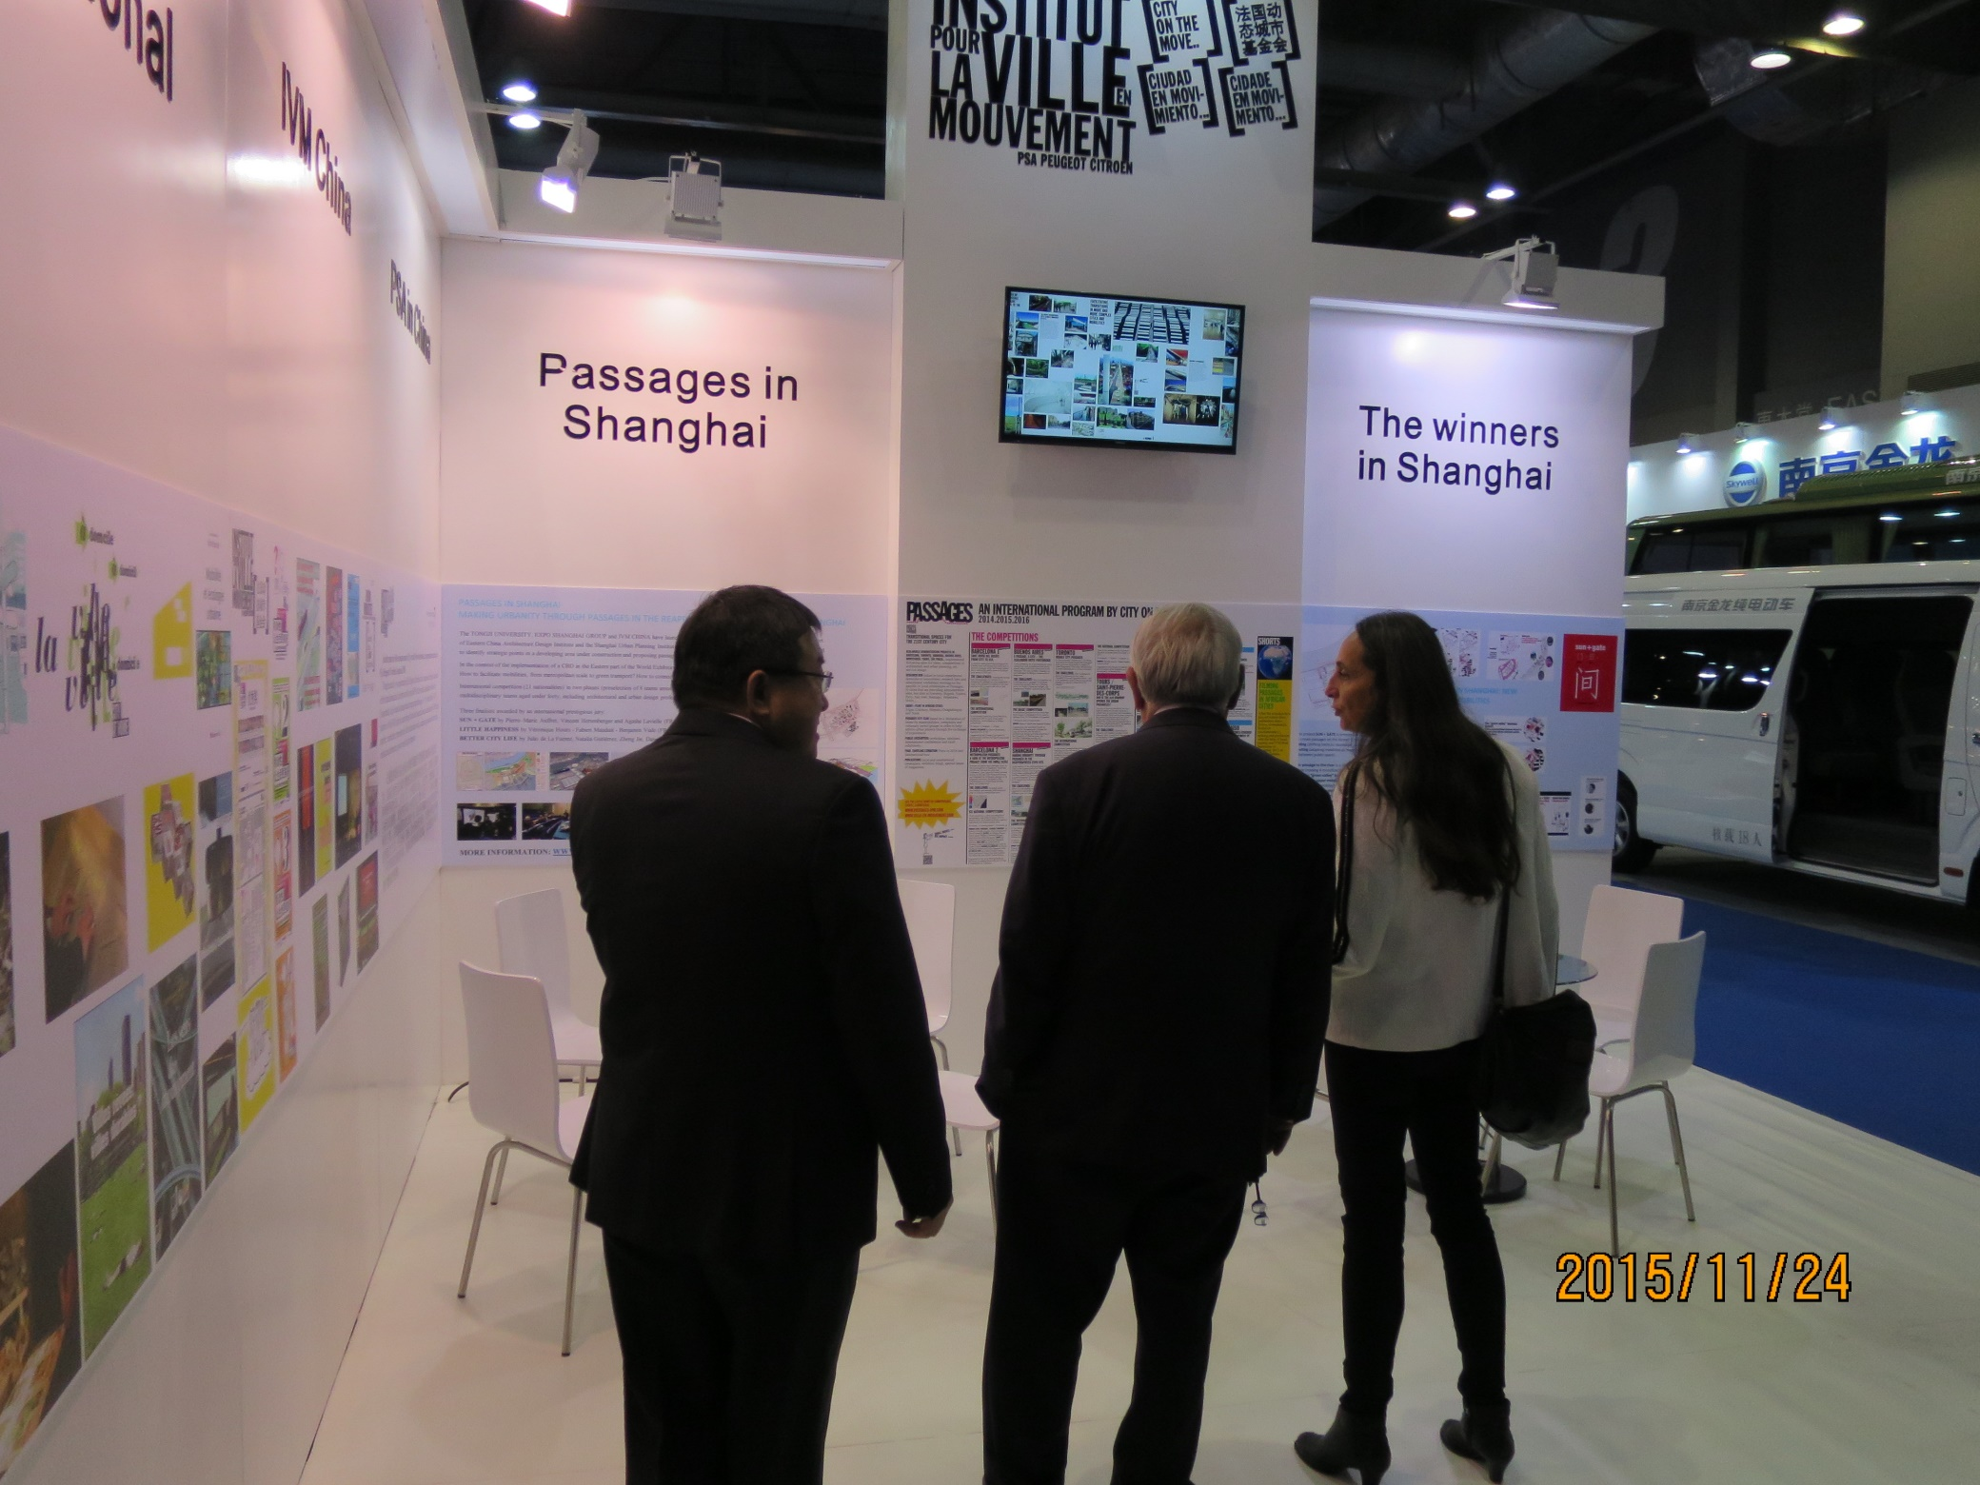

Slide 12
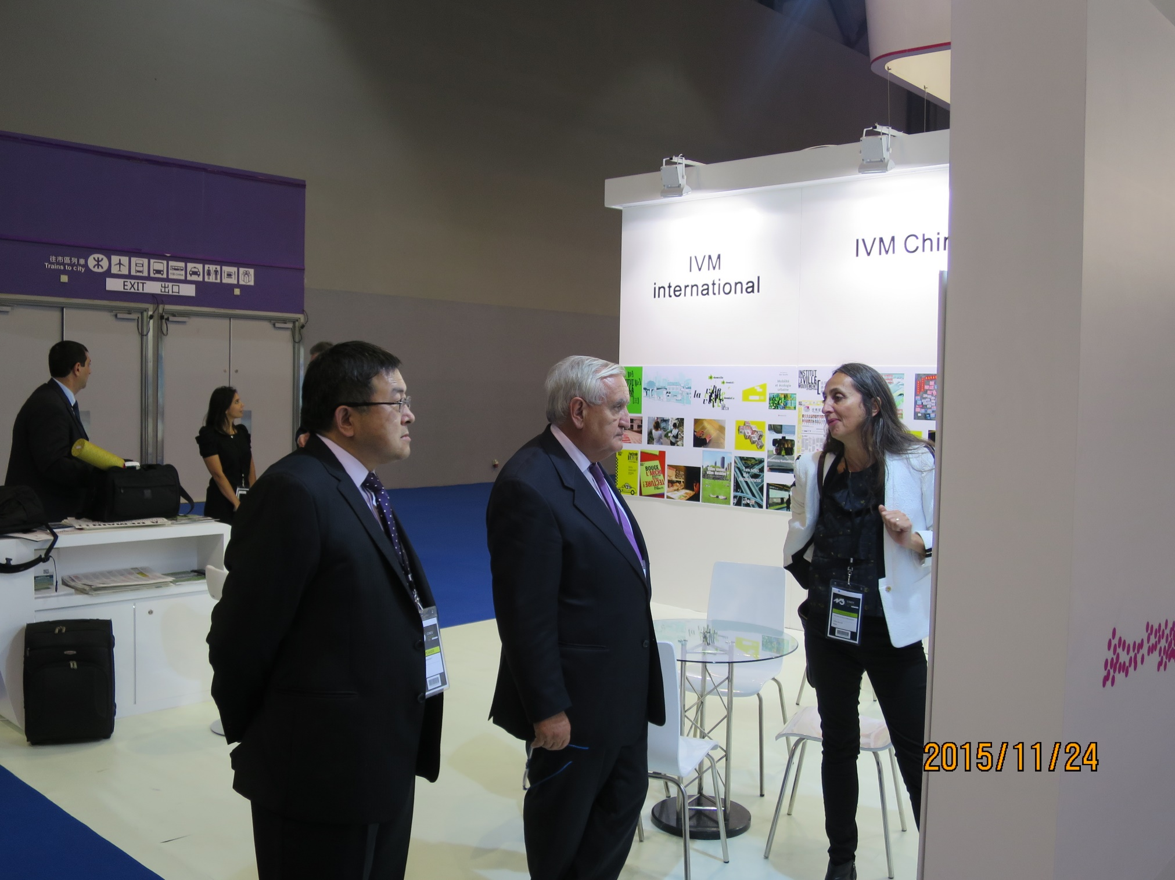

Slide 13
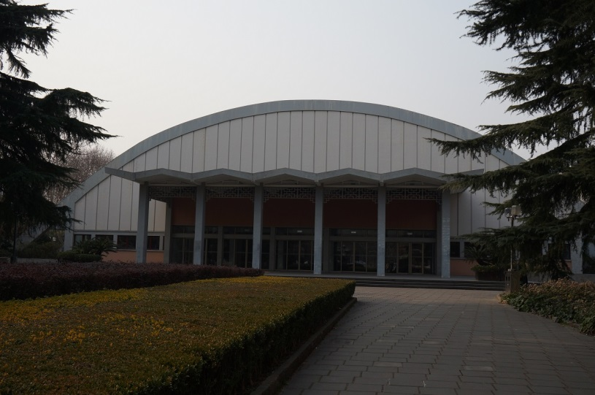
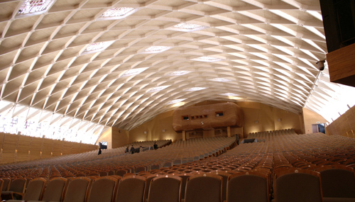
同济大礼堂
University Hall(Opening Ceremony)
University Hall has 1892 seats, with two large LED screen on both sides of the stage, stage at the top of the banner frame for elevating design auditorium is also equipped with a VIP reception room, eight dressing rooms, rehearsal rooms, podium, central air conditioning, etc., five restrooms

Slide 14
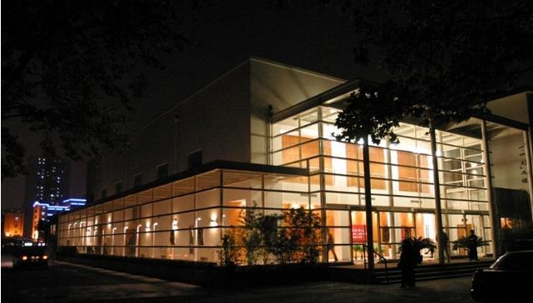
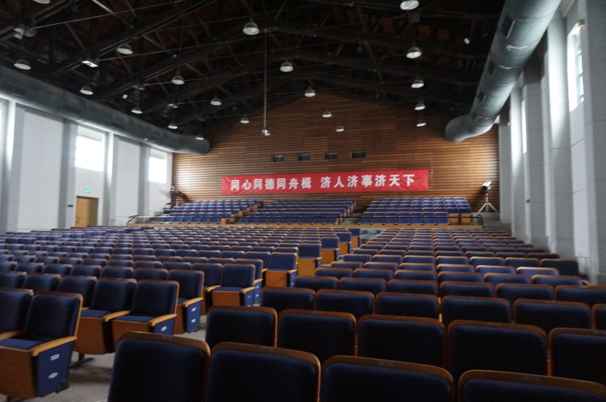
同济129礼堂
129 Hall (Closing & Awards Ceremony)
Tongji 129 Hall has 570 seats, equipped with two projectors, professional audio set, big screen film screenings, performances lighting, air conditioning, and equipped with a dressing room

Slide 15
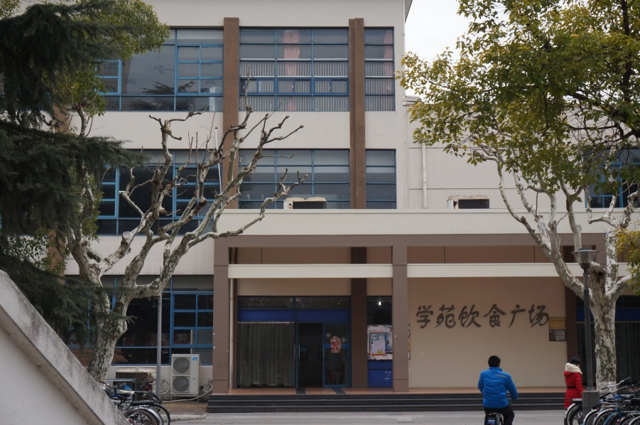
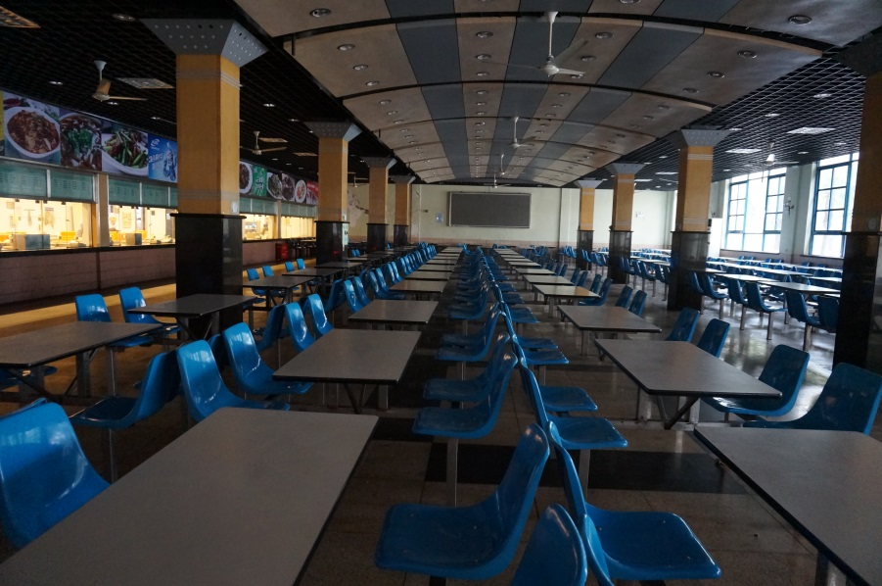
学苑餐厅
Xueyuan Canteen (Lunch)
A total of three floors, can accommodate about 1500 people dining at the same time

Slide 16
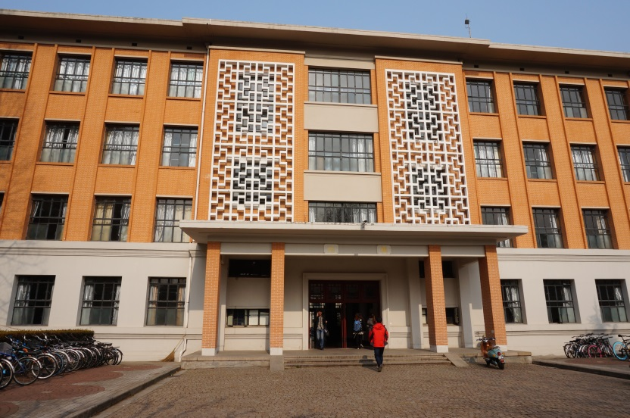
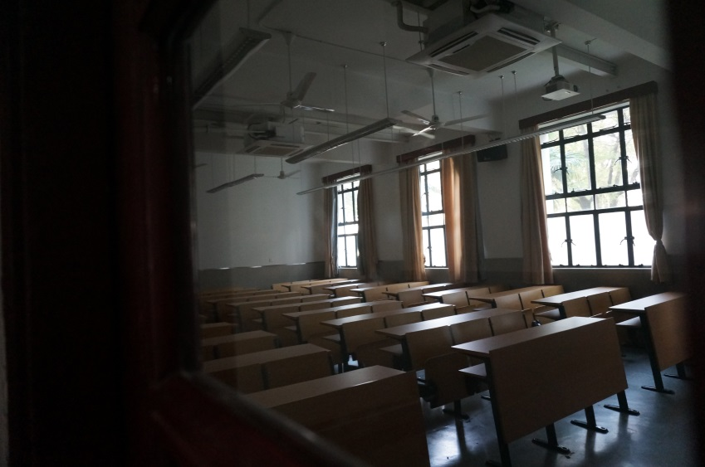
北楼
North Building (Parallel Meeting)
The North Building, a four-floor building, built in 1955, was one of the most important teaching buildings in the University.

