Slide 1
Energy Efficiency Potentials in Public Urban Traffic
Institute of Electrical Power Systems
University of Technology Graz
Tongji University

Slide 2
Theme
Overview Wiener Linien
Importance of energy efficiency
Energy efficiency measures in the metro sector
Energy efficiency measures in the tram sector
Energy efficiency measures in the bus sector
Energy efficiency measures in the infrastructure

Slide 3
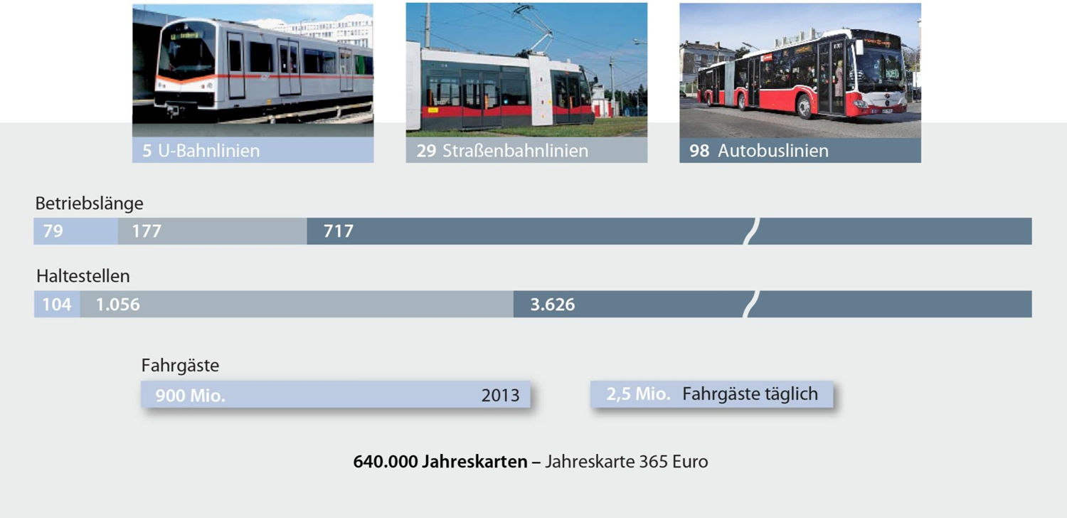
All About Wiener Linien
5 Metro Line
29 Tram Line
98 Bus Line
Operation length
Station
Passenger
2.5 Mio. Passenger/day
640.000 Annual Tickets
Annual Ticket: 365 Euro

Slide 4
Theme
Overview Wiener Linien
Importance of energy efficiency
Energy efficiency measures in the metro sector
Energy efficiency measures in the tram sector
Energy efficiency measures in the bus sector
Energy efficiency measures in the infrastructure

Slide 5
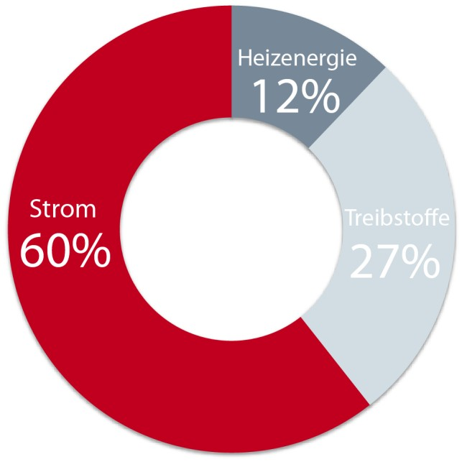
Energy Consumption
Heating energy
Energy consumption
706 GWh per year
Energy costs
61 Mio. Euro per year
Electricity
Fuel
Energy mix 59% renewable energy
Actual study ecological footprint of Wiener Linien: → appr. 1% of the ecological footprint of Vienna
A view into the energy flow diagram of Vienna → Wiener Linien 5% of the city energy consumption for traffic purposes

Slide 6
Energy efficiency
Energy efficiency is part of the corporate strategy and process landscape
Energy efficiency is practiced in all branches of industry
From strategy to planning, new construction to renovation and maintenance
Any further increase in public transport will have a positive effect on the overall traffic energy balance of the city

Slide 7
Theme
Overview Wiener Linien
Importance of energy efficiency
Energy efficiency measures in the metro sector
Energy efficiency measures in the tram sector
Energy efficiency measures in the bus sector
Energy efficiency measures in the infrastructure

Slide 8
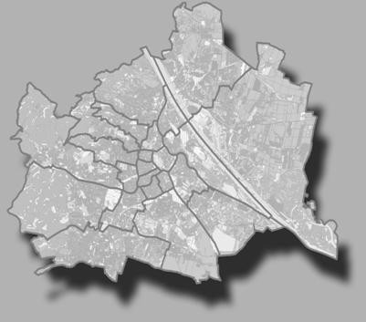

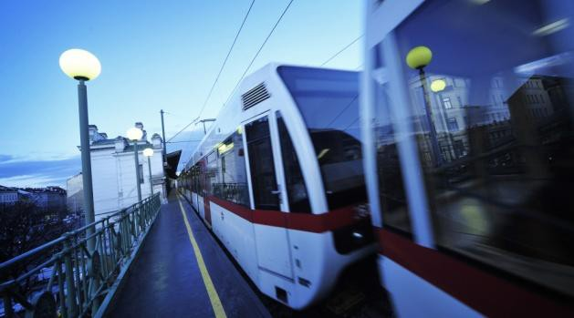
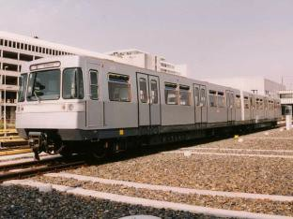
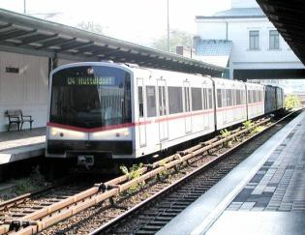
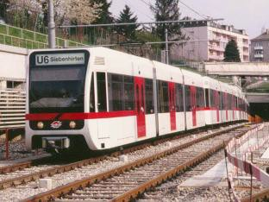
Vienna Metro System
U1
5 lines
79 km
104 stations
158 metro trains
429‚000,000 passengers / year
80 km/h max. speed
70 substations
Heiligenstadt
U6
Leopoldau
U4
Floridsdorf
U3
U2
U4
Ottakring
U2
Seestadt Aspern
Hütteldorf
Karlsplatz
U1
U3
Reumannplatz
Simmering
U6
Siebenhirten
2,5 Min Fahrintervall Tagesspitze
71 U/U11/U2
51 V
36 T/T1

Slide 9

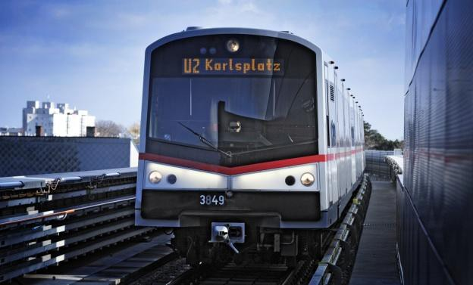
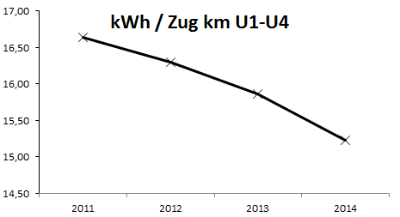
Energy Efficiency in Vienna Metro System
Energy optimized automatic operation of metro lines U1-U4
100% vehicles with feedback of traction energy
Energetically optimized duct of lines
Shut-down of trains
LED lighting in all new trains
Research project: Brake Energy
!Measuring values
!development of energy conscious operation
kWh/ train km U1-U4

Slide 10
Theme
Overview Wiener Linien
Importance of energy efficiency
Energy efficiency measures in the metro sector
Energy efficiency measures in the tram sector
Energy efficiency measures in the bus sector
Energy efficiency measures in the infrastructure

Slide 11
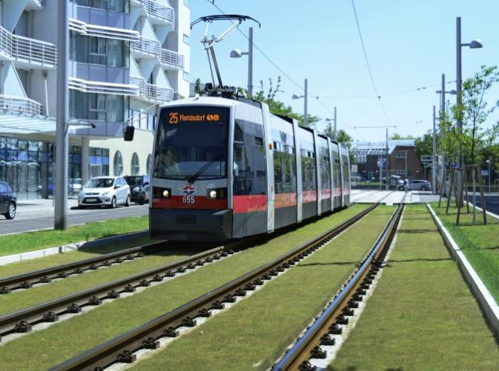
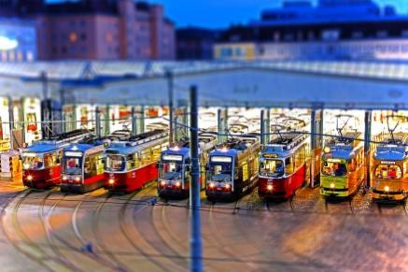
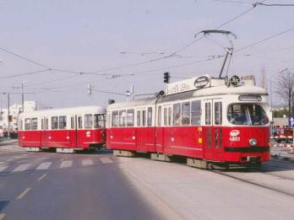
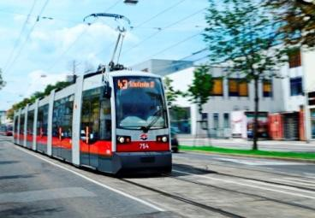
Vienna Tram System
29 lines
177 km
521 trains
  294 Mio. passengers / year
  60 km/h max. speed
63 electrical substations
238 E1/E2
283 ULF A/B/A1/B1

Slide 12
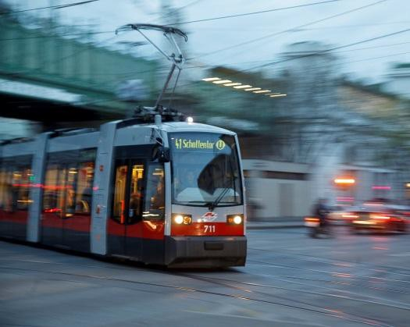
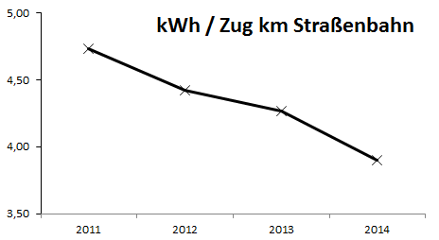
Energy Efficiency in Vienna Tram System
84% vehicles with traction energy feedback when braking
Modification of E2 vehicles
ECO Upgrade ULF vehicles
Raising of feedback voltage, shutting down magnetization in idling phases, reduction of Vmax acceleration
Research project: ECO Tram
Testing ULF Energy storage Double layer capacitors
Shutting down of vehicles during standstill
Instruction of drivers
Display of rolling phases percentage in the operator‘s display
kWh/ train km tram
!Measuring values
!development of energy conscious operation

Slide 13
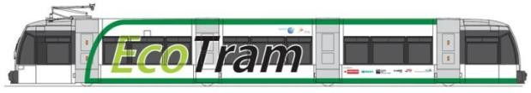
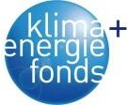
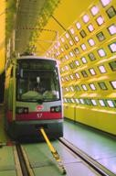
Eco Tram
Recording the energy profile of a tram type ULF A1
  Measurements in the climate wind tunnel and in passenger service for 12 months
Conversion of a prototype with measures to increase energy efficiency
  Heating / air conditioning systems with heat pump technology
  Frequency variable air conditioning compressors
  Predictive control
  Occupancy-dependent fresh air supply with CO2 sensors
  Window surfaces with heat protection films
Measurements in the climatic wind tunnel and in passenger service for 10 months
  13% of the energy for the HKL system was saved - around 4,200 kWh
  Insights into energy-saving potential in production vehicles and new purchases
funded by

Slide 14
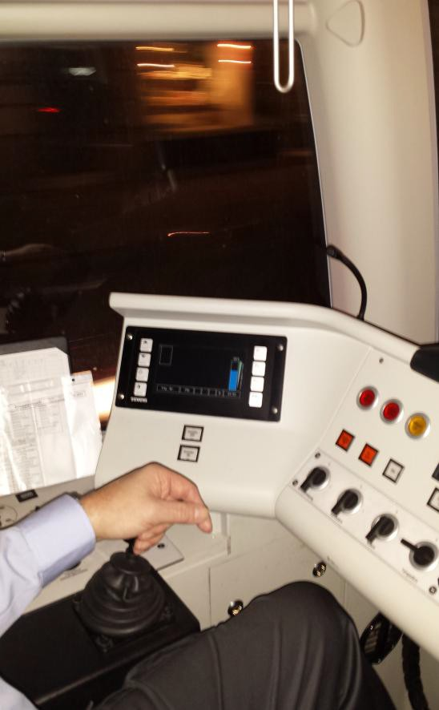
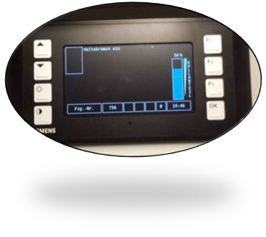
Gliding % Indication
Drivers‘ support systems
Display of rolling phases percentage in the operator‘s display
Short time (30 sec.)
30-min. mean value
Drivers are encouraged to keep this percentage high

Slide 15
Theme
Overview Wiener Linien
Importance of energy efficiency
Energy efficiency measures in the metro sector
Energy efficiency measures in the tram sector
Energy efficiency measures in the bus sector
Energy efficiency measures in the infrastructure

Slide 16
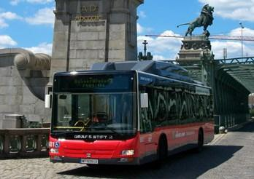
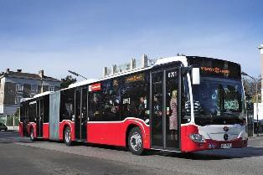
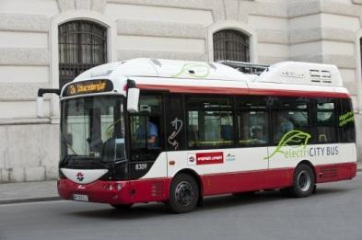
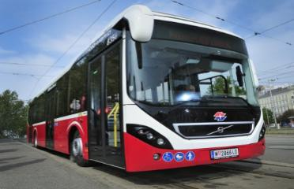
Vienna Bus System
98 lines
717 km
469 buses
178 Mio. passengers / year
371 LPG
80 Diesel
12 Elektro
6 Hybrid

Slide 17
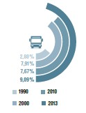
Energy Efficiency in Vienna Bus System
Modernisation of the car park → EURO 6 Citaro Mercedes
Bus Change over to alternative traction technology:
  2 lines with electric bus
  1 line with hybrid bus
More dedicated bus lanes and traffic light control
Instruction of drivers
Separated from indiviual traffic

Slide 18
Theme
Overview Wiener Linien
Importance of energy efficiency
Energy efficiency measures in the metro sector
Energy efficiency measures in the tram sector
Energy efficiency measures in the bus sector
Energy efficiency measures in the infrastructure

Slide 19
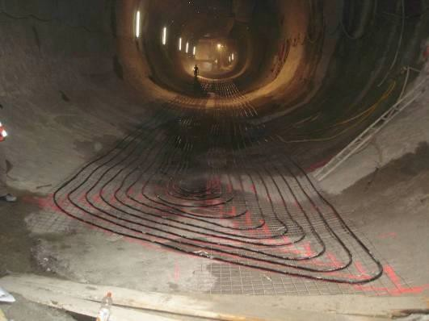
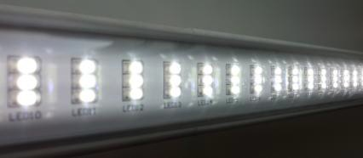
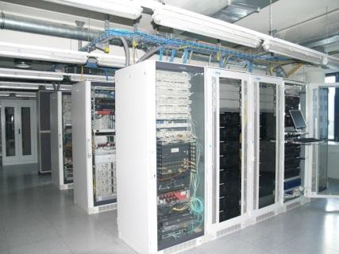
Infrastructure
Use of terrestrial heat
5 metro stations
2 train stations
1 office building
1 main workshop
Change of Stations Lighting to LED
Fluorescent tube 36 W at the platform is replaced by LED tube with 20 W.
New Metro stations: Max. use of waste heat
For stations where waste heat from technical rooms is generated, it is used for heating. There is no additional heating system installed..

Slide 20
Energy Efficiency Potentials in Public Urban Traffic
Institute of Electrical Power Systems
University of Technology Graz
Tongji University

