Slide 1
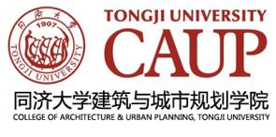
Shanghai 2040 :
Integration between urban transport and land use
THNS 2017: Mobility and Governance for New Urbanization
18th-19th, November, 2017, Shanghai, Tongji University
Jian ZHUO
Professor, Deputy Head
Department of Urban Planning, CAUP, Tongji University

Slide 2
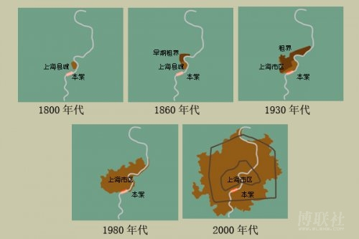
A “young” city

Slide 3
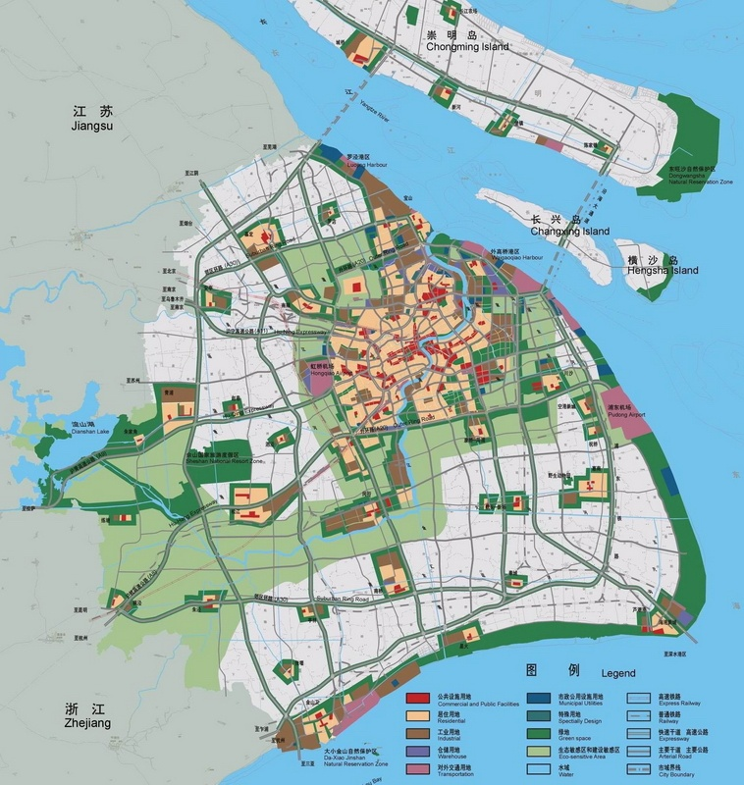
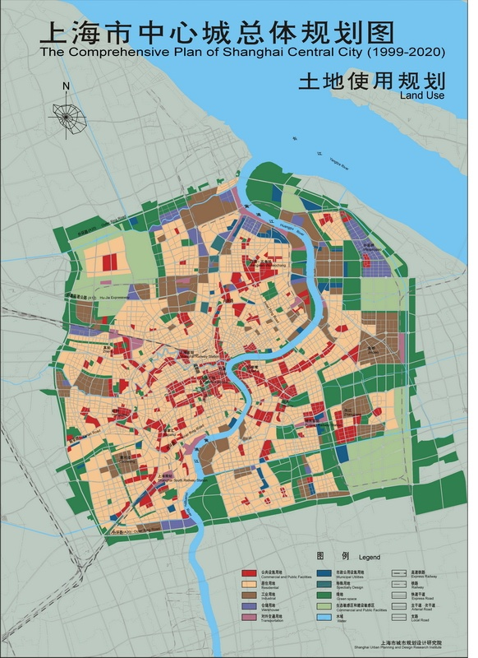
Master Plan 1999-2020
World Center in 4 aspects: World Economic, Financial, Shipping and Trade Center

Slide 4
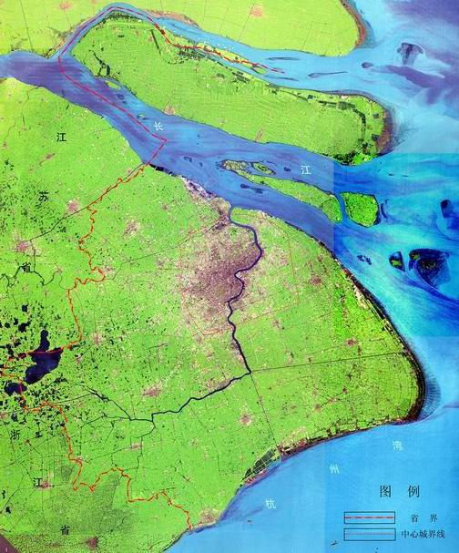
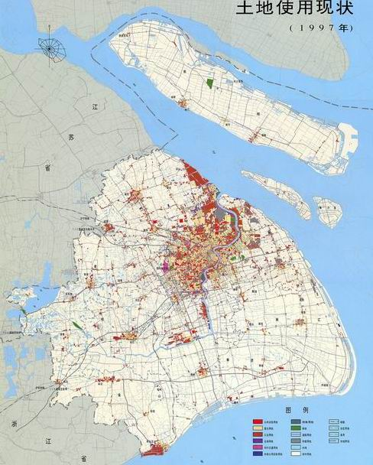
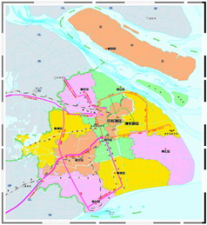
The city : Administrative territory
One municipality at regional scale
- a city or a metropolitan area?
- Greater London: 1579 km2, 33 administrative zones
A “city” dominated by rural space
- Urban built areas 2057 km², rural space 4283.5km² (2010)
 | Area (km2) | %
Municipality | 6340,5 | 100%
7 Ctrl. Dist. | 289,44 | 4,57%
8 Suburban Dist. | 5009,85 | 79,01%
Chongming island | 1041,21 | 16,42%

Slide 5
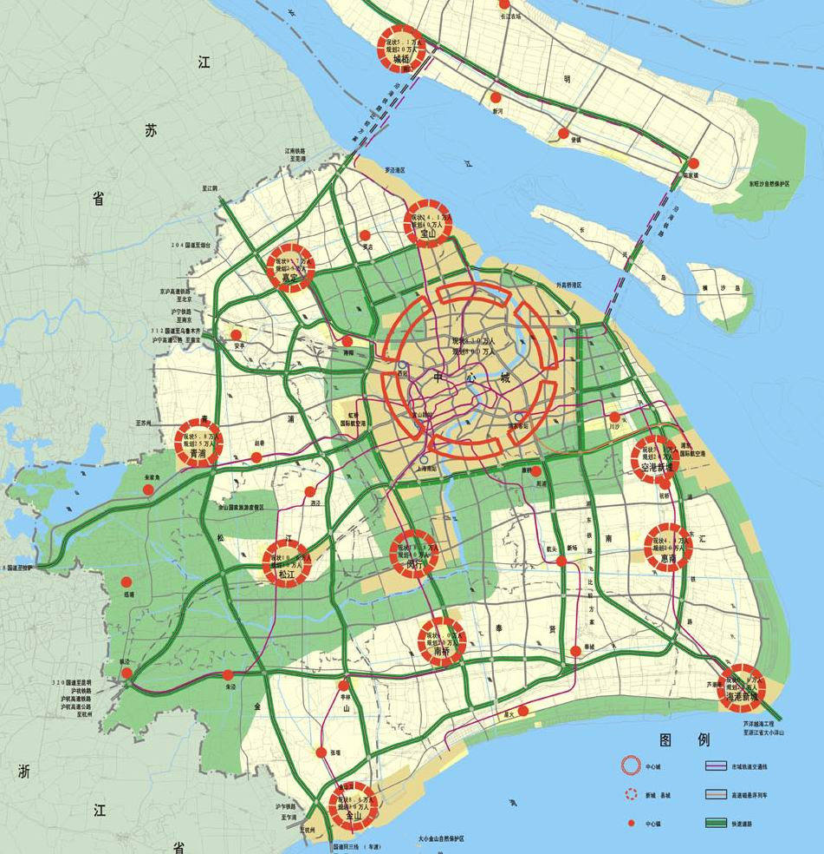

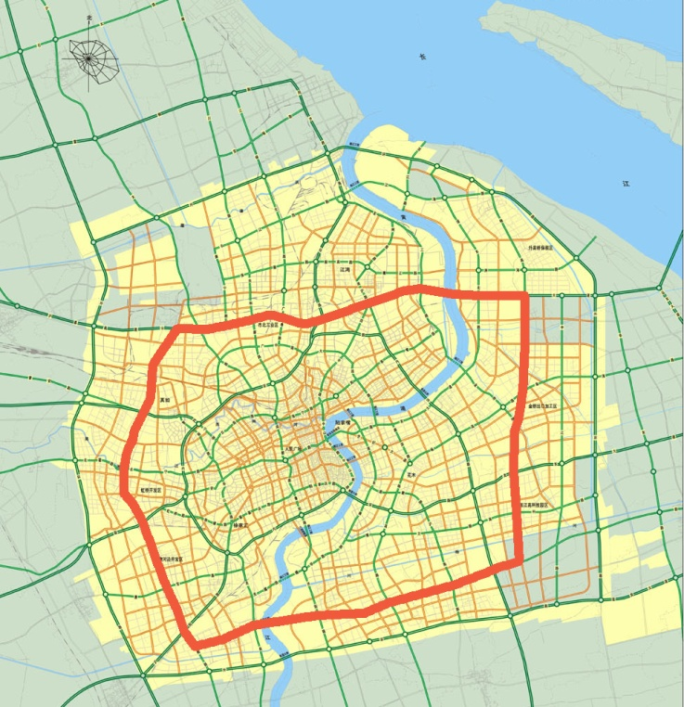
The city : Functional territory
Urban system : “1966”
- Urban: 1 central city, 9 new cities,
- Rural: 60 key towns, 600 administrative villages
- How to distinguish urban/rural : Land use regime
High population concentration
- More than 10 millions population in the central city
- 42% population concentrated on 10% of the territory
 | Area km2 | %
Municipality | 6340,5 | 100%
Outer ring road | 630-880 | 9.9-13.8%
Middle ring road | 400 | 6.3%
Inner ring road | 120 | 1.9%

Slide 6
Objectives & Challenges
Shanghai 2040

Slide 7
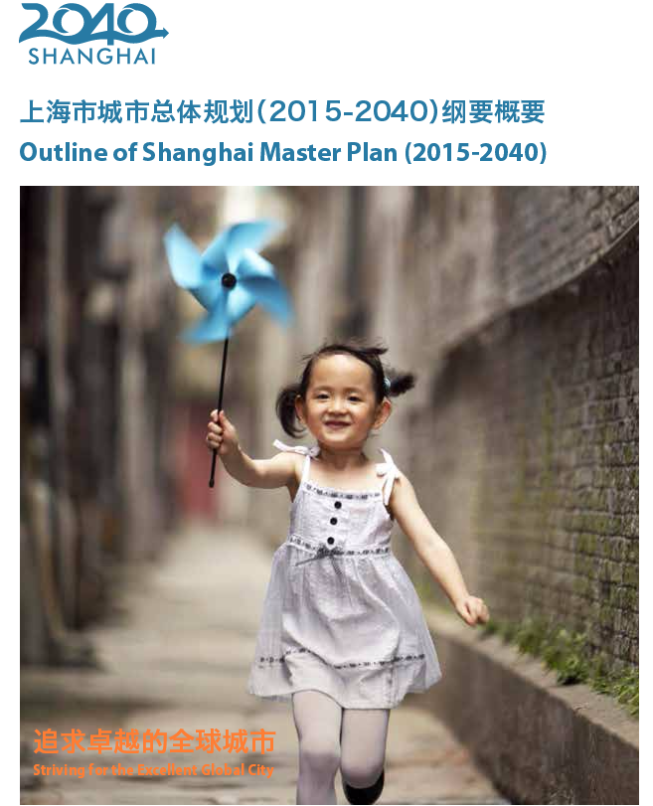

Shanghai 2040: global city ambition
KEY DATE
Dec 2015, Outline Published
Aug 2016, Public concertation
Nov 2016, examination by Representative of the Municipal People’s Congress
May 2017, evaluation by MOHURD and relevant ministries, Submission to State Council for final approval

Slide 8
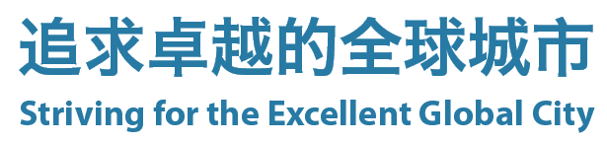
The objective
Global Competitiveness
a City of Prosperity and Innovation
Sustainable Development
a City of Green and Well-being
Cultural Attractiveness
a City of Happiness and Humanity

Slide 9
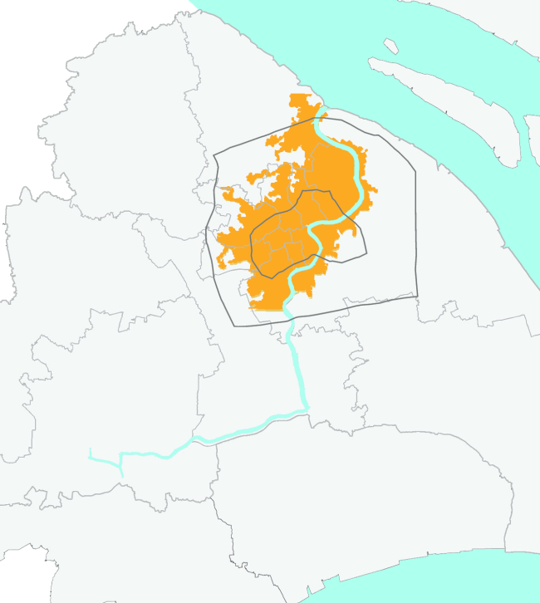
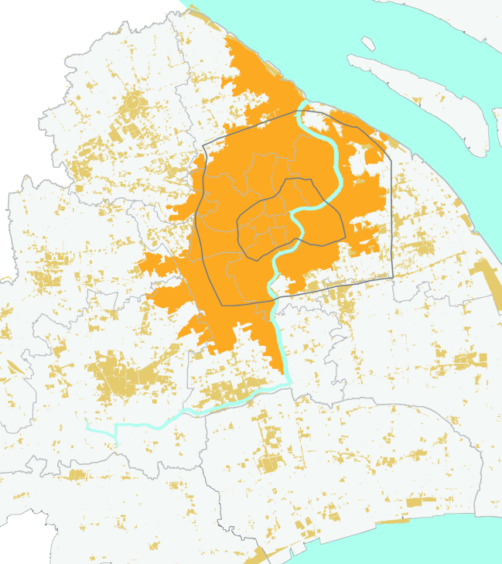
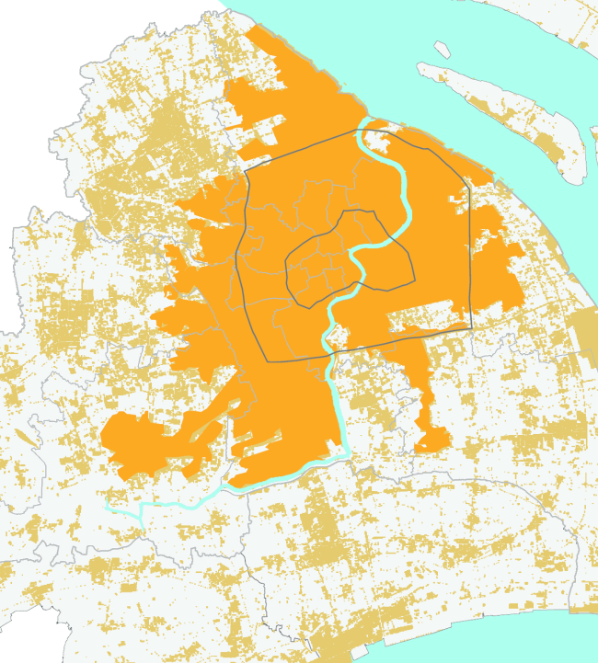
MAIN challenges of Shanghai 2040
Constant growth of population vs limited resources
  population: 24.26 mln (2014), +45% Compared with 2000 (16,74 mln)
  urbanized areas: 3100 km2 (2014), close to 50%
1991
2003: 1505km2
2008: 2288km2

Slide 10
MAIN challenges of Shanghai 2040
Regulation of Population Scale
  Objective: under 25million in 2040
  Measures: Land supply + Industrial restructure + Spatial distribution
Intensification of Using Land Resources
  Objective: Zero growth of lands for urban construction
  Measures: Coordination at regional level + Land-Use Optimization and Mixed Spatial Use

Slide 11
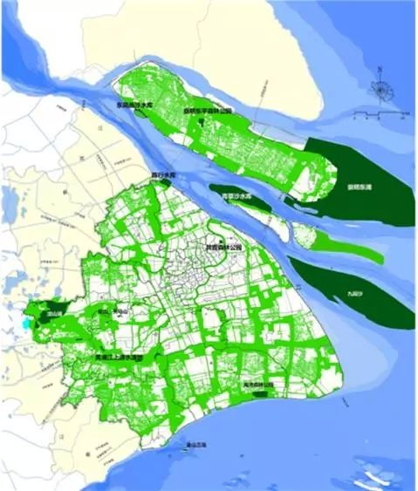
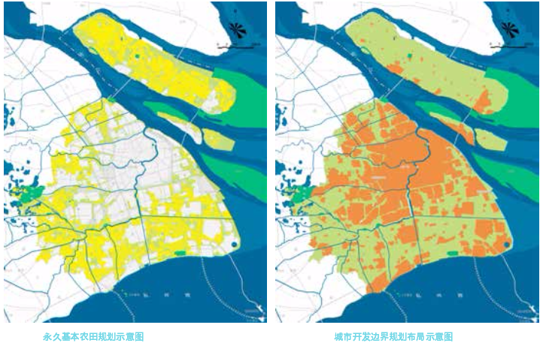
Ecological Protection Bottom Line
Strategies of Town Clusters in Shanghai Metropolitan Area
  Foster a Multi-Center Functional System for public services
  Guide the transfer of employment to the suburban areas

Slide 12
Importance of Urban regeneration
Transformation of Urban Development Mode
  Bottom-line Constraints
  From expansive new development to use better existing space
  Wide involvement of stakeholders
Transformation of Planning Approach
  From government to governance
  Involvement of different institutions within the planning elaboration
  Public participation enhanced

Slide 13
Innovative Urban Mobility
in Globaling Shanghai

Slide 14
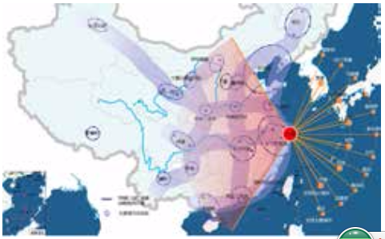
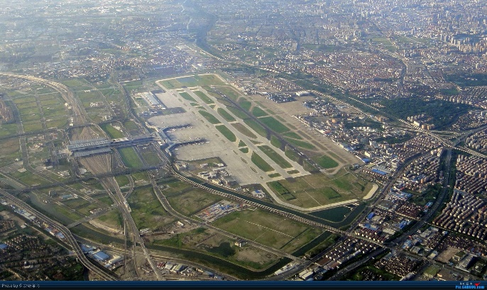
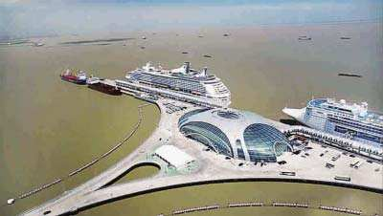
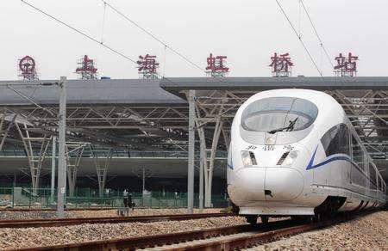
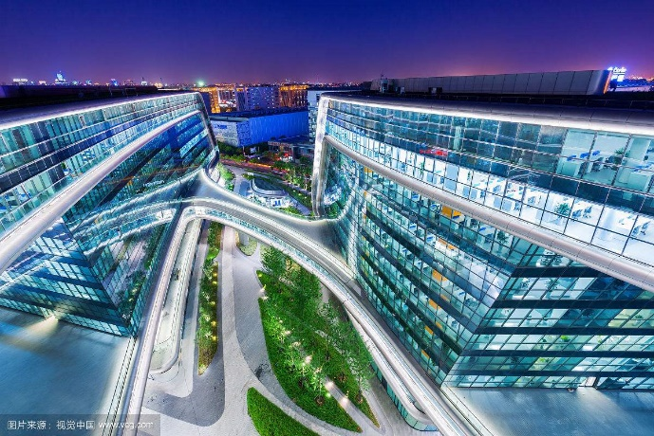
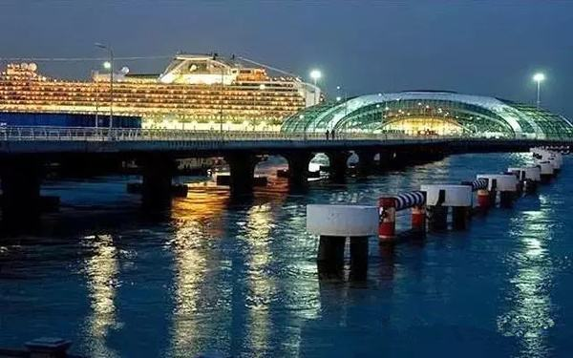
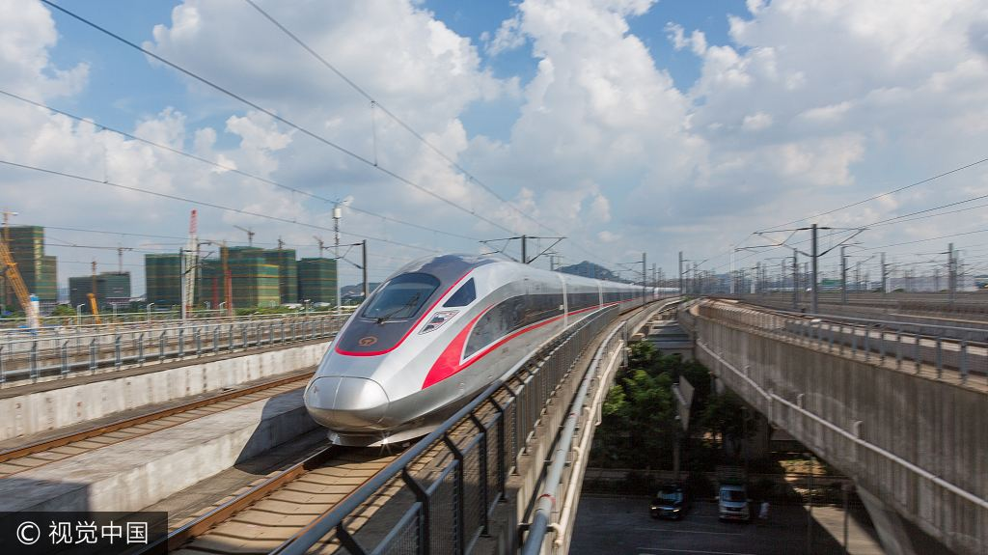
1-Enhance the Functions of International Hub
  Civil aviation: Air-gateway for the Asia-pacific region
  Sea transportation: Upgrade the Service of the International Port Hub
  Rail transportation: Strengthen the Radiation Capability of the Railway Hub

Slide 15
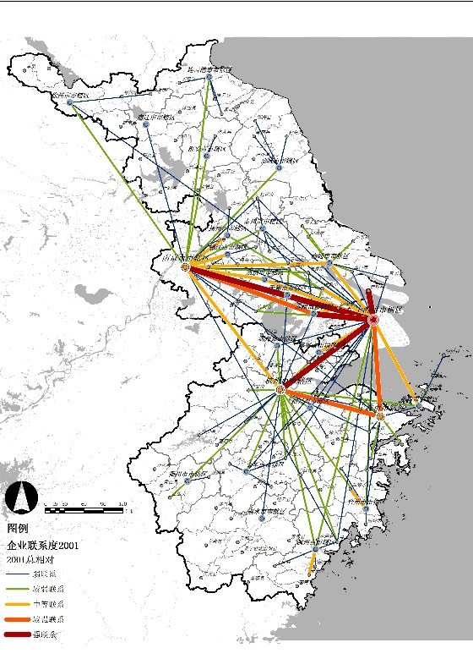
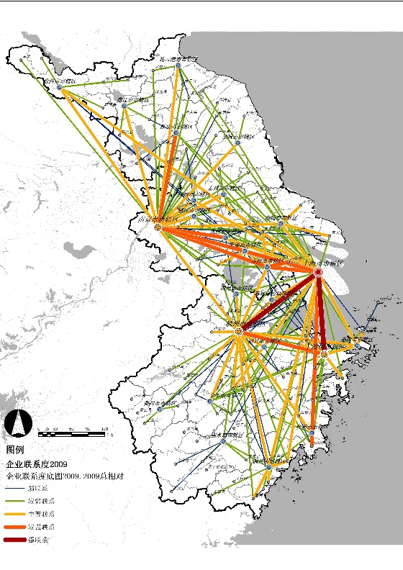
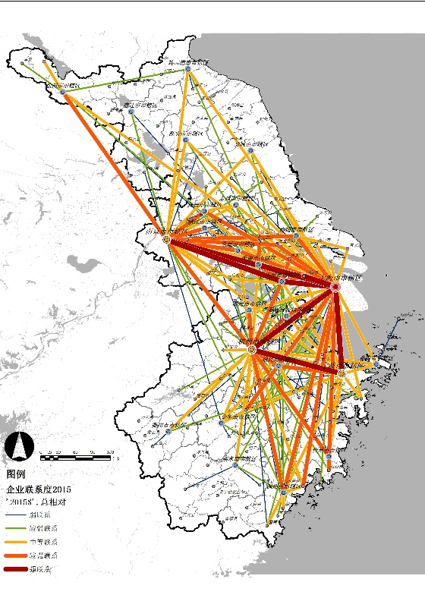
2-Integration with Yangtze River Delta Region
  Improve the Functional Network
    Hierarchy of different hubs
  Reinforce Transportation Corridor
    Rail system
    Freeway system
    Yangtze river
The Hinter-world for the globaling Shanghai
2001 2008 2013

Slide 16
3- Multi-layer Urban Transportation System
  Spatial organization of municipal territory
    1 Central city: 1137km2 (including 4 special districts)
    5 New Cities + 2 Nodal cities : JD/ SJ/ QP/ NQ/ NH + JS/CM
    New Towns: 4 levels, 50-200 thousand inhabitants
    Villages: protected, conserved, merged

Slide 17
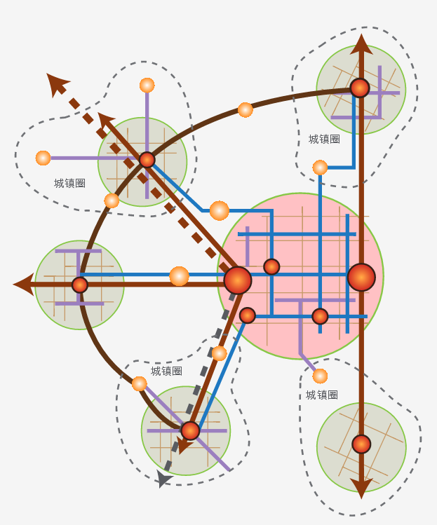
3- Multi-layer Urban Transportation System
  Time based accessibility control
    1 hour commuting at Metropolitan level:
      all towns with 100+ thousands populations connected by rail system
    30min commuting by PT Within the Town Clusters: multimodality
    Building the 15 min living circle (on foot)

Slide 18
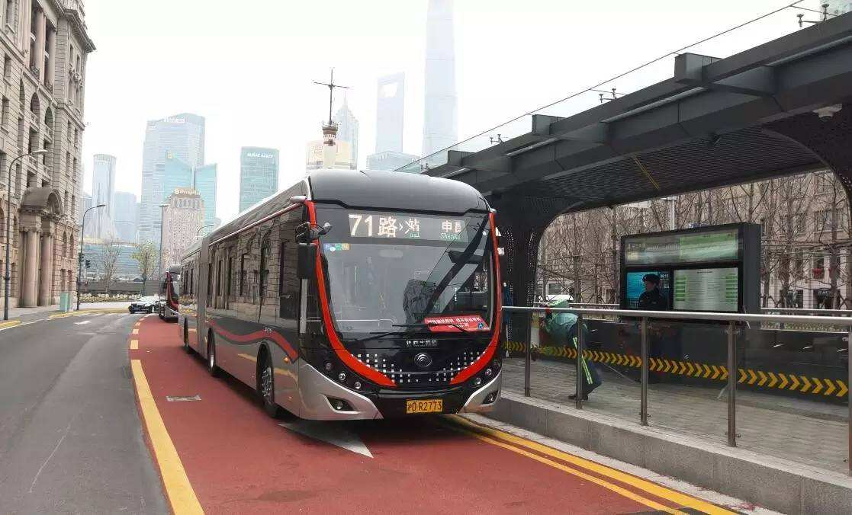
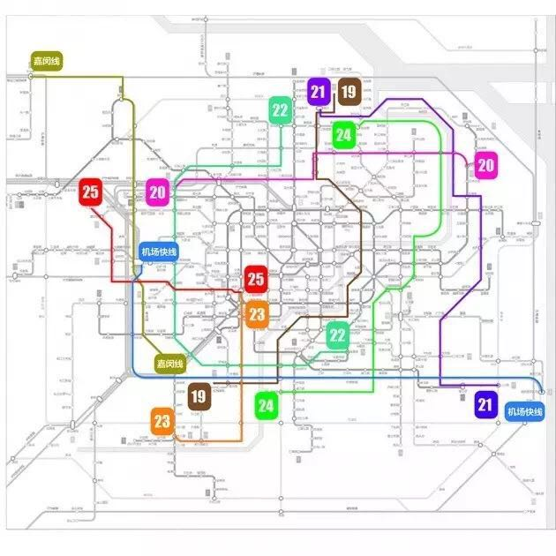
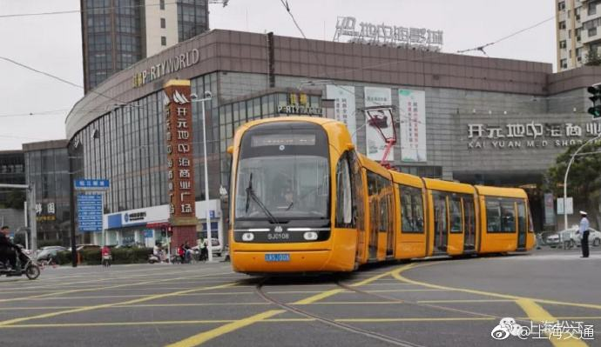
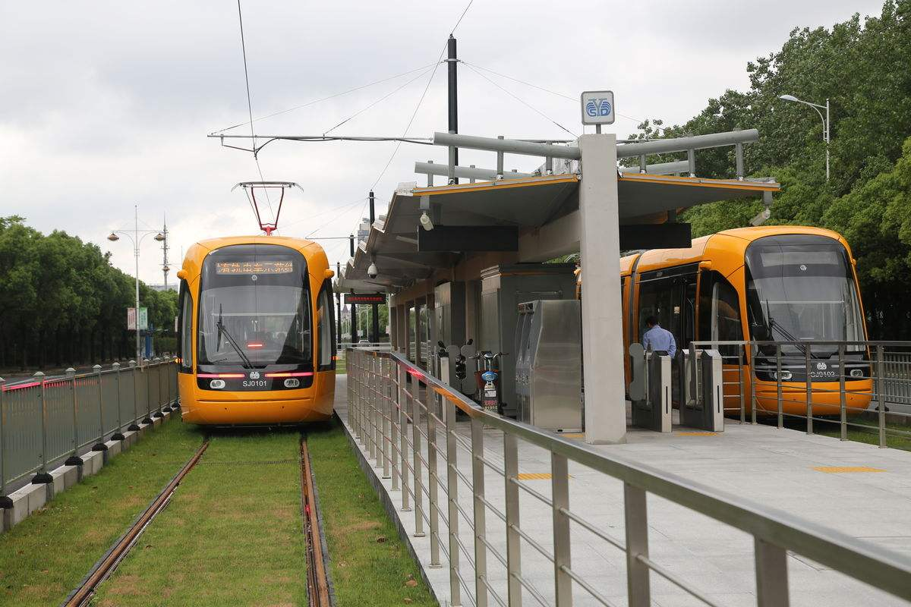
4- Strategies of Public transit prioritizing
3 levels of metropolitan rail system
  Central city-new cities: Intercity Lines, Train, Rapid Transit
  Within the central city: M line (metro) and L line (light rail)
  Local lines: Tram, Trolley, BRT…
Modal share of PT:
40% in the whole city,
Commuting duration 40min.
50% in the central city.
Share of car reduced to 15%.
9 new subway lines planned for 2017-2025

Slide 19
5- Strategies of Town Clusters in Metro area
Development of Town Clusters in Suburban Area
  23 Town Clusters planned for the integration of urban-rural development
  Guide the transfer of employment to the suburban areas
  Promote the Integration of Industrial and Urban Development

Slide 20
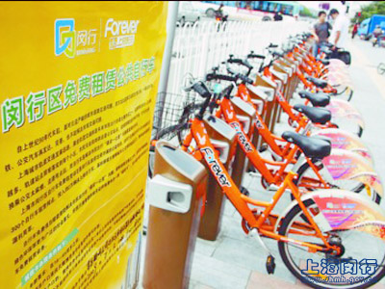
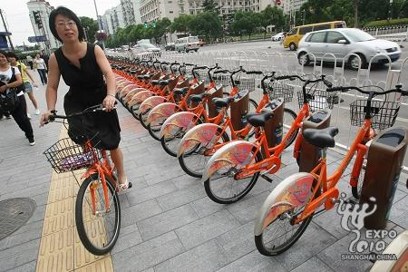
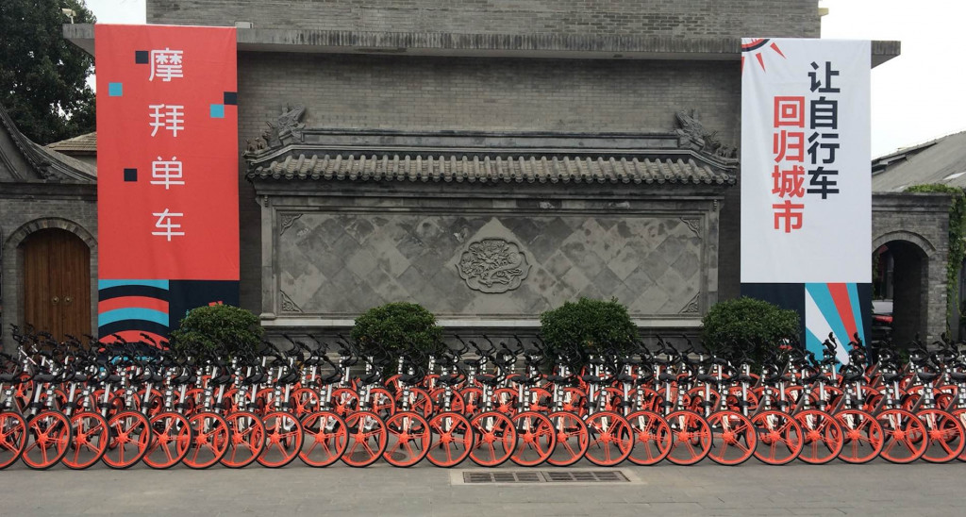
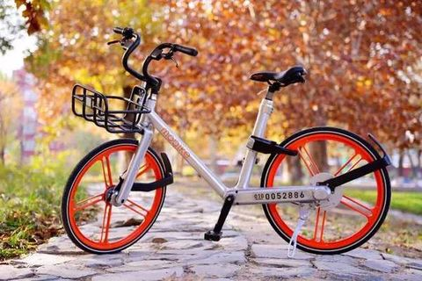
6- building 15 min living circle area
Urban living circle
  3~5 km2, 50-100 thousand people
  TOD communities
Non motorized transport mode
  Travel distance for daily life: 2.5km
  5min walk for the access to open space
  B+R facilities in PT stations

Slide 21
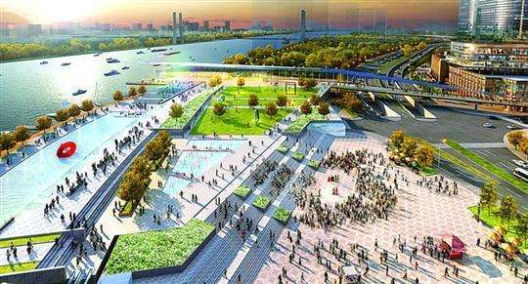
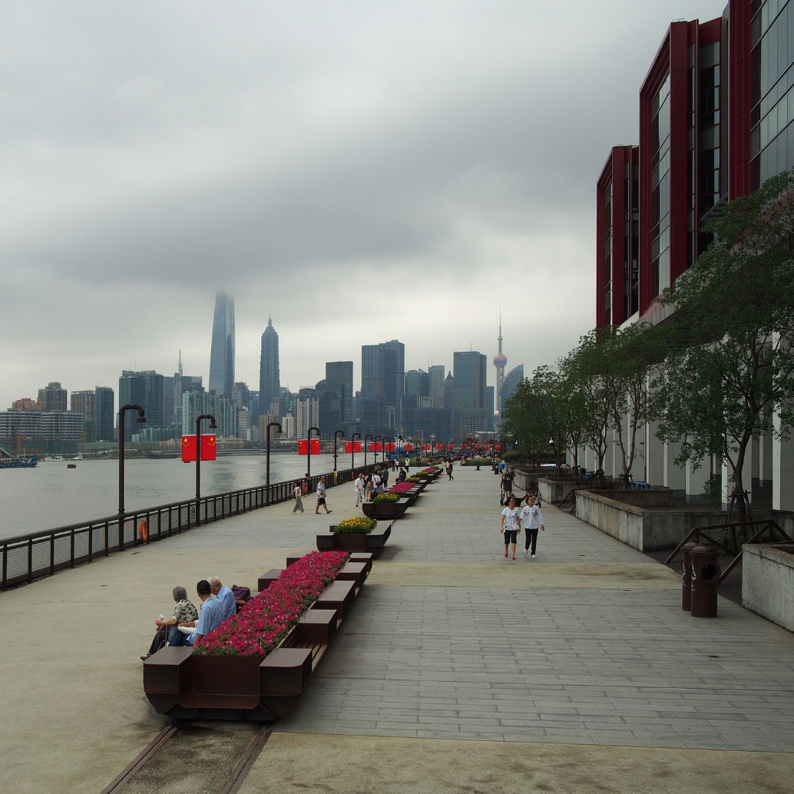
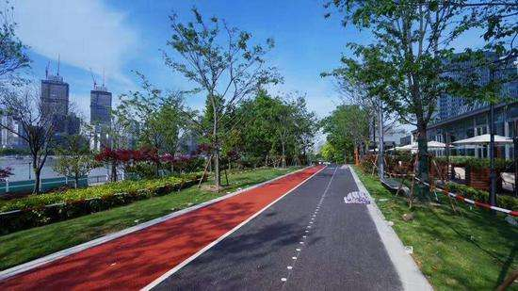
6- building 15 min living circle area
Green Way on both bank of Huangpu River

Slide 22
THANKS FOR YOUR ATTENTION !
Jian ZHUO
-
Professor, Deputy Head
Department of Urban Planning, CAUP, Tongji University
Jian.zhuo@tongji.edu.cn

