Slide 1
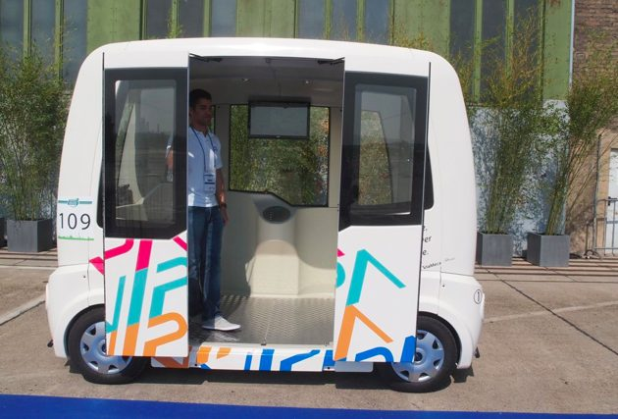
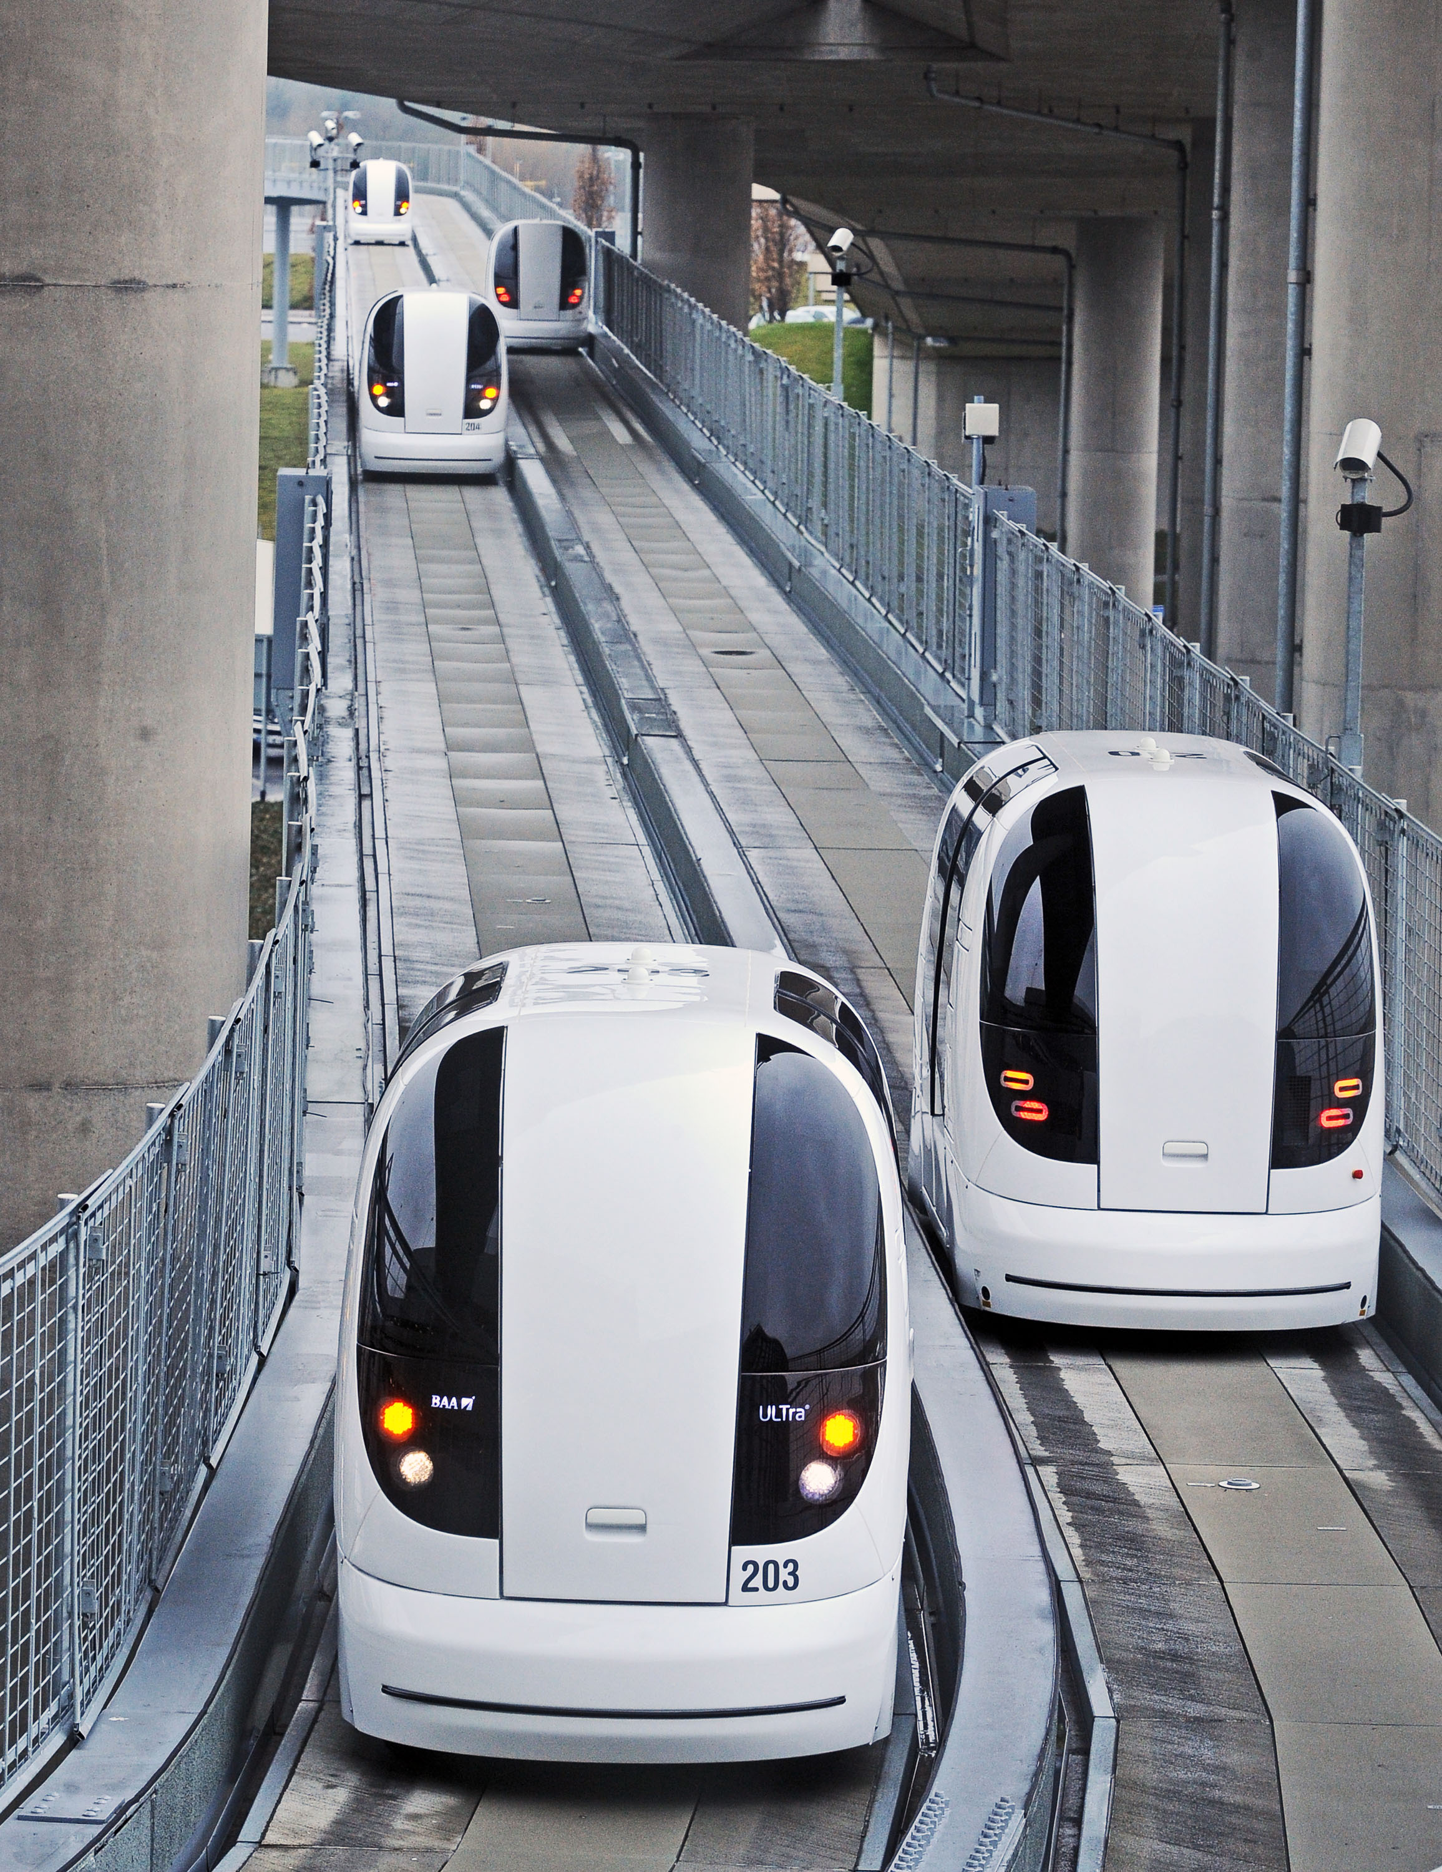
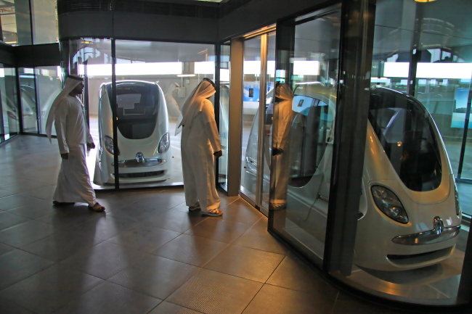
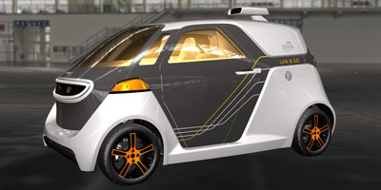
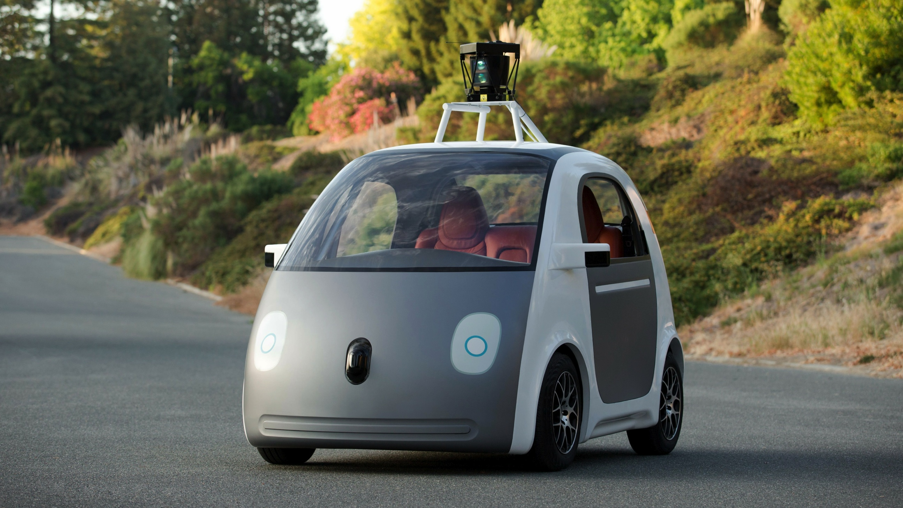
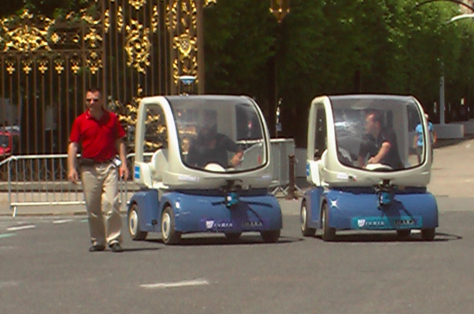
Development status of cybercars
Michel Parent, INRIA michel.parent@inria.fr

Slide 2
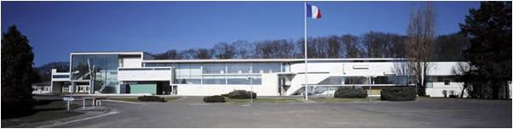
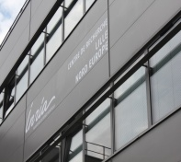

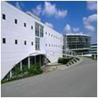
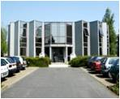
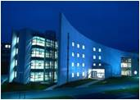
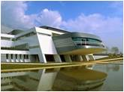
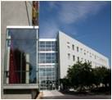
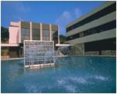
Inria Research Centers
Inria LILLE
Nord Europe
Inria PARIS - Rocquencourt
Inria NANCY
Grand Est
Inria SACLAY
Île-de-France
Inria RENNES
Bretagne Atlantique
Inria GRENOBLE
Rhône-Alpes
Inria BORDEAUX
Sud-Ouest
Inria SOPHIA ANTIPOLIS
Méditerranée
More than 4000 researchers from all over the world

Slide 3
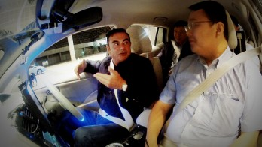
Carlos Ghosn (Renault/Nissan). Oct. 2013
I am committing to be ready to introduce a new ground-breaking technology, Autonomous Drive by 2020, and we are on track to realize it

Slide 4
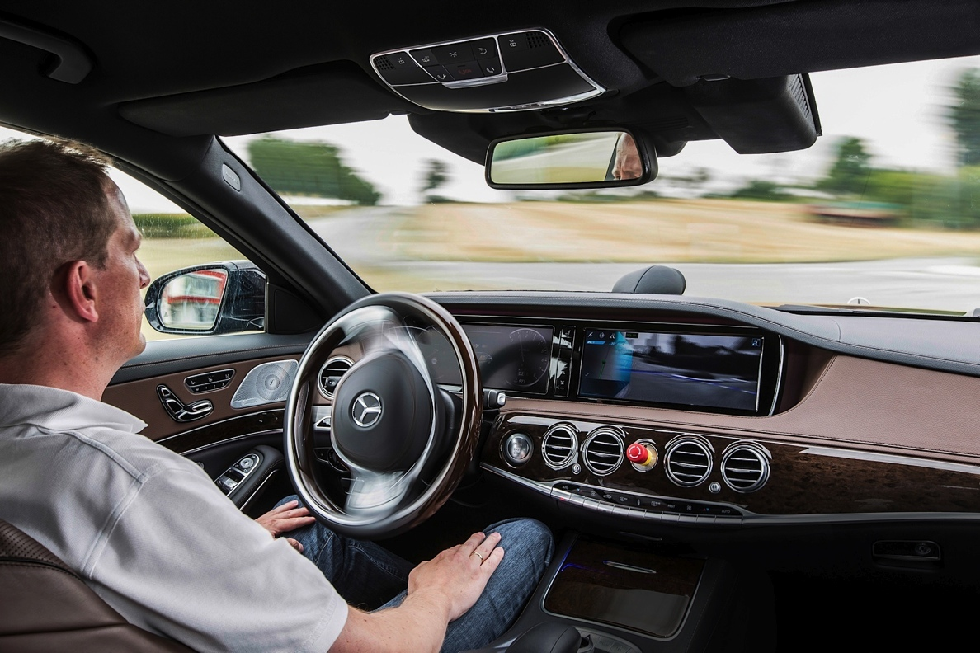
Daimler Autonomous Vehicles
"We want to be the first to launch autonomous functions in production vehicles. You can be sure: we will accomplish that in this decade," Thomas Weber, Daimler head of development said.
Autonomous
Mannheim-Pforzheim
trip in Sept. 2013

Slide 5
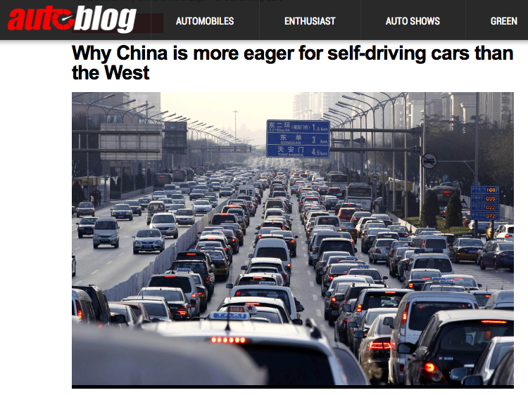

Slide 6
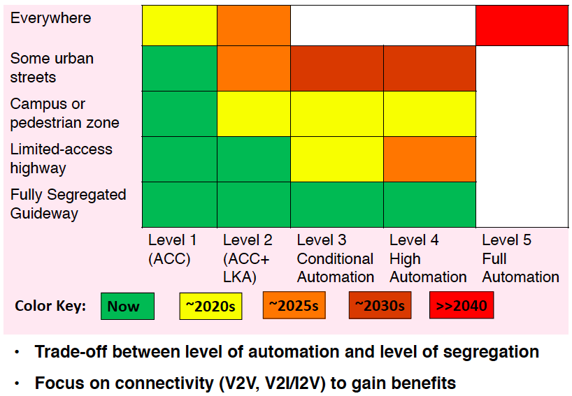
Deployment of SDC (seen by OEMs)

Slide 7











Connected Vehicles Projects

Slide 8
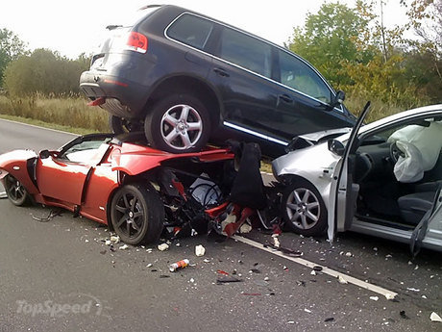
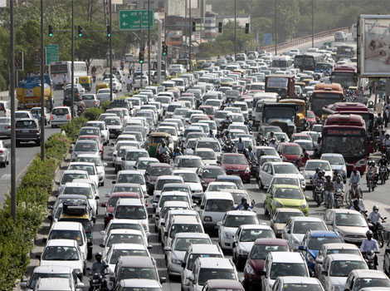
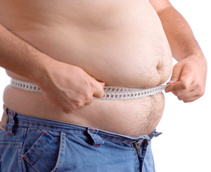
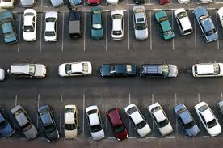
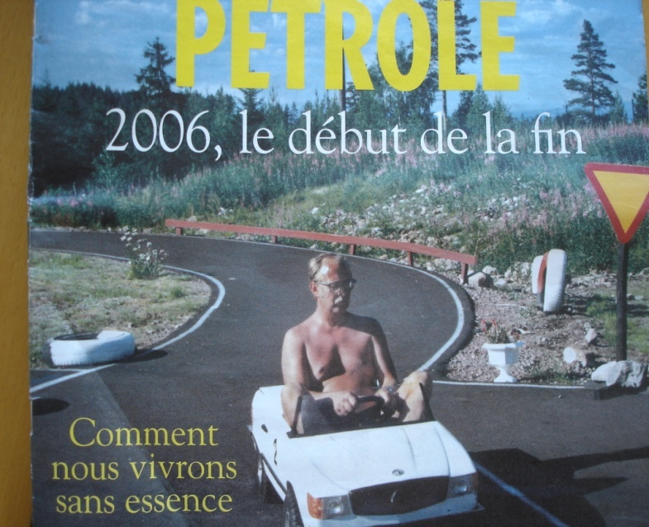
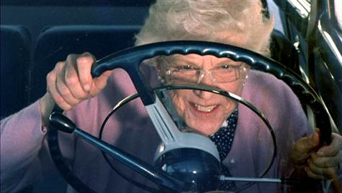
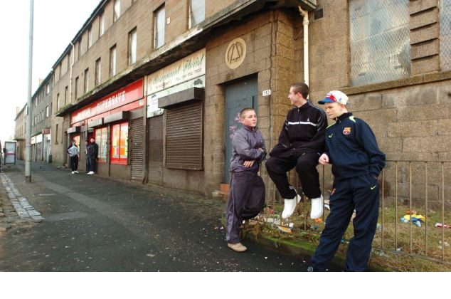
Problems of the automobile

Slide 9
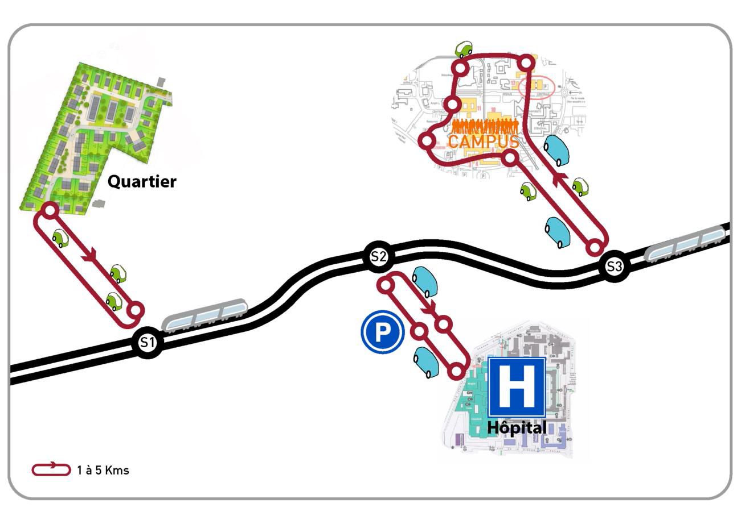
Multi-modality. Last Mile Link

Slide 10
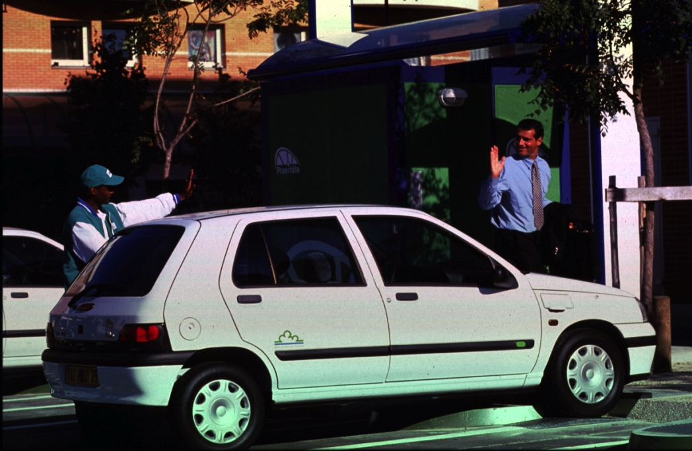

Praxitele (1993-1999)

Slide 11
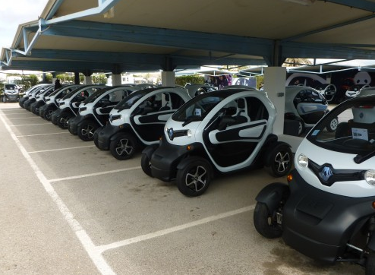

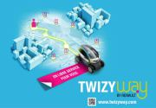

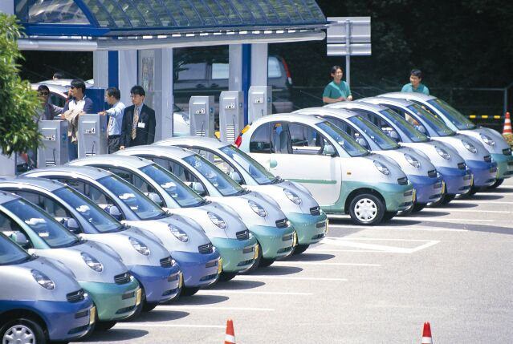
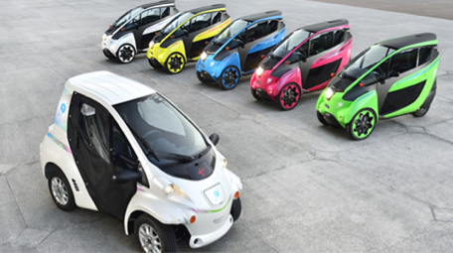
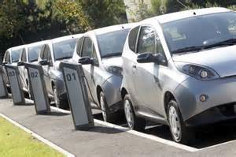
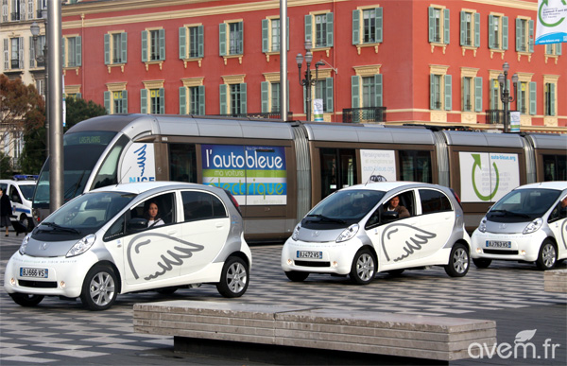
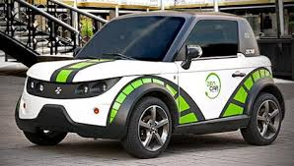

Car Sharing

Slide 12

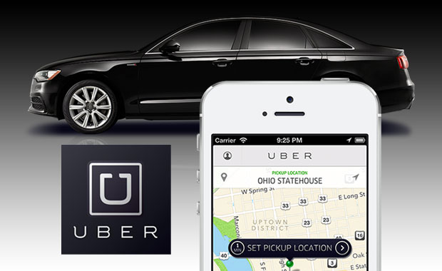



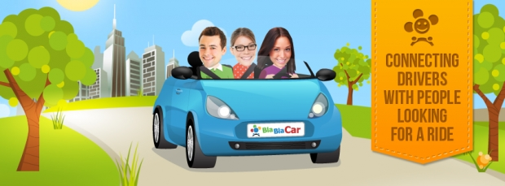

Economy of Sharing

Slide 13


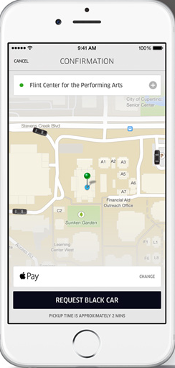

Electronic Payment

Slide 14
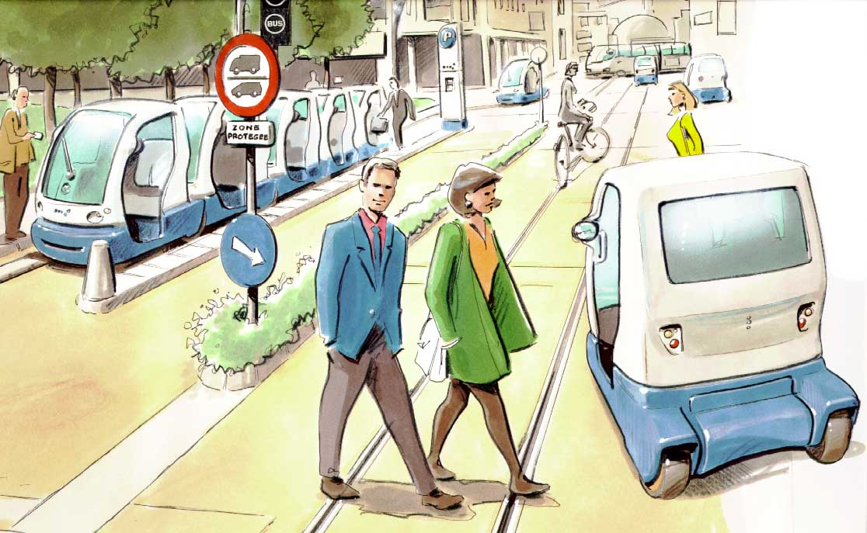
Concept INRIA/INRETS (1991)
Small Public Urban Vehicles
Assited driving
Platooning
Automated Parking
Automated tracks
Complement to
other modes

Slide 15
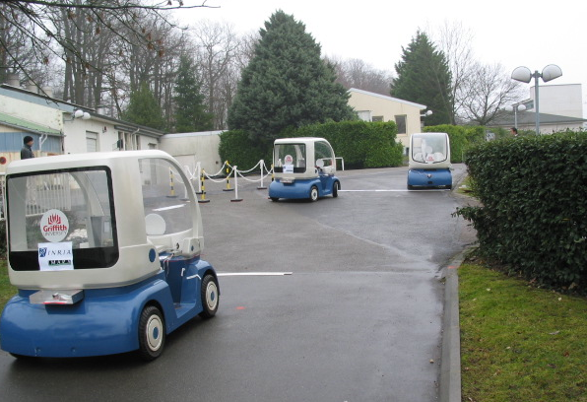
INRIA CyCab (1996)

Slide 16
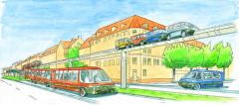

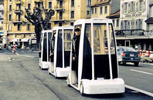
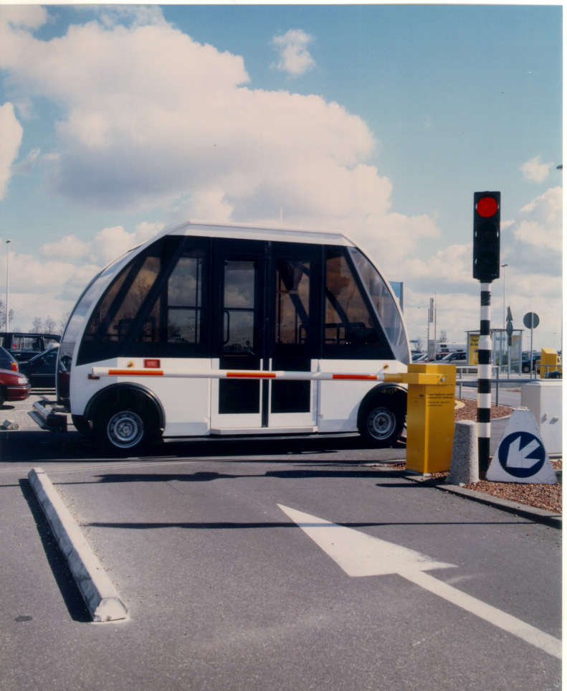
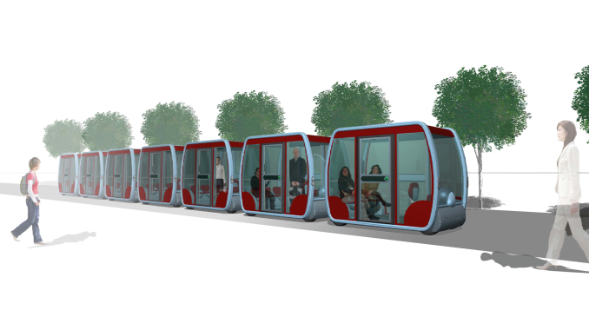
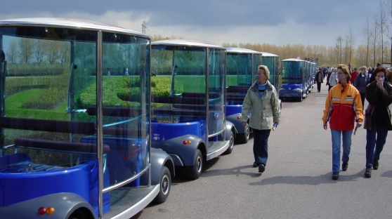
Cybercars Story
First concepts in 1990’s
First exploitation in 1997
CyberCars/CyberMove en 2001
Demonstrations Antibes en 2004
MobiVIP (2004)
CyberC3 (2005)
CyberCars2 (2006)
CityMobil (2006)
Cristal-CATS (2007)
CityNetMobil (2008)
CityMobil2 (2012)

Slide 17
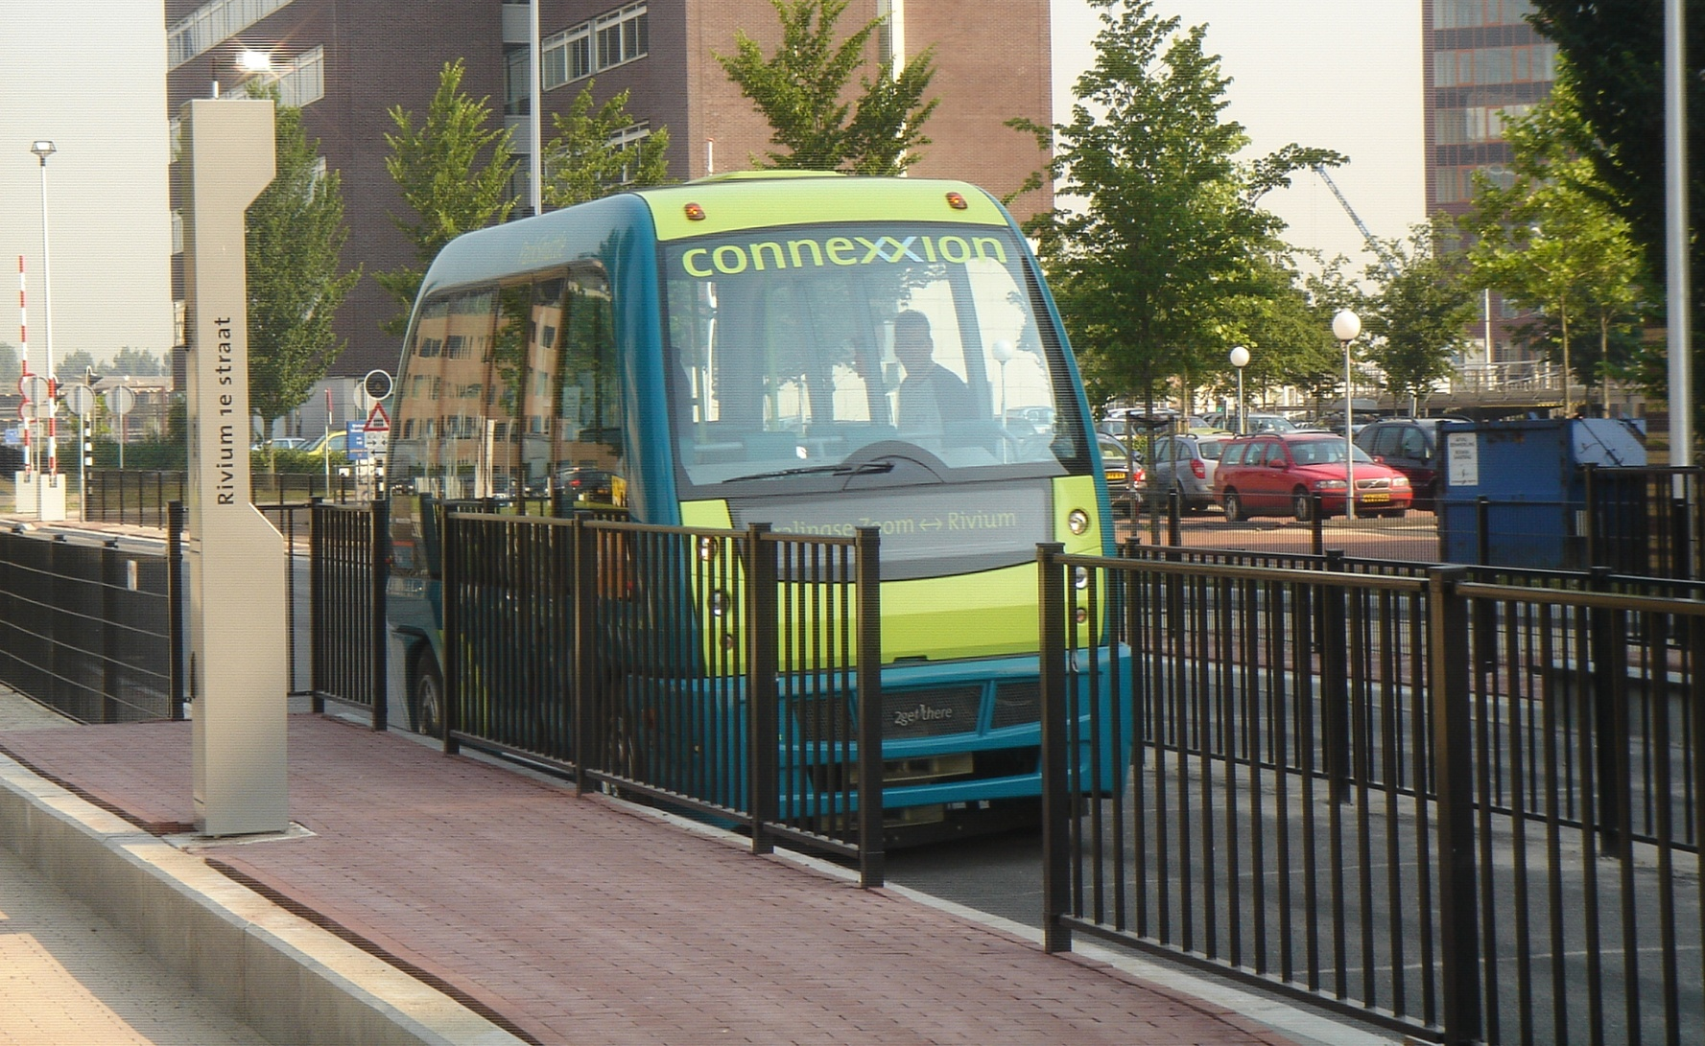
ParkShuttle-2 Rotterdam

Slide 18
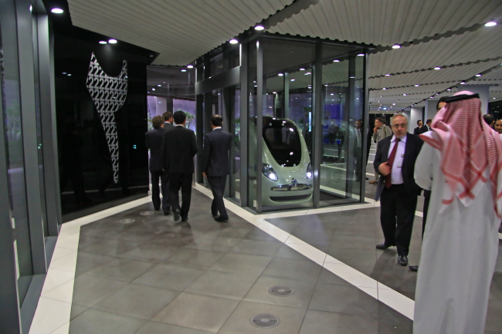
2GetThere – Masdar City (2010)

Slide 19
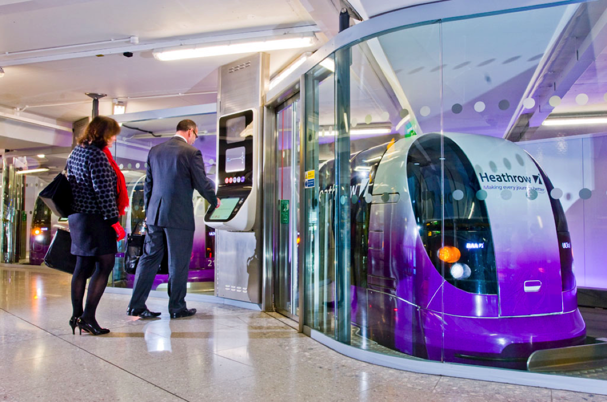
Heathrow Terminal 5 Station (2010)

Slide 20
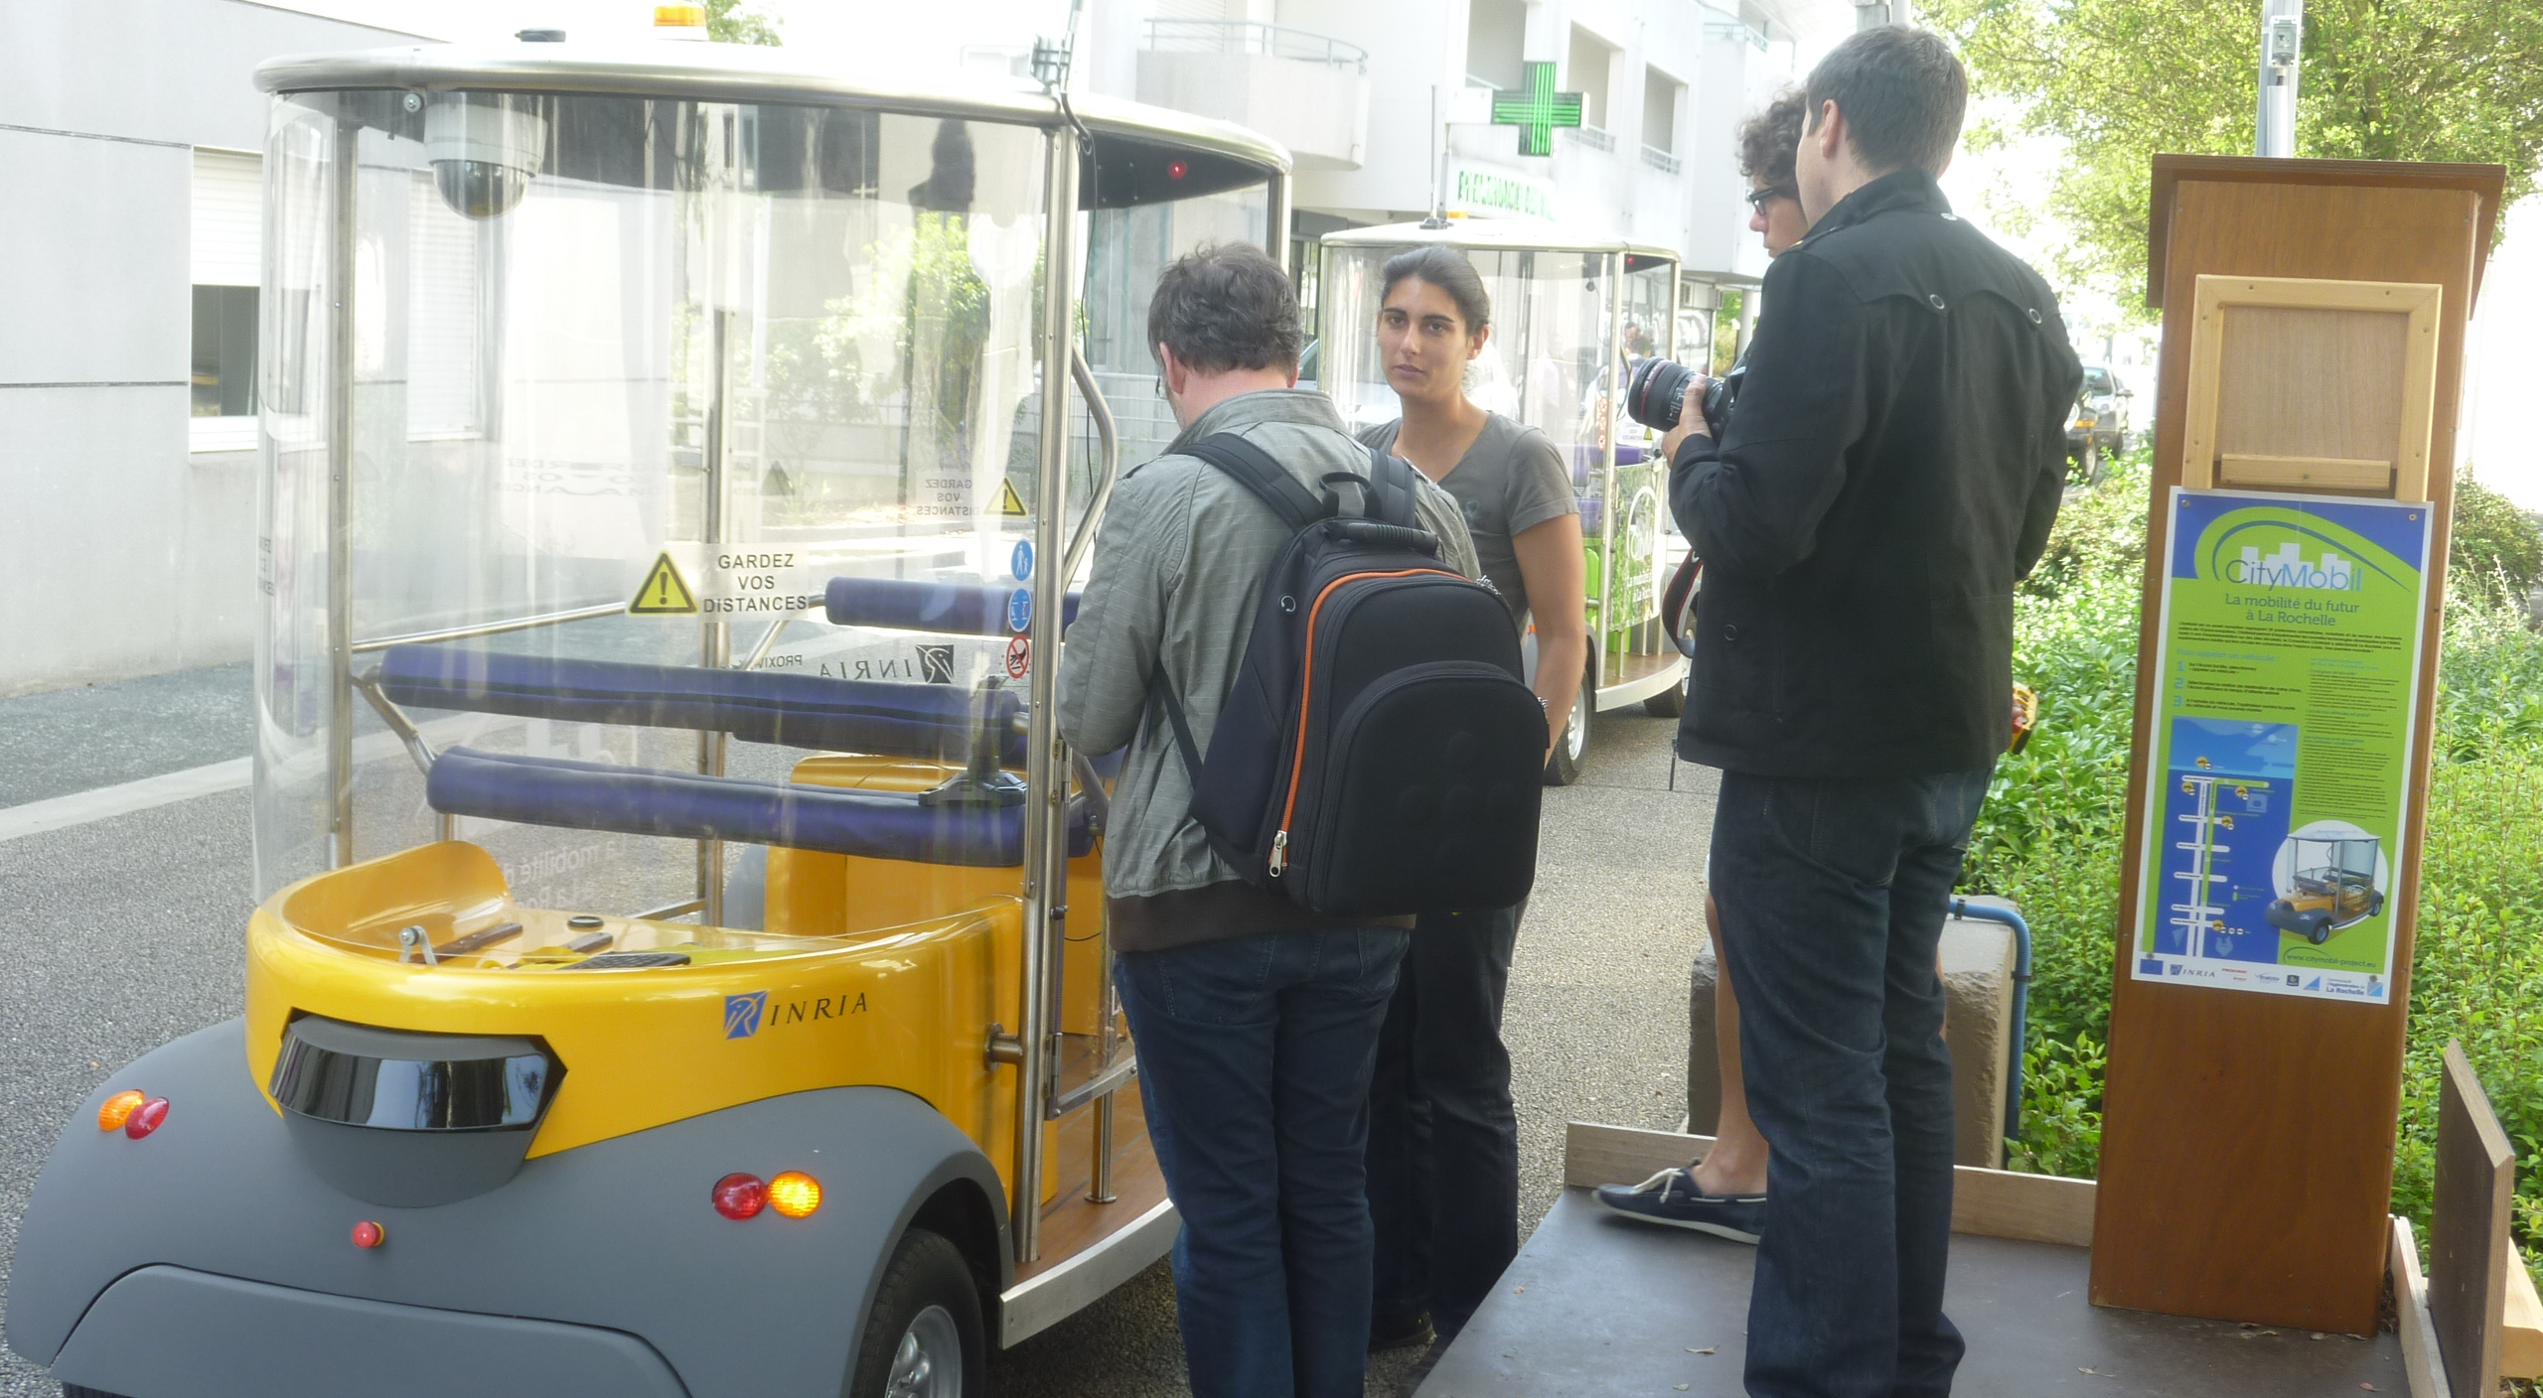
CityMobil in La Rochelle (2011)

Slide 21


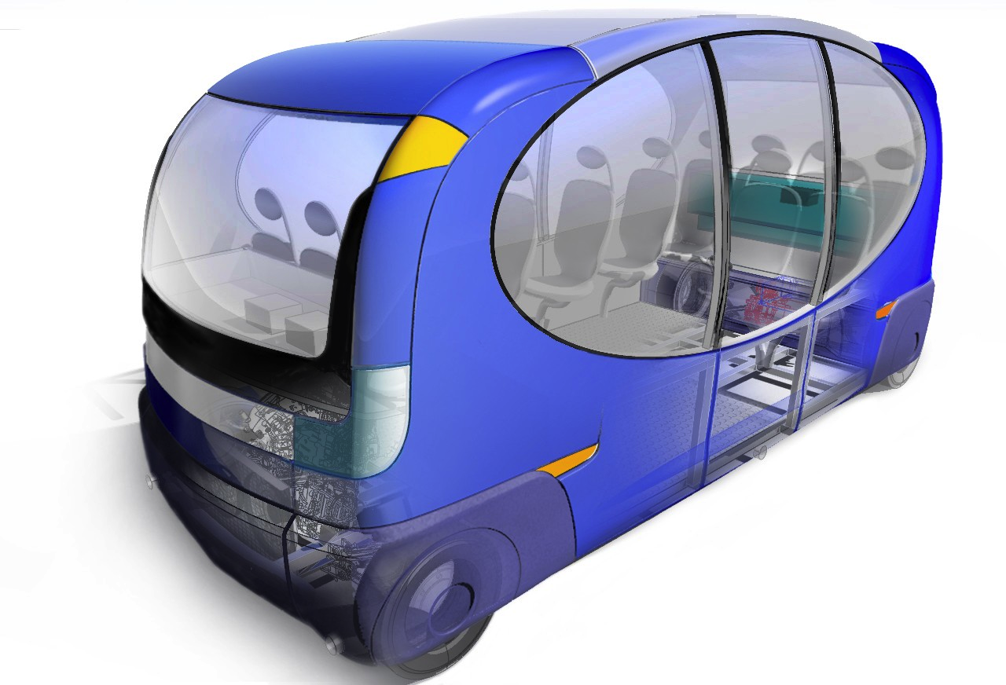

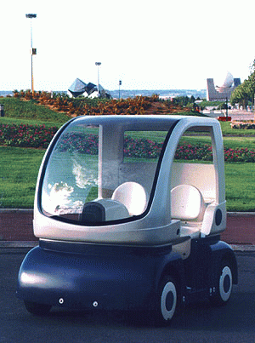







Slide 22
CityMobil2 (2012-2017)
5 manufacturers
12 cities
12 vehicles to be built
4 large scale demonstrations
10M€ funding from EC

Slide 23


Slide 24
Political Vision
In twenty years, only cybercars will be allowed to enter most cities in industrialised countries.
Senator Trégouët, March 2000

Slide 25
Topics for Discussion
Hardware/Software for ECUs and Communications
Precise localisation/Maps
Protection of systems (hackers)
Software certification
Standards
Field Operational Tests (FOT)
New road infrastructures for SDC
Vienna convention/Local legislation
Business models (road/city charging, tourism,…?)

Slide 26
Michel.Parent@inria.fr www.cybercars.fr www.citymobil2.eu
Merci

