Slide 1
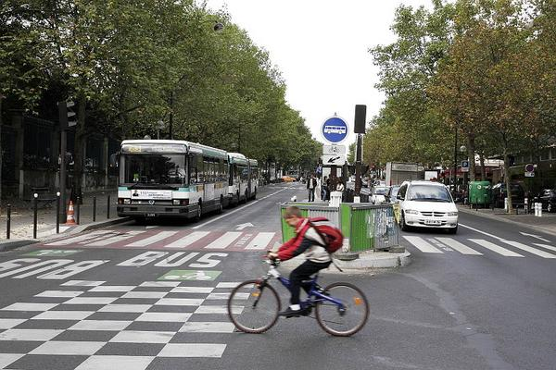

RIDESHARING IN PARIS REGION
Results of the EXPERIMENTATION LED BY the TRANSPORT AUTHORITY BETWEEN OCTOBER 2017 AND JUNE 2018
THNS 2019 « Villes intelligentes et systèmes de transports durables » – 6 november 2019
  Paris Region Institute
  Dany Nguyen-Luong
(c) ersinkisacik/Getty Images

Slide 2
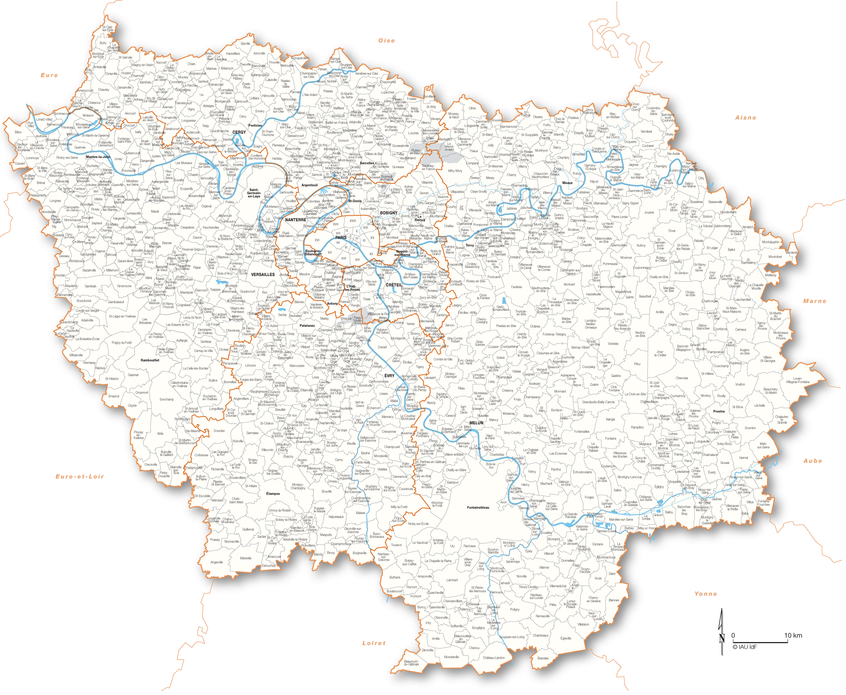
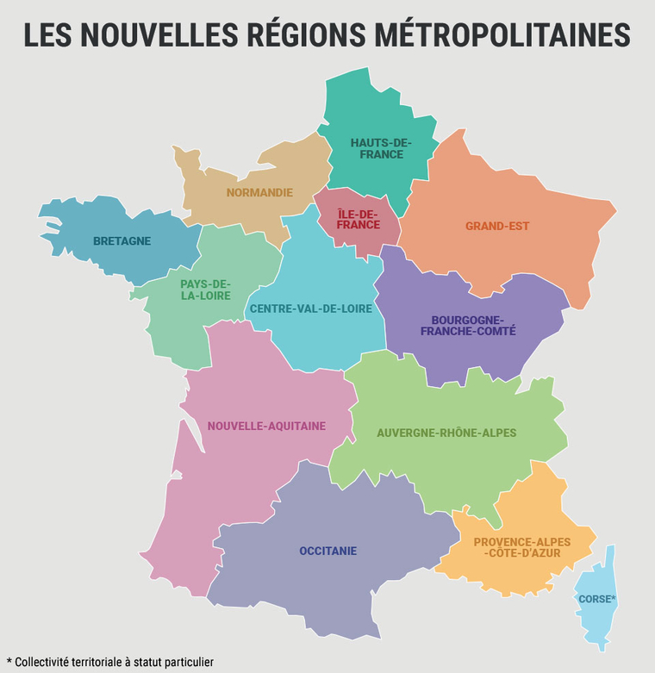
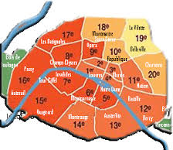
PARIS-ÎLE-DE-FRANCE REGION
Ring 1
Ring 2
Paris
Population : 12 M
Jobs : 6,1 M
Area: : 12 000 km² (Paris : 100 km²)
+ 2 rings
(1287 municipalities)

Slide 3
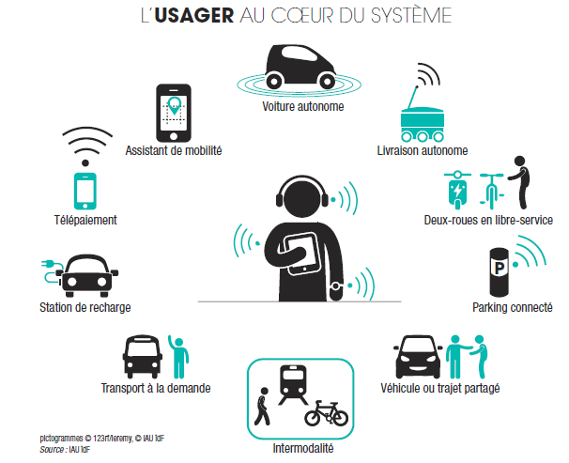
MOBILITY 3.0
The user at the heart of the system
Autonomous vehicle
Assistant of mobility
Autonomous logistics
Telepaiement
Free-floating vehicles
Charging station
Connected parking
Transport on demand
Ridesharing or carsharing
Intermodality

Slide 4
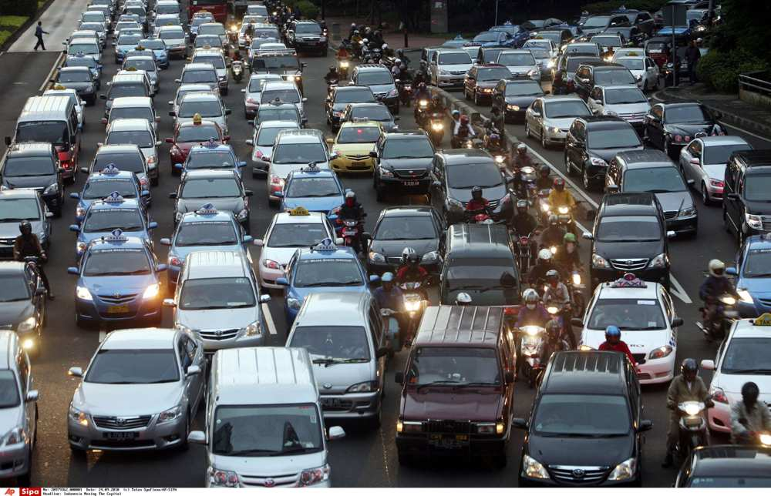

RIDESHARING : CONSIDERED AS A LEVER BY POLICY MAKERS AND TRANSPORT AUTHORITIES
Situation today in Paris Region : occupation rate 1.3 (1.06 for home-work) (source : HTS 2010)
So the ambient political speech is : short-distance ridesharing in Paris Region for daily commuting is still too underdeveloped.
Main obstacles are well known : fear of the unknown, obligation for a detour, financially inattractive, return unknown
Hence one possible incentive : financial subsidy. Île-de-France Mobilités (the Transport Authority) launched a large experimentation in october 2017 to test the impact of financial subsidies.
Notes:
An overall increase in mobilty : 41 million trips/per day registered
A majority of short-distance trips (average distance travelled is 4,4km)
In addition, the daily trips represent mainly short distances, under 10 km in average, and 50% of car travels represent less than 3 km. => suggesting there is a potential to unlocked for alternative modes of transport,
So there is a high potential to develop the use of AFVs. Alternative Fuel Vehicles
In 2010, the modal share of the 41 million trips per day observed in the Region is distributed as follows:
40%: active transportation mode (walking & cycling)
38%: motorized vehicles
20%: public transport
Increase in public transport use : +21%
Stability of road traffic at the regional scale, but spatial differentiation of car use locally with:
private car use significantly dropping within the city of Paris (-35%) while continuously increasing in the outer ring (+12%).
Future: rising mobility demand reflecting pop growth (2020: 12,4 million inhabitants againt 11 million today) and employemnt

Slide 5
LIMIT OF THE ANALYSIS : « INFORMAL » RIDESHARING
Home-Work ridesharing on-platform
Regular, distances at least 10 km long, average gain for the driver : 0,1 €/km/passenger.
Lever, operators can be subsidied.
Not exhaustive, because of two other ridesharing types :
1) « Informal » ridesharing : shopping, leisures, accompanying children, etc.
Occasional, short distances
=> Not interesting to subsidy
2) « Informal » Home-Work ridesharing off-platform : between colleagues, neighboors.
Impossible to quantify
=> Impossible to subsidy
Notes:
An overall increase in mobilty : 41 million trips/per day registered
A majority of short-distance trips (average distance travelled is 4,4km)
In addition, the daily trips represent mainly short distances, under 10 km in average, and 50% of car travels represent less than 3 km. => suggesting there is a potential to unlocked for alternative modes of transport,
So there is a high potential to develop the use of AFVs. Alternative Fuel Vehicles
In 2010, the modal share of the 41 million trips per day observed in the Region is distributed as follows:
40%: active transportation mode (walking & cycling)
38%: motorized vehicles
20%: public transport
Increase in public transport use : +21%
Stability of road traffic at the regional scale, but spatial differentiation of car use locally with:
private car use significantly dropping within the city of Paris (-35%) while continuously increasing in the outer ring (+12%).
Future: rising mobility demand reflecting pop growth (2020: 12,4 million inhabitants againt 11 million today) and employemnt

Slide 6
HOME-WORK TRIPS IN PARIS REGION
In 2010 (source HTS) : every day
7,1 millions H-W trips (go or return) all modes
43% by car -> 3 millions trips
40% are more than 10 km long -> 1,23 millions car trips
Among them, 60% have their origin in the second ring, 30% in the first ring and 10% in Paris.
=> Potential market of home-work ridesharing :
1,23 millions trips

Slide 7
EXPERIMENTATION : « ALL TOGETHER FOR CARSHARING »
Financial incentive paid to the operators :
Period 1 (T4-2017) : 1st october 2017 to 31 december 2017
  Maximum subsidy up to 50 000 € for each private operator (1 M € budget, 20 operators identified)
  2 € paid to the driver or the passenger for each trip.
Period 2 (T1 to T3-2018) : 1st january 2018 to 30 september 2018
  Maximum subsidy up to 200 000 € for each operator.
In case of exceptional conditions (strike, peak of pollution) :
  4€ paid by trip in the limit of 4000 € per day and per operator
  From 1st april 2018 to 30 june 2018 : SNCF strike, so « exceptional conditions »
Notes:
An overall increase in mobilty : 41 million trips/per day registered
A majority of short-distance trips (average distance travelled is 4,4km)
In addition, the daily trips represent mainly short distances, under 10 km in average, and 50% of car travels represent less than 3 km. => suggesting there is a potential to unlocked for alternative modes of transport,
So there is a high potential to develop the use of AFVs. Alternative Fuel Vehicles
In 2010, the modal share of the 41 million trips per day observed in the Region is distributed as follows:
40%: active transportation mode (walking & cycling)
38%: motorized vehicles
20%: public transport
Increase in public transport use : +21%
Stability of road traffic at the regional scale, but spatial differentiation of car use locally with:
private car use significantly dropping within the city of Paris (-35%) while continuously increasing in the outer ring (+12%).
Future: rising mobility demand reflecting pop growth (2020: 12,4 million inhabitants againt 11 million today) and employemnt

Slide 8
8 OPERATORS AS PARTICIPANTS
Period 1 : 8 operators (out of 20 on the french market)
Blablalines, Citygoo, Covivo, Ecov, IdVroom, Karos, Klaxit, OuiHop
Period 2 : 6 operators
Withdrawal of Citygoo, whose usage looked like disguised taxis and of Covivo who didn’t comply with the convention.
Notes:
An overall increase in mobilty : 41 million trips/per day registered
A majority of short-distance trips (average distance travelled is 4,4km)
In addition, the daily trips represent mainly short distances, under 10 km in average, and 50% of car travels represent less than 3 km. => suggesting there is a potential to unlocked for alternative modes of transport,
So there is a high potential to develop the use of AFVs. Alternative Fuel Vehicles
In 2010, the modal share of the 41 million trips per day observed in the Region is distributed as follows:
40%: active transportation mode (walking & cycling)
38%: motorized vehicles
20%: public transport
Increase in public transport use : +21%
Stability of road traffic at the regional scale, but spatial differentiation of car use locally with:
private car use significantly dropping within the city of Paris (-35%) while continuously increasing in the outer ring (+12%).
Future: rising mobility demand reflecting pop growth (2020: 12,4 million inhabitants againt 11 million today) and employemnt

Slide 9
RESULTS : AN IMPORTANT GROWTH RATE …
Number of shared trips per period
Source : IDFM
Within constant perimeter, *3 of the number of trips between T4-2017 and T2-2018. But T2-2018 was a period of strikes in railways.
RIDESHARING IN PARIS REGION
6 november 2019

Slide 10
… BUT THE VOLUMES ARE STILL NEGLIGIBLE
In Paris Region, 16 millions car trips every day and 1,23 millions as the potential for H-W purpose.
June 2018 : only 1 222 shared car trips per day (so only 1‰ captured)
6 operators
8 operators
6 operators
average
T4-2017
T1-2018
T2-2018
Source : IDFM
RIDESHARING IN PARIS REGION
6 november 2019

Slide 11
RESULTS BY HOUR
Shared trips are mainly made during commute hours.
Source : IDFM
RIDESHARING IN PARIS REGION
6 november 2019

Slide 12
RESULTS BY RING ORIGIN-DESTINATION
Shared trips are mainly made from and/or to the second ring (75%).
Source : IDFM
RIDESHARING IN PARIS REGION
6 november 2019

Slide 13
RESULTS BY USAGE FREQUENCY
Most passengers rideshare only one month. Only 10% have participated during 6 months to the experimentation.
Same observation for the drivers : 50% only have rideshared during one month and 30% during 3 months.
So all operators meet problems of fidelity.
Possible explanations :
The service is not satisfactory.
The ridesharing is organised off-platform once the matching has been made.
The ridesharing meets specific needs.
=> To know, a survey has to be conducted.
RIDESHARING IN PARIS REGION
6 november 2019

Slide 14
RESULTS BY OPERATOR : A MODEST RESULT EXCEPT FOR KAROS
But a suspicion of fraud by Karos users.
Ecov : a serious disillusion (buzz three years ago).
Then a « register of ridesharing proof » has been set up
by the goverment.
Source : IDFM
RIDESHARING IN PARIS REGION
6 november 2019

Slide 15

AFTER SEPTEMBER 2018, WHAT HAPPENED ?
IDFM (the Transport Authority) decided to extent the experimentation.
IDFM decided to increase the subsidy amounts from the 1st may 2019 :
For passengers Navigo customers: 2 trips per day are offered.
For drivers: an insured benefit of 1.5€ to 3€ per trip depending on the distance travelled. Possibility to cumulate the benefits if there are several passengers (maximum 2 trips per day per driver).
That means up to 264€ per month for drivers with 2 passengers.
The market is concentrating : in 2019, Klaxit bought IDVroom, Ecov bought Ouihop
RIDESHARING IN PARIS REGION
6 november 2019

Slide 16
AFTER SEPTEMBER 2018, WHAT HAPPENED ?
Some results were provided by the national register for june 2019.
The average in june 2019 is 2500 shared trips per day .
So from T2-2018 to T2-2019, the growth rate per trimester is +20%.
So the growth observed in the beginning has slowed down sharply after september 2018.
Will we reach a threshold, despite the last incentives from may 2019 ?
Or with a steady growth rate of 20% per trimester, it would take about 7 years before reaching the critical mass while the transport authority will keep on paying, thus increasing the subsidy budget ?
RIDESHARING IN PARIS REGION
6 november 2019

Slide 17
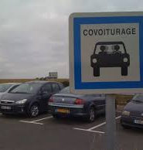
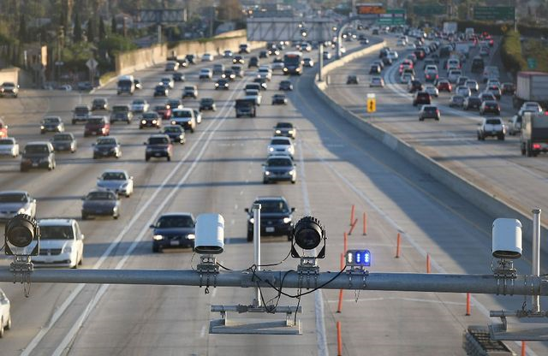
CONCLUSION
Ridesharing in Paris Region through platform is still marginal, even if we observe thanks to a financial incentive a growth dynamics but which has slowed down rapidly.
But the suspicion of fraud to benefit the subsidy hangs over the whole system.
Financial incentive seems not enough to reach massification of ridesharing.
Other public actions may be implemented, to permit gains of time and not gains of money. For example : development of ridesharing hubs, development of dedicated lanes on highways and on main secondary roads (HOV lanes) complemented with a penalty for those who have no passengers (SOV lanes).
RIDESHARING IN PARIS REGION
6 november 2019

Slide 18

Thanks for your attention
Email : dany.nguyen-luong@institutparisregion.fr
RIDESHARING IN PARIS REGION
6 november 2019

