Slide 1


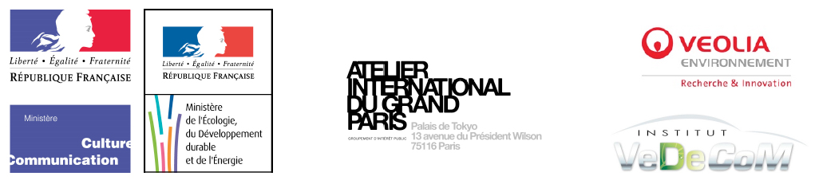
The Sino-French “Atelier of metropolitan mobility” in CAUP – Tongji supported by public research in :
1. Urban democracy and territorial regulation (POPSU2 - MEDDE)
2. City of “short distances”, the roles of tramway and light rails in urban context
(IMR - Ignis mutat res – MCC/MEDDE/AIGP/VEOLIA/VEDECOM)
Cristiana Mazzoni, professor in ENSAS
ZHUO Jian, professor in CAUP-Tongji
FAN Lang, assistant professor in ENSAS
YANG Chen, assistant professor in CAUP-Tongji

Slide 2
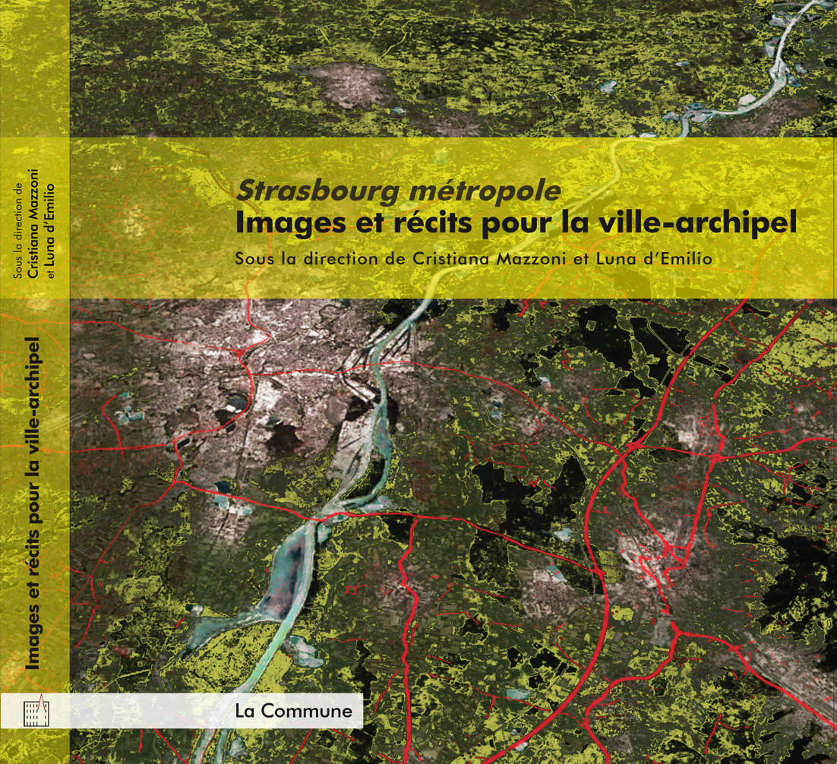

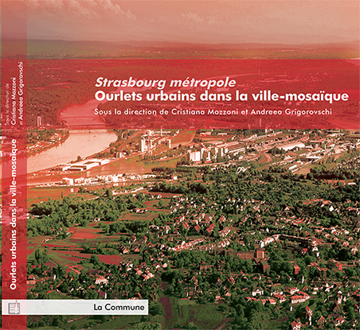

« Strasbourg, between ville-archipel and ville-mosaïque »
Publications financed by POPSU 2-MEDDE/CUS/ADEUS/AMUP
Mobility infrastructures as important public spaces
in the city of “short distances”

Slide 3
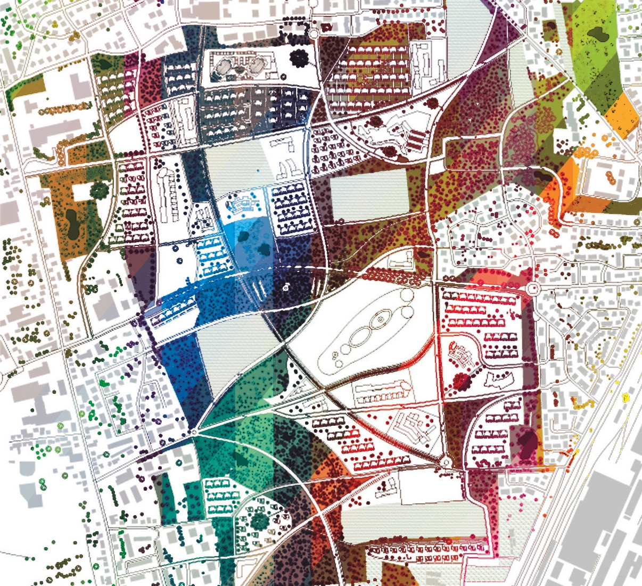
Urban democracy and territorial regulation (POPSU2 - MEDDE) ©Georges Heintz-ENSAS

Slide 4
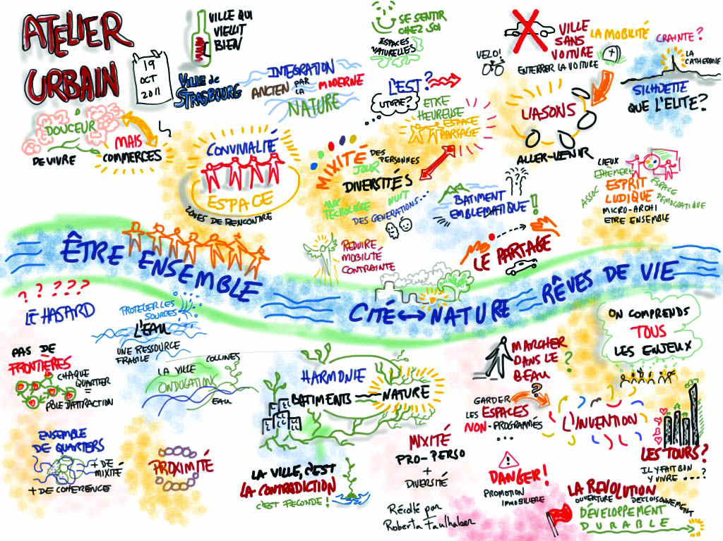

Slide 5
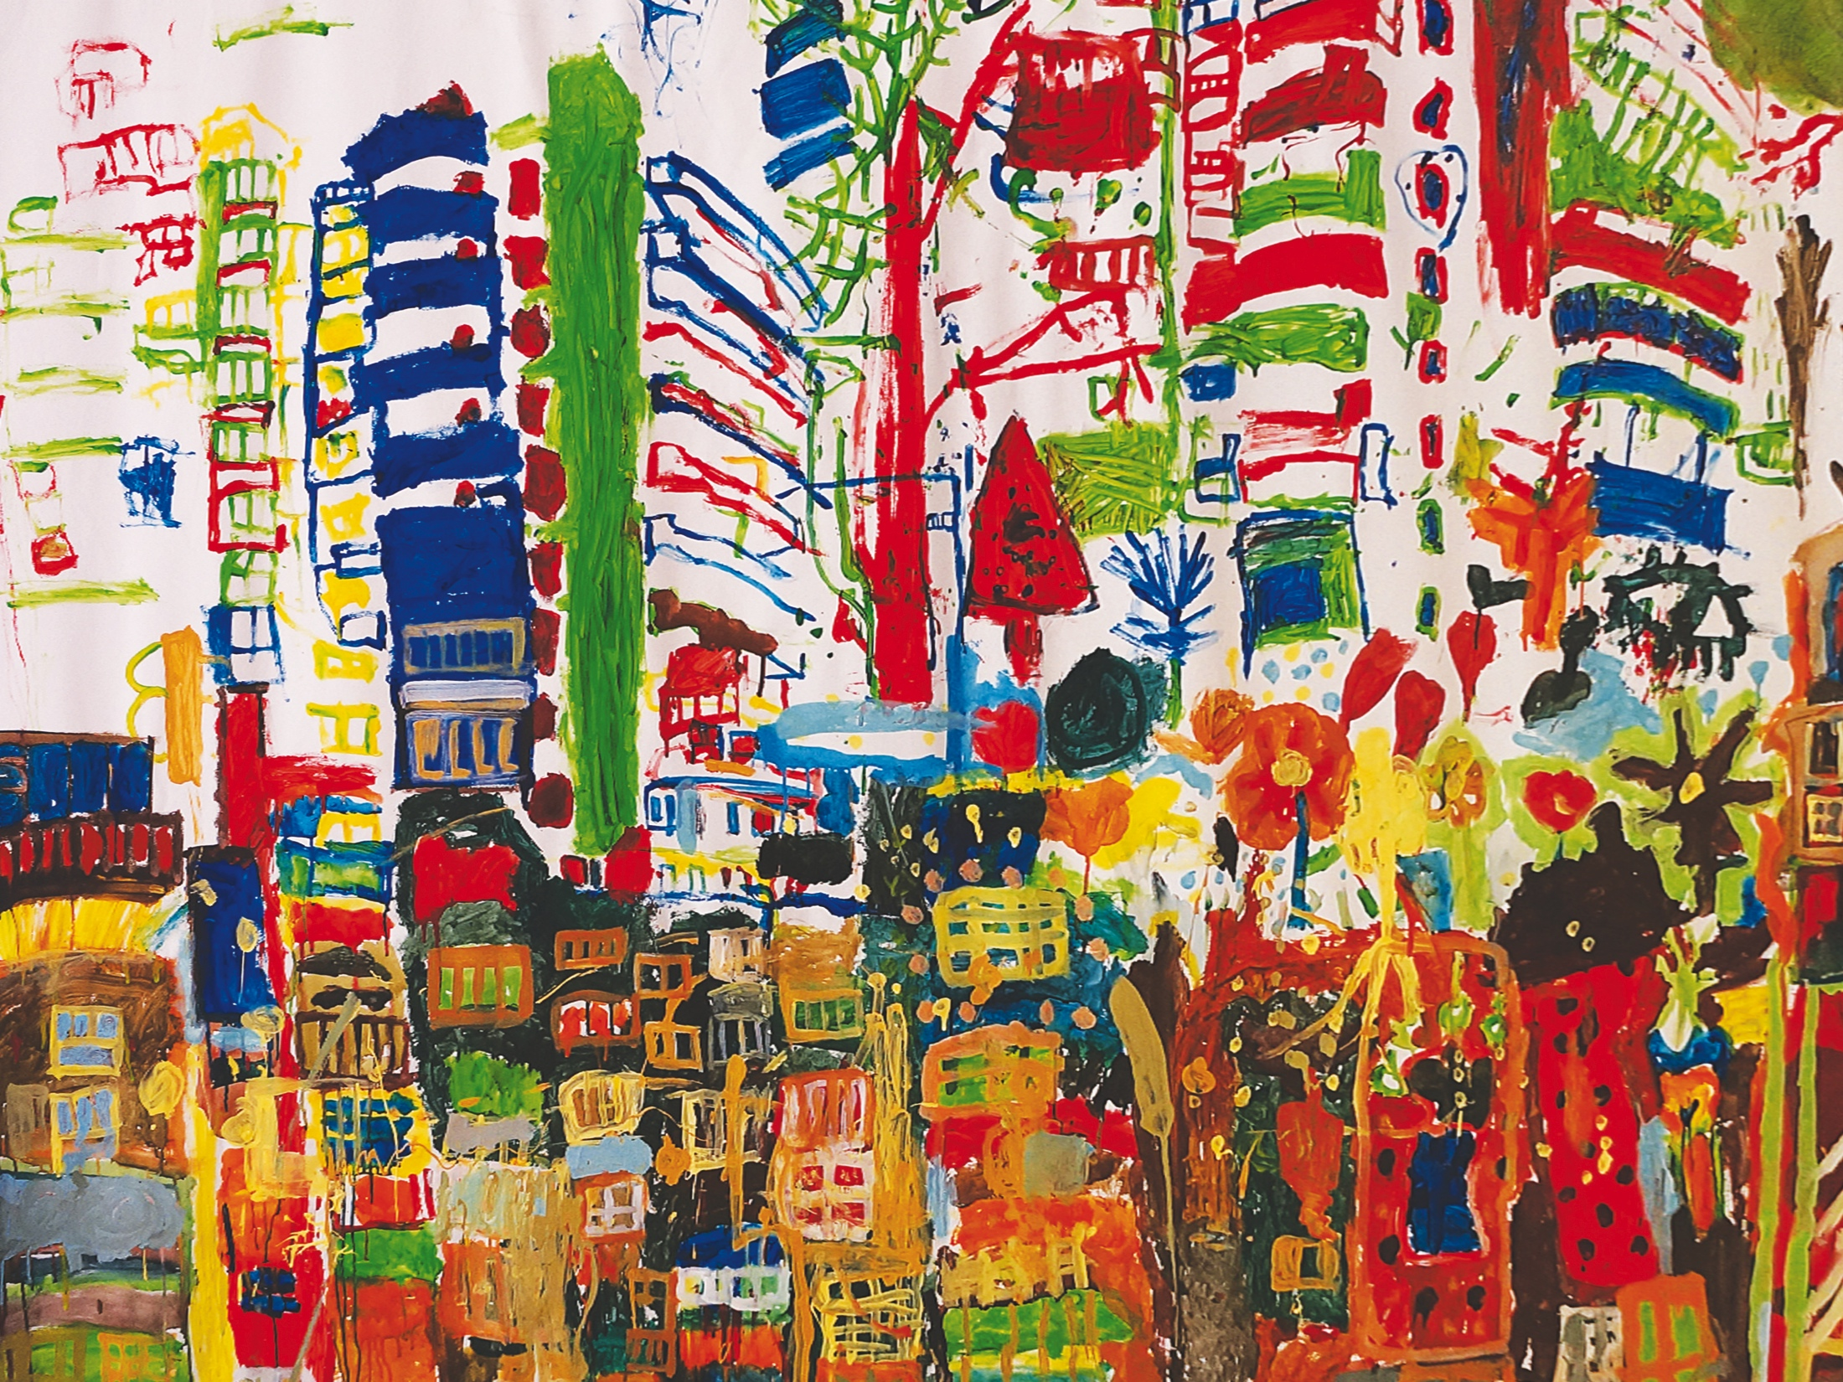

Slide 6

Strasbourg - the Port
Urban “energy”
Ignis mutat res – MCC

Slide 7
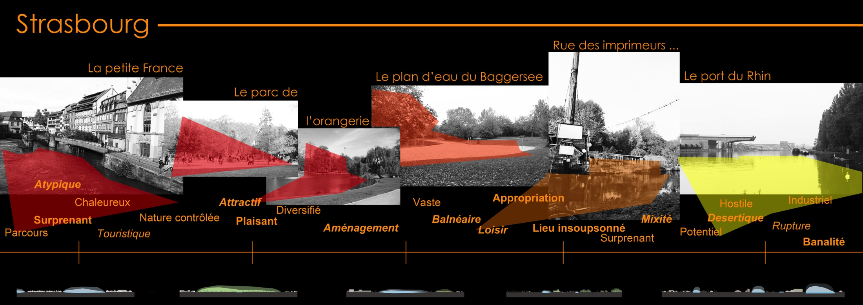
The Sino-French “Atelier of metropolitan mobility” :
Mobility infrastructures, “sensitive analysis” of territory
Dialogue between city representatives and researchers

