Slide 1
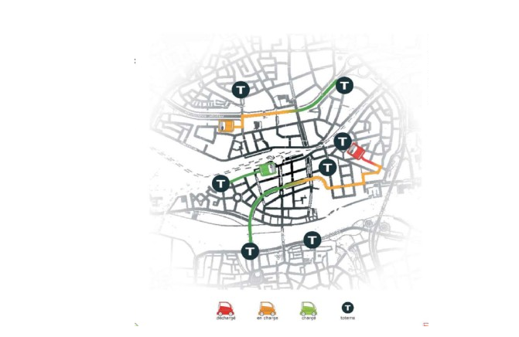
Green
Technologies for Green Cities
绿色科技 – 绿色城市 – 中国
in
China
Presentation
MACAUTO
Ltd
MACAUTO
Ltd
项目介绍
75 rue de Lourmel
75015 PARIS - France
Tél : (0033)1 40 33 40 80
Fax : (0033)1 40 33 40 10
@ : macauto.systeme@free.fr
Meeting Chine – France Wuhan
中法 中国武汉
September16 -18, 2014
2014.09.16 - 2014.09.18
MACAUTO Ltd - FRANCE

Slide 2
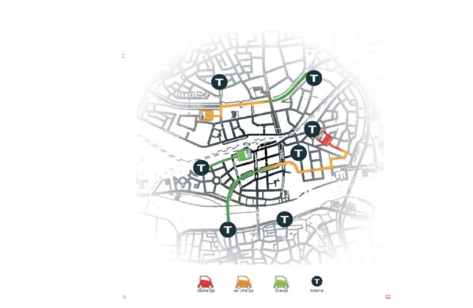
Green Technologies for Green Cities in China
_{The solutions that we bring}
项目目标
Reduce pollutions
international recognition
Attracting foreign companies
Promotion city
Mobility challenges
降低污染
国际影响
吸引外资
城市推广
交通挑战
1
-
2
-
3
-
4
-
5
-
MACAUTO

Slide 3
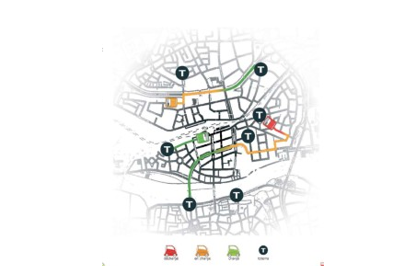

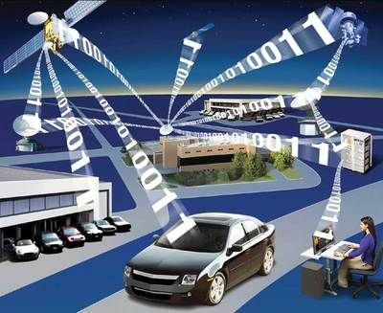
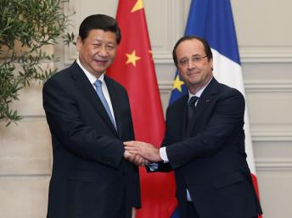
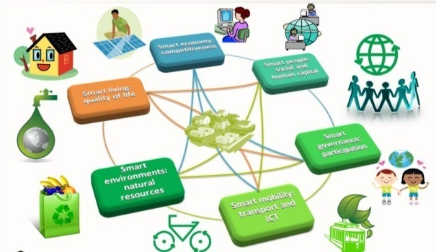
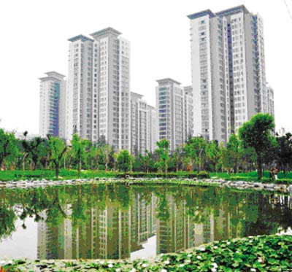
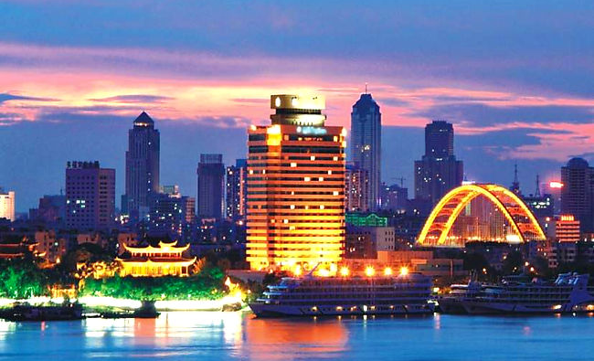
Electric vehicule sharing system
The electric vehicle statement
电动车租用系统优越性介绍
Smart system
High technology 高科技
Foreign cooperation
+
+
智能系统
外资合作
MacAuto
Will bring us:
MacAuto 为我们带来：
Smart city 智能城市
Clean city 清洁城市
International city 国际都市
+
+

Slide 4
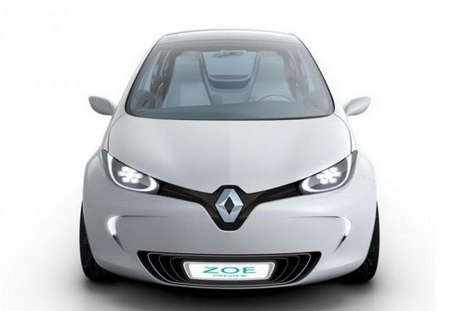

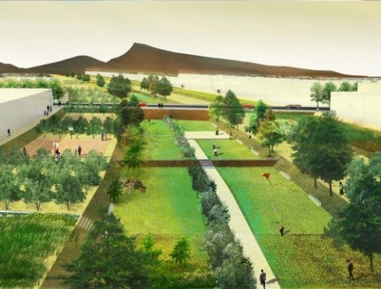
Electric vehicule sharing system
The electric vehicle statement
电动车租用共享系统介绍
Electric Cars
Sharing 分享
Traffic Decongestion
+
+
电动汽车
交通疏导
MacAuto
solution: Self Service
MacAuto 的解决方案：自助服务
Reduces
congestion
减少拥堵
Decreases
pollution in the
city center
减少市中心污染
Supporting future electric vehicles
支持电动汽车
未来发 展
Reduce the number of individual cars
减少私人汽车数量
+
+
+

Slide 5

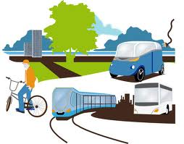

Electric vehicule sharing system
L’expérience de MacAuto
_{Advantages of this system}
系统将会带来的发展优势
MacAuto
solution: High-technology
MacAuto 的解决方案：高科技系统
Clean transportations
环保交通
Foreign cooperation
外资合作
International recognition
城市国际影响力

Slide 6
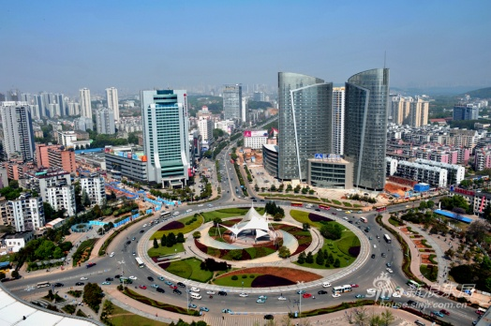
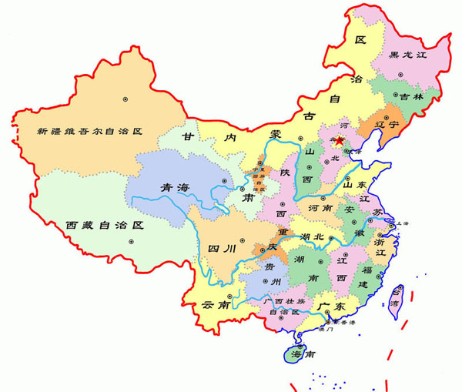
Electric vehicule sharing system
L’expérience de MacAuto
_{Advantages of this system}
系统将会带来的发展优势
International recognition 城市国际影响力
MACAUTO
Wuhan City 武汉
A modern and smart transportation system, like MacAuto, can bring international recognition to a city like Wuhan.
MacAuto现代智能交通系统，将会为城市带来国际影响力

Slide 7
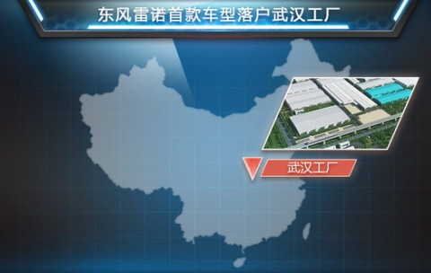
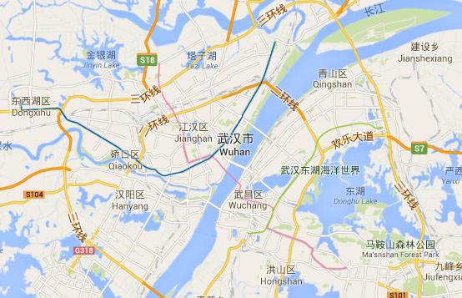

Electric vehicule sharing system
L’expérience de MacAuto
_{Advantages of this system}
系统将会带来的发展优势
MACAUTO
Attracting foreign companies 吸引外资
Renault-Dongfeng Factory
in Wuhan
Wuhan 武汉
Renault-Dongfeng Factory has settled down in Wuhan.
东风雷诺在武汉建立生产基地
MacAuto system will help increase employment and activity in the city. It will also help attract foreign companies, especially innovation and hightech companies.
MacAuto系统有助增加就业和吸引外商外资企业，特别是创新型企业和高科技技术企业。

Slide 8
Electric vehicule sharing system
L’expérience de MacAuto
_{Advantages of this system}
系统将会带来的发展优势
Promotion city 城市推广
MACAUTO
Wuhan 武汉
A city equipped with MacAuto will be a globally recognized reference for solving problems like pollution and congestion. With MacAuto, Wuhan can show itself to the world as a smart city.
建设有MacAuto系统的城市可以成为世界范围内解决污染交通拥挤等问题的智能城市典范。

Slide 9
Electric vehicule sharing system
L’expérience de MacAuto
_{Advantages of this system}
系统将会带来的发展优势
Mobility challenges 交通挑战
MACAUTO
Wuhan 武汉
All the big cities in the world are facing the mobility challenges. Together with MacAuto, Wuhan may explore the solutions to that challenge and be an example for the whole world.
面对世界范围内普遍存在于大城市的交通挑战，MacAuto可以与武汉市一起探索解决这一问题的方案。

Slide 10
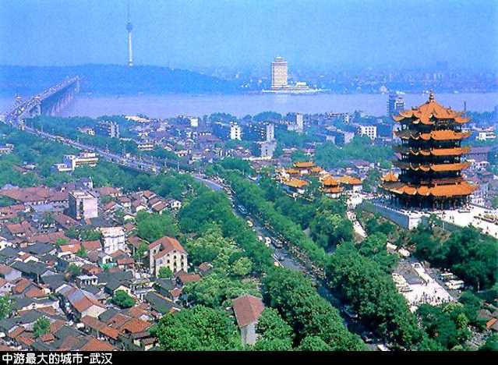
Green Technologies for Green Cities in China
_{The solutions that we bring}
New Wuhan with MacAuto
共筑新武汉
MACAUTO

Slide 11
Green
Technologies for Green Cities
绿色科技 – 绿色城市 – 中国武汉
in Wuhan, China
MACAUTO
MACAUTO
Ltd
Ltd
Address: 75 rue de Lourmel
75015 PARIS - France
Tel : (0033)1 40 33 40 80
Fax : (0033)1 40 33 40 10
Mail : macauto@free.fr
Thank you !
谢谢！

