Slide 1

Hervé de Tréglodé
Director
RedPanda Co.
Before TongJI university
Lyon, November 2019

Slide 2
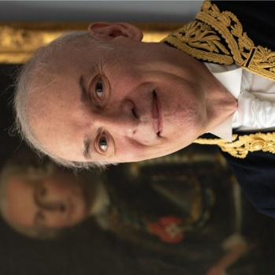

Who am I?
Graduate of Ecole polytechnique and Mines ParisTech (Top 1, France)
High official in French Ministries of Industry, European affairs, Agriculture, Ecology, Transport
Director - French national railways (SNCF) – 10 years
Deputy CEO - French rail network (RFF) – 14 years
Inspector General near the Minister of Ecology and Transport – 7 years
Founder of RedPanda Co.

Slide 3

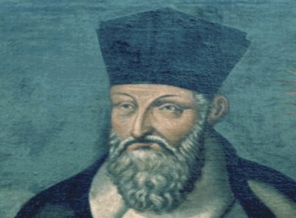
Two main consultancy services
RedPanda Co. seeks French or European high-level consultants requested by Chinese companies. Management consulting only: improvement & development of industrial operations mainly
Although far behind Europe and North America, consulting market is rapidly expanding in China.
Foreign high-end consultants can help Chinese companies to compete with the best ones in the world.
French high-end consultants are most often pleased and honored to travel to China. As Matteo Ricci (d. 1610).
RedPanda Co. sets up links between French or European companies and Chinese companies
Smaller French or European companies too often don’t have enough time and money to explore alone Chinese market.
An example: cooperation sought by a French company (TK’Blue) in Zhejiang

Slide 4
TK'Blue makes managing the environmental impact of your transport, a lever for your economic performance
Methodology & tools to measure and monitor the reduction of CO₂ / GHG emissions and negative externalities of freight transport
For a sustainable transport development.
08.2019
Notes:
tool for collecting information from more than 50 countries wide world and, more importantly, able to calculate the environmental impact of our operations.
Experience
Evolution
certified

Slide 5

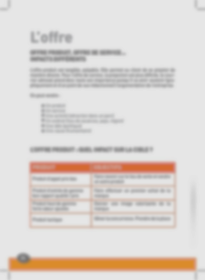

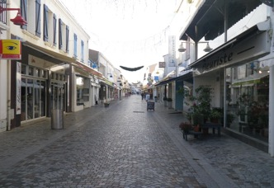
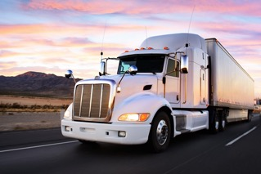

The constraints of the supply chain Management
Know your subcontractors performances
Congestion, Accidents,
Pollution
Dumping
Subcontractors proposals are transparent ?
Urban constraints and last mile delivery / collection
Equipment to the latest standards ?
Ensuring service quality

Slide 6







The business expectations of TK’Blue customers
Reduce the costs caused by low quality transport operations (late deliveries, breakage, theft,...)
Measure my subcontractors transport service performance, manage and ensure their sustainable progress
Enhance internal purchasing processes and transport tenders. Answer precisely the tenders from customers
Be compliant with CO₂ / GHG, CSR regulations and goals according your customers expectations
Comply with subcontractors social and tax regulations
Help promote your company with investors
Communicate on progress, value the efforts of your teams, improve your company’s corporate image with customers, employees, candidates and local authorities.

Slide 7

































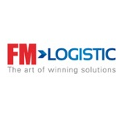
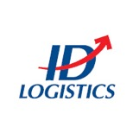









TK’Blue, a full SaaS company: vision and mission
Extra-financial rating agency dedicated to transportation (Founded 2011) offering methodology and tools to measure / rate / monitor / improve and publish the reduction of GHG freight transport emissions
SCOPE:WTW GHG EMISSIONS
Pollutant Emissions
Negative externalities societal costs
EASE OF USE
SaaS web platform 7/24,
EN/FR/ES
Ticketing support system
Local agents (DE, ES, CH, AT, AU, UK, LATAM, expanding)
EXPERTISE/
TRANSPARENCY
Scientist council of 14 Professors from 9 EU universities
+100 shippers, + 10 000 carriers and Freight-Forwarders
INTERCONNECTION
Various TMS, ERP & DOMO already connected
4PL, 3PL,
TMS, ERP
DOMO
COMMUNICATION
Primary data collected from carriers and freight forwarders
COMPLIANCY

Slide 8

A back office with experts ensuring data integration, analyses, and continuous improvement of the methodology at Shipper’s disposal
Integration of new standards, new emission factors, new facilities…
METHODOLOGY DEPARTMENT
BACK OFFICE / PRODUCTION DEPARTMENT
Expert team (4 FTE) in logistic, energy, standardization & regulation
Expert team (8 FTE)
in logistic (maritime, air, road transport) for different sectors
GLEC, « Base Carbone »,
GHG, CDP, regulations …
SHIPPERS
SCIENTIST COUNCIL OF 14 PROFESSORS FROM 9 EU UNIVERSITIES
STEERING COMITTEE 48 PERSONS

Slide 9
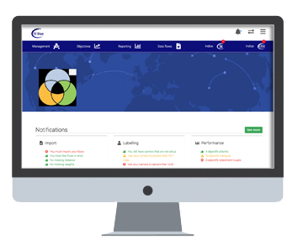

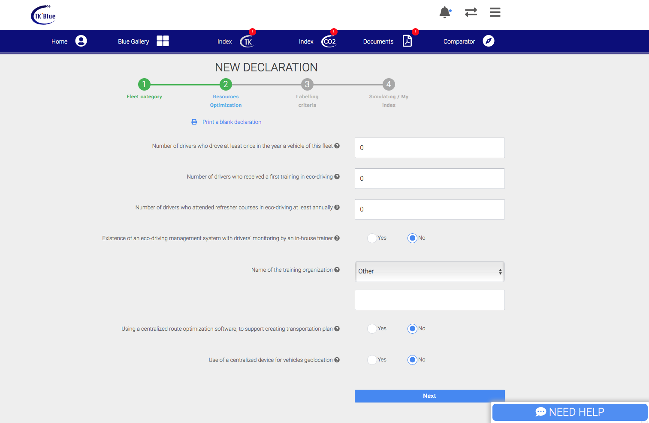

TK'Blue: The power, simplicity, accuracy and added value of the Cloud :
Input data --> Computation --> Benefits --> Data externalization
DATA
COMPUTATION
RESULTS
1
2
3
4PL, 3PL,
TMS, ERP
DOMO
DATA EXTERNALIZATION
Open SQL database
Automatic transmission of transport flows
WTW + TTW
GHG emissions
EN 16258 Compliant
GLEC Framework 2.0
GHG Protocol
CSR reporting
1
(file upload Excel/CSV or web-service)
INPUT DATA
4PL, 3PL,
TMS, ERP
DOMO
BENEFITS FOR SHIPPERS
(MULTI-USER ACCOUNT)
Weight
Distance or Origin Destination
Mode
Date
Carrier
…
SHIPPER DASHBOARD
2
Powerful B.I. Tools
Dashboard, graphics
Environmental and societal analysis
Customizable segmentation, KPI
Benchmarking
Monthly, quarterly and annual CO₂ reports
Action plans, Goals, Alert, cost control
Monitoring improvement
3
PRIMARY DATA
FROM CARRIERS
TK’BLUE CARRIER DECLARATION
2
CARRIER
1
CO₂/GHG Index
Societal index (TK’T)
Online advice
BENEFITS CARRIERS
TK'T Index: valorization of the economic and environmental performance of the carrier.
GHG Index: calculation of CO2/GHG emissions
CSR index: valorization of social, societal and ethical performance
Updates of social and tax authorizations
Performance improvements
Valorization in the Blue Gallery
Materials, equipment, drivers
Energy, consumption, loading rate, mileage
Otherwise,
Default value
Glec, En 16258 or specific values from modeling
Sending justifications documents
Verification of documents by TK'Blue
Data validation by TK'Blue
Transmission of indices
NON TK’BLUE CARRIER

Slide 10


TK’Blue, a real added value for each involved in the transport chain: a virtuous circle for all
CARRIER LABELLING
Help to improve the quality of services and reduce costs
SHIPPER RATING
Assisting in selecting the best transport solution and optimizing flows
FOR THREE COMMON BENEFITS
Improve
environmental and societal performance
Improve safety and punctuality
Improving economic performance
€

Slide 11
TK'Blue makes managing the environmental impact of your transport, a lever for your economic performance

