Slide 1
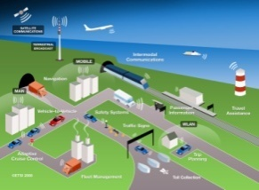
Mobility as integral part of city transition: New thinking and new practices
未来交通 --- 城市变革带来的新理念和新模式

Slide 2

Thales close to its customers
Europe
Austria
Belgium
Bosnia
Finland
France
Germany
Hungary
Italy
Latvia
Netherlands
Norway
Poland
Portugal
Romania
Russia
Spain
Sweden
Switzerland
United Kingdom
North America
Canada
United States
Asia Pacific
Australia
China
Hong Kong
Taiwan
India
Singapore
Korea
Japan
Malaysia
Latin America
Argentina
Brazil
Chile
Mexico
Venezuela
Dominican Republic
Middle East & Africa
Algeria
Saudi Arabia
South Africa
UAE
Notes:
2
多年来，泰雷兹集团在世界60余个国家的百余个顶级交通运营商和政府部门的长期合作中，不仅为当地交通建设贡献了世界领先的技术产品，也乐于与我们的客户和合作伙伴探讨变革，总结得失。我们很自豪，作为奠基人参与了如伽利略，欧洲列车控制系统，非接触式智能卡等一系列智能交通相关的产业革命。

Slide 3


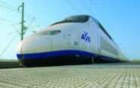


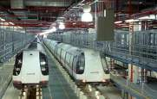
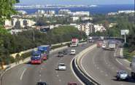
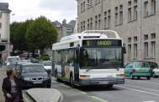
Thales in ground transportation
More than 100 transport customers worldwide
Over 6,000 people specialized in transportation activities
Providing mission-critical information systems to mainline rail, urban transport and road operators
Pioneer of “Open and standard platform” for multimodal mobility management
Notes:
3
正如刚才Yannick在其精彩演讲中所提到的一样，我们正处在一个充满变革和创新的年代，交通作为城市发展的中枢环节，更加面临着前所未有的挑战。我觉得我们的中华文明真的特别伟大，“衣食住行”四个字清楚地预见了无论时代如何发展，出行永远是社会发展的“主线”之一。同样，要是我们参考一下中医理论，“通则不痛，通则不痛”更是可以形象地比喻现在我们所面临的迷局。交通问题越来越成为城市发展的心病。。。
如何理解现实危机？

Slide 4












































Slide 5
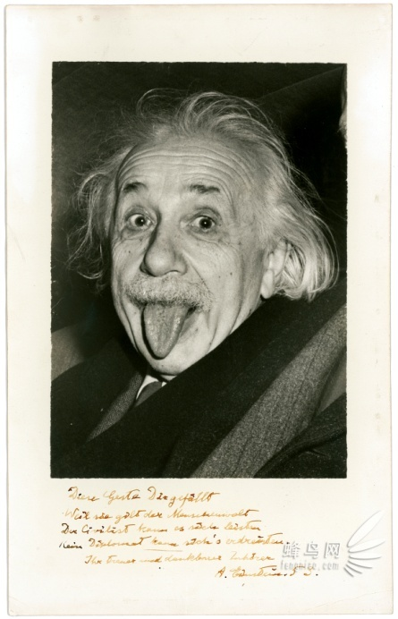
New thinking for our mobility problems?
“The significant problems we face cannot be solved at the same level of thinking we were at when we created them.”
Albert Einstein
“我们不能用造成问题的思维方式来解决问题。”
爱因斯坦
Notes:
还好，危机危机，危中见机，危机在一定程度上正预示这新的时代的到来。
。。
如何来医？爱因斯坦说过：“我们不能用产生问题时的思维水平来解决这一问题”。
The significant problems we face cannot be solved at the same level of thinking we were at when we created them.”(Albert Einstein)，面临当前的交通挑战，我们不妨“跳出圈子”，将交通问题放在城市和社会的社会人文和技术变革的大潮中去思考，相信可以更有效地找到更加深刻和更具创新理念的成功之道！
今天我的报告将尝试和大家一道畅想未来城市的若干新理念,new power and new practices！

Slide 6
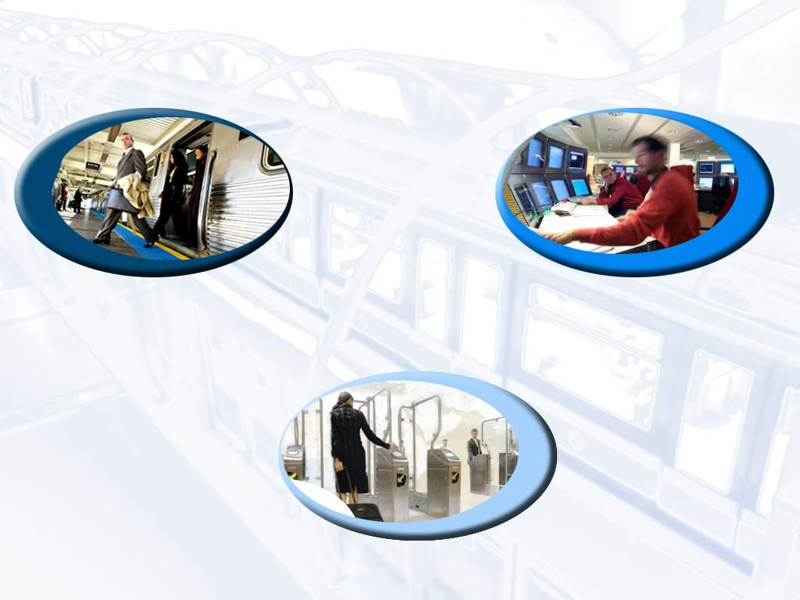


Performance of transportation systems
Open platform for City’s multimodal transportation
Safety & Capacity
Operational efficiency
安全与运能
运营效率
Travel Comfort and Services
服务与品质
Notes:
6
交通系统的SEC目标，不可调和的矛盾？
安全Safety、效率Efficiency、舒适Comfort

Slide 7
“Glitches” of traditional practices
System construction dilemma: “The more we get built, the more we need to build further” (…while with diminishing Contribution Margin Ratio)
一味以建设解决需求，系统网络边际效益递减
System design: Pushed by offer vs. Pulled by needs
模式单一，缺乏从城市定位和需求出发的设计
System efficiency: Hardware vs. Software?
硬件有余，软件不足
System utility: Regulation vs. Service?
重监管而弱服务：将公众和组织融入到交通管理的事务中
System boundary: Independence vs. interoperability?
坚守独立，轻视合作，难以形成规模效应和“范围”效应
System evolution: “plug-in” and…… “push-down”
“倒退”与“推倒”的往复：系统进化重传承而乏有序创新
… …
Notes:
我们不免要提到知道现在在大部分国内城市交通基建中设计粗糙，缺乏人性化考量的问题。我们这几年迎来了交通枢纽和高铁的第一波高峰。当然，多数设计是成功的，我们上海的虹桥枢纽也是一个成功的作品。也是一个国际化合作的样板。然而有一些城市的交通枢纽，标识不清，服务不周，不仅没有方便旅客，还让旅客往往在寻路上浪费了很多时间。

Slide 8
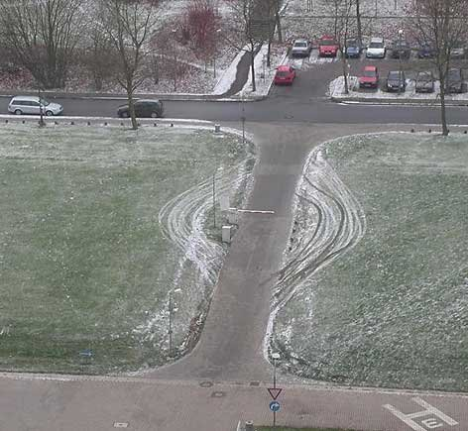
“Glitches”: sample case 1
We are all well trained to “do things right”, but it’d be more important to “do right things”…

Slide 9
“Glitches”: sample case 2
As they say, the devil is in the details…

Slide 10
“Cha-Cha-Cha” dance
Some inspiration from Mr. Kenichi Ohmae: “Cha-Cha-Cha”
大前沿一: 挑战现状（ Challenge）、把握机会（Chance）、实现变革（Change）
Change
Challenge
Chance

Slide 11
If social transition is kind of fashion show…
“Assuming transport services as pure public products, then the society we live in, as well as the organizations and public it hosts, consist the main customer segments; from this viewpoint, every social transition is no different to major fashion show …”
如果把交通看作纯粹的公共产品，那社会、组织和大众正是交通的主要客户群，社会发展的趋势正是交通产品更迭应该遵循的导向…
蒸气机时代
Age of steam
电气时代
Age of electrification
芯片时代 Age of IC chip
Notes:
可以说，我们所处的芯片时代和正在萌生的概念时代应该是我们考察眼下一切交通问题和城市的宏观思考主线！
一流作势，二流作市，三流做事，就像诸位朋友炒股票一样，咱们抓不住大升浪，搞再多波段也都是账面收益，早晚还回去。忙了半天，还自己安慰自己“我已出舱，感觉良好！”

Slide 12
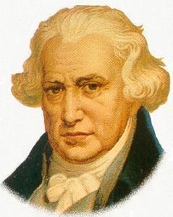
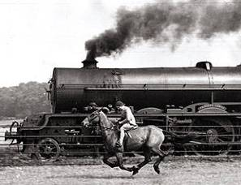
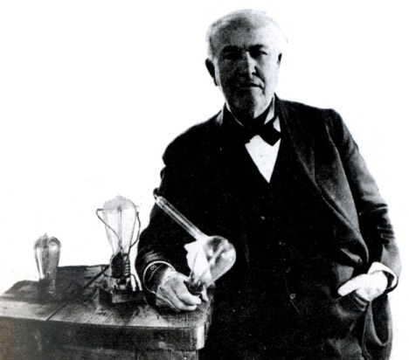
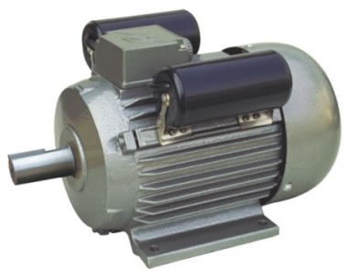
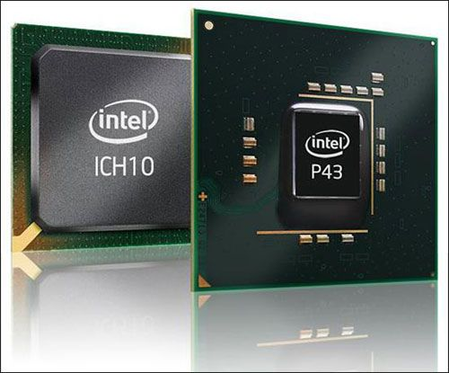

1780-1820年 是以瓦特为代表的蒸汽机时代
1880-1920年 是以爱迪生为代表的电气化时代
1980-2020年 我们进入了芯片时代

Slide 13
New thinking, new power and new practice
Dominance of “Pre-figurative culture”: new culture and new thinking “后喻”文化成为主导
Knowledge-driven society: new power of social evolution
知识成为社会发展的“主驱动力”
Value of diversification in “globability” (Globability): new pattern of existence and interaction
多元化的开放与交融（越发紧密和激烈的“竞合”）
New thinking
New power
New practice

Slide 14
New thinking
New power
New practice

Slide 15
1. Dominance of pre-figurative culture
Dominance of “Pre-figurative culture”: new culture and new thinking “后喻”文化成为主导
Imagination is power !
创新被社会和权利阶层所接受，并显示革命性作用。推倡后来居上！
Small is beautiful !
小的就是美的！
Everybody is one-click away !
固有等级制度的变革，世界是平的！
Hyperarchy:
大众声音得到放大，平等和民主的风尚得以推行。英雄不论出处！

Slide 16
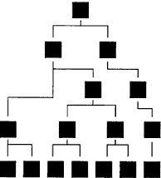
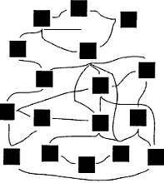
“Hyper-archy” in pre-figurative culture
“Hyperarchy” challenges all the traditional hierarchies, whether of logic or of power ...
Transport users will more and more be part of decision making process of the mobility system, especially for those service-oriented systems.
Hierarchy
Hyperarchy
Source: The Boston Consulting Group on Strategy

Slide 17
“Great Minds Think Alike…”
Futurist Alvin Toffler 未来学家 阿尔文.托夫勒 | Agriculture 农业浪潮 | Industry 工业浪潮 | IT 信息浪潮 | 《The third wave》 《第三次浪潮》
Socialist Danniel Bell 社会学家 丹尼尔.贝尔 | Pre-industrial 前工业社会 | Industrial 工业社会 | Post-industrial 后工业社会 | 《The Coming of Post-Industrial Society》 《后工业社会来临》
Info-economist N. Negroponte 信息经济学家 尼格洛.庞蒂 | Oral 口语文明 | Writing 文字文明 | Byte 计算机文明 | 《Being Digital》 《数字化生存》
Humanist Margaret Mead 人类学家 玛格丽特.米德 | Post-figurative 后喻文化 | Co-figurative 同喻文化 | Pre-figurative 前喻文化 | 《Culture and Commitment》 《文化与承诺》

Slide 18
2. knowledge driven society
Knowledge-driven society: new power of social evolution
知识成为社会发展的“主驱动力”
“Soft power” 硬实力---软实力
Service concept 生产---服务
Individualism and customization 主流---个性

Slide 19
In knowledge driven society…
Value Creation is increasingly tied to intangibles
未来是“无形资产主导价值创造”的时代。
“To certain extent, every company will be IT company.”
Assets
Intangible
Tangible
Industrial Era
Information Era

Slide 20
3. What does “Globability” mean for transport…
Value of diversification in “globability” (Globability):
New pattern of existence and interaction
多元化的开放与交融（越发紧密和激烈的区域间竞合）
Multimodality 多模式
Interoperability 互联互通
Adaptability 适应性
Openness 开放性
Standards 标准化
“Co-competition” (value chain, value network…)
竞合（价值链和价值网络）
Notes:
Web 2.0
Value network

Slide 21
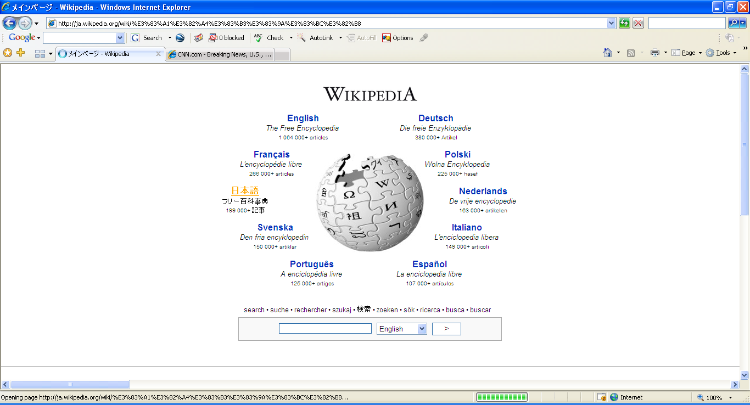

Slide 22



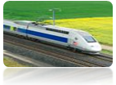







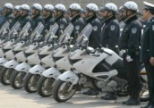

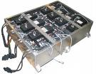



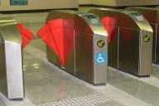


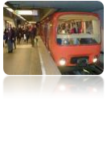





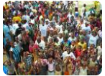


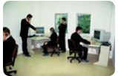
Maestro : enabling collaboration in city operation
Integrated Web MMI
Ajax
System Configuration & Deployment Tool
SOA Connector
3rd Party Applications
(Data Warehouse,
Maintenance Mgt
System, ERP, …)
Secured SOA Framework
SOA connector
Oil & Gaz Process
Eqt Interface
SOA connector
SCADA
Eqt Interface
SOA connector
ATS
Eqt Interface
SOA connector
Rail Traffic Mgt
Eqt Interface
SOA connector
Ticketing
Eqt Interface
SOA connector
Public Info
Eqt Interface
SOA connector
Access Control
Eqt Interface
SOA connector
Video Mgt
Eqt Interface
SOA connector
Voice & Data
Eqt Interface
SOA connector
Incidents & Resources Mgt
Eqt Interface
VENTILATION SYSTEMS
ESCALATOR
Passengers
Information
Displays
EMERGENCY
CALL BOX
TRAINS
VALIDATORS
PVU
ACCESS CONTROL
SYSTEM
PTZ CCTV
Police
TRAMS
PUMPS, VALVES,
...
TRACTION
POWER
SYSTEM
ENVIRONMENT
CONTROL
SYSTEM
TICKET
BARRIERS
PUBLIC
ADDRESS
CCTV Systems
RADIO
TICKET
MACHINES
INTRUSION ALARM
SYSTEM
METRO
Fixed CCTV
Fire brigades
FIRE ALARM
SYSTEM
LIFTS
Real World or Synthetic World
TELEPHONE
Role
Players
People
Threats
Instructors /
Animators
Notes:
22

Slide 23
Smarter mobility enabled by MAESTRO platform

Slide 24
Back to the real world of mobility…
Why are these “cha-cha-cha” important to us?
结束空谈，回到现实问题，为何我们需要考虑这一变革？？!

Slide 25
Rethinking the traditional practices…
System construction dilemma: “The more we get built, the more we need to build further” (…while with diminishing Contribution Margin Ratio)
一味以建设解决需求，系统网络边际效益递减
System design: Pushed by offer vs. Pulled by needs
模式单一，缺乏从城市定位和需求出发的设计
System efficiency: Hardware vs. Software?
硬件有余，软件不足
System utility: Regulation vs. Service?
重监管而弱服务：将公众和组织融入到交通管理的事务中
System boundary: Independence vs. interoperability?
坚守独立，轻视合作，难以形成规模效应和“范围”效应
System evolution: “plug-in” and…… “push-down”
“倒退”与“推倒”的往复：系统进化重传承而乏有序创新
… …
Notes:
重新用新的理念，新的武器，新的做法还审视现有问题的话，我们又有一番感受。
前喻文化，知识驱动，开放交融为主题的未来社会…

Slide 26
Concrete way to transform the competitivity
Service
服务
Knowledge
知识
Physical
物质

Slide 27

Microsoft & “Service Economy”
On November 9, 2005 an internal memo from Bill Gates revealed Microsoft’s strategy to adapt to the emerging service economy.
The document admits that Microsoft has fallen behind many competitors, whose early adaptation to the service economy threatens more traditional product-oriented companies.
  “This coming ’services wave’ will be very disruptive… we have competitors who will seize on these approaches and challenge us.”
Notes:
This shift within Microsoft demonstrates that even the largest “traditional” product-based company is immune to the service economy evolution, even if they are high-tech.

Slide 28
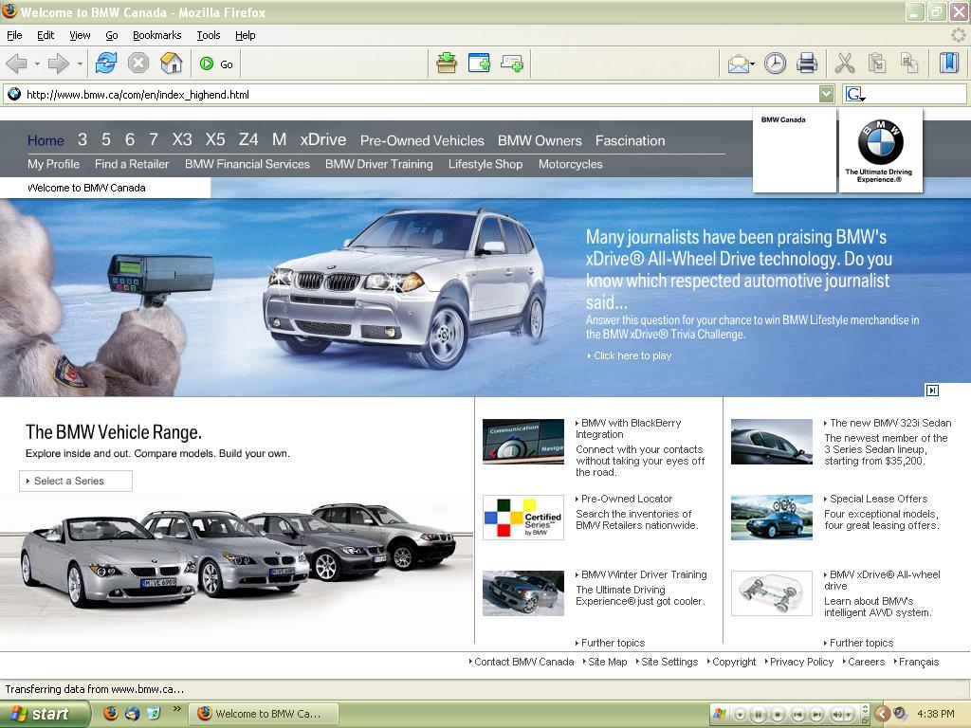
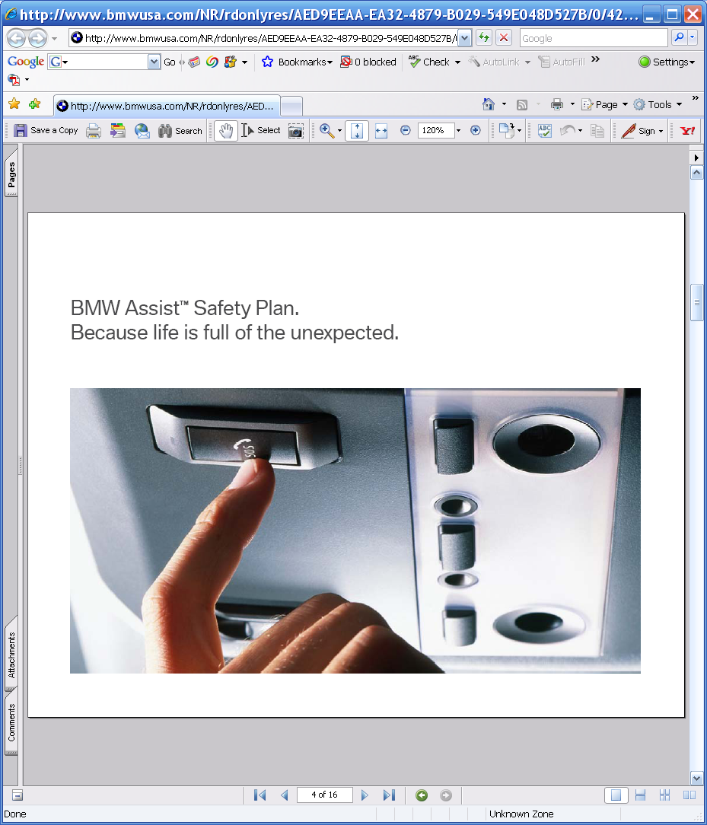
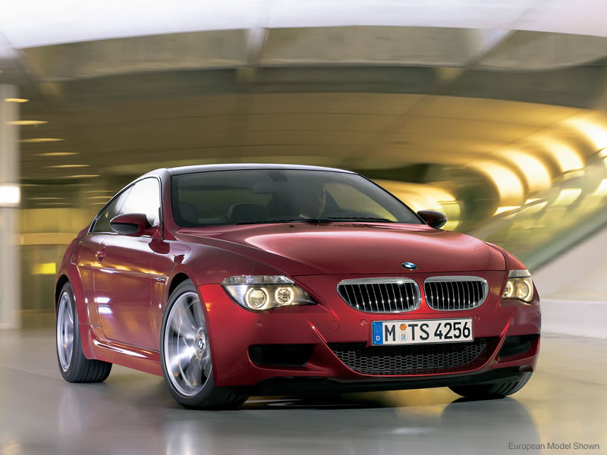
Traditional Transport in a Service Economy
Information
Service
.
.
.
Users
Physical
http://www.fast-autos.net

Slide 29
Contrast with a Production Economy
The traditional mobility system was primarily focused on producing the best/largest transport capacity (in a safe way), and generating revenues on larger capacity.
Technology is giving the advantage to those innovative organizations which wield expertise and technology into “hard systems” to bring about “individualized” and “everywhere” services effectively to gain supreme service quality and additional value for users…
(the 3rd mode as defined by Mr. Mayet)
Notes:
Essentially, we’ve seen a shift from one-time large purchases at the center of the economy, to smaller, continuous revenue streams derived from services as the key.

Slide 30
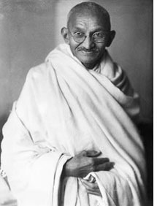
“Be the change you want to see in the world.”
Mohandas Gandhi
“欲变世界，先变其身。”
圣雄甘地

Slide 31


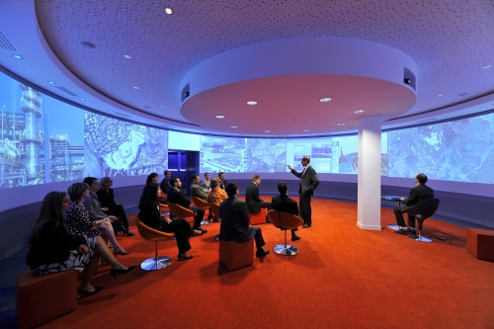
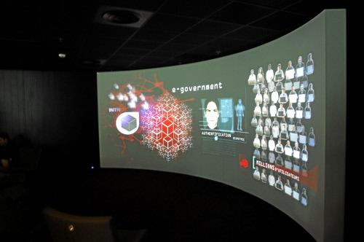
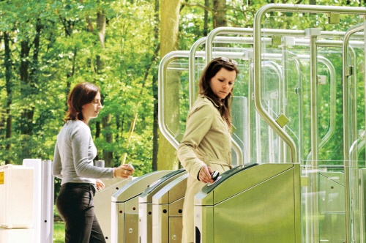
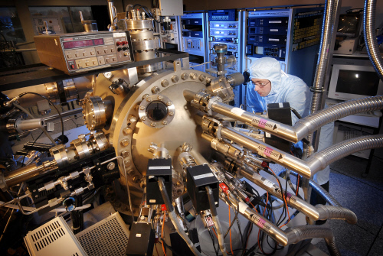
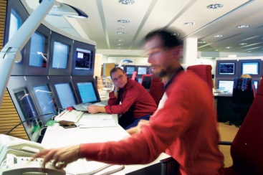
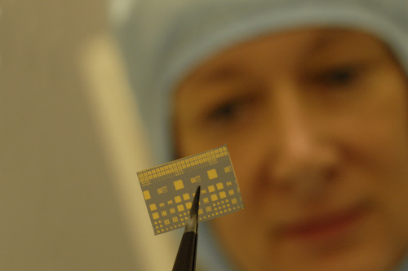
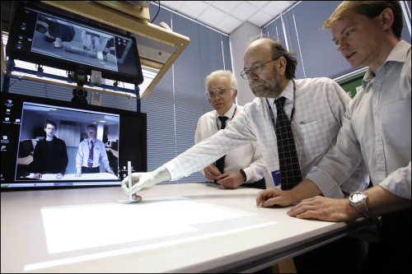
Thales of innovation
Notes:
R&d partnerships with chinese leading…
First chinese 863 program award to foreign company for the technical excellence
Open collaboration and innovation

Slide 32


Mission-critical information systems
delivering safety and security
for ground transportation

Slide 33
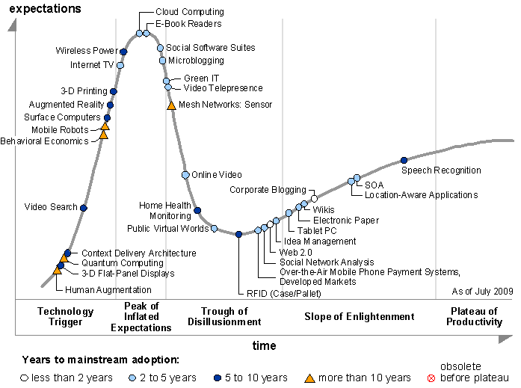
Smarter mobility enabled by open platform
Notes:
云计算是计算机领域的第三次大的技术变革。第一次变革是上世纪80-90年代个人计算机的普及，这次变革将计算机的应用从研究和专业领域带入到广大的企业 和个人应用领域，大大帮助企业和个人大幅度提高了生产效率，产生了一批伟大的公司，比如：微软，Oracal，SAP，惠普，戴尔，联想等等。第二次变革 是最近10年互联网的普及，这次变革将数以亿万计的信息孤岛汇集成国际互联网，大幅度扩展了人类知识共享和交流沟通。产生了一批伟大的互联网公司，比 如：Google，Amazon，百度，阿里巴巴等等。云计算在前两次变革的基础上，将更进一步解放社会生产力，通过大规模的集群服务，全世界的计算机用 户将更好地共享计算机的计算资源、存储资源等等，甚至改变信息化的运营模式并减少能源消耗。从当前的形式来看，引导这次变革的主要是 Google,ZOHO,Salesforce等等公司。

Slide 34
Smart city: Main functional Architecture
The smart city is the Information & communication Infrastructure
e-Tourism web 2.0 approach
User Generated Contents
Context Awareness Info Push
Energy Management
E-learning
Knowledge Management
Role gaming
E-learning
Tourism
Ambient
Energy
Smart
City
Homeland
Security
Video surveillance
Sensor networks integration
Video semantic capabilities
Traffic information
Fleet management
Access Control
Road Charging
Emergency Call
Mobile Payments
Parking Management
Pay As You Drive
City Logistics
Vehicle Tracking
Work Force Managem.
Intelligent
Transportation
Systems
Electronic Patient Record
Therapy management
Biomedical parameters monitoring
Second Opinion Management
Pharmaceutical risk mgmt
e-Health
WSN
Management
platform
ICT platform for Wireless Sensor Networks management and control

Slide 35
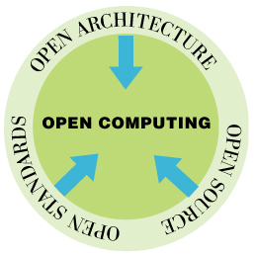
THALES ICT policy : Towards Open System
Open Systems
  Ensure flexibility & Interoperability
  Avoid vendor lock-in / Drive cost effectiveness
  Ensure future access to information
  Maximize freedom of action
Open standards
  Promoting interoperability by using open
  published specifications for API's,
  protocols and data and file formats
  Open architecture
Building loosely coupled, flexible reconfigurable solutions
Open Source Software
  Promotes standards
  Leverages community development and collaborative innovation
OPEN SYSTEMS
Notes:
10 Open Computing: Staying…..Open for Business
Open standards, open architectures and open source software can all move a company’s systems to greater degrees of flexibility, resilience maximizing freedom of action. Adopting open technologies is not the only way to address business needs, and in some limited cases, may not always be the most expedient. However, there is little doubt that software technology will continue to move from closed, proprietary base infrastructure to open, standardized platforms, allowing software innovation to take place higher up the software stack.

Slide 36



Implement open systems principles
Process
Application SW
Tools
Process
Application SW
Workbench
C
C
C
TUP
Domain Middleware
Middleware
Platform
Platform
Platform
No Middleware
No separation between
Applicative and
technical software
Middleware
Provide technical services
to enforce
technical software reuse
Framework
Tooled-Up Process & Domain Middleware enforcing
Reusable Domain component
Domain Middleware
1997
Third Party
components
C
C
C
TUP
2007-2010
Domain Middleware
Open Middleware
Platform
Open Architecture – Platform

Slide 37


    Integrated Training Module to provide Realitic Training & Simulation for operators and Commands Team
        Threat models
        People behaviour model
        Students assessment, accreditation and records
        Record & Replay function
        Assess procedures
        Guided Learning (making sure procedures are followed)
    Operational analysis based on Simulation
        impact on platform occupancy if one escalator is added, or if train timetable is modified
    System SOA & communications protected at all levels («Secured by Thales»)
    Singular MAESTRO architecture provides
        Reduced future Developments costs
        Reduced upgrade costs
        Open system solution
    Open Architecture enables integration with External Data Bases and Systems

